Slide 1



Non-conformal obstructions to bubble expansion
Pedro Tarancón-Álvarez
institute of cosmos sciences (ICCUB), Universitat de Barcelona
VAST 2026 (Madrid)
21/10/2026
In collaboration with: David Mateos and Mikel Sanchez-Garitaonandia
Arxiv: 2607.27874

Slide 2
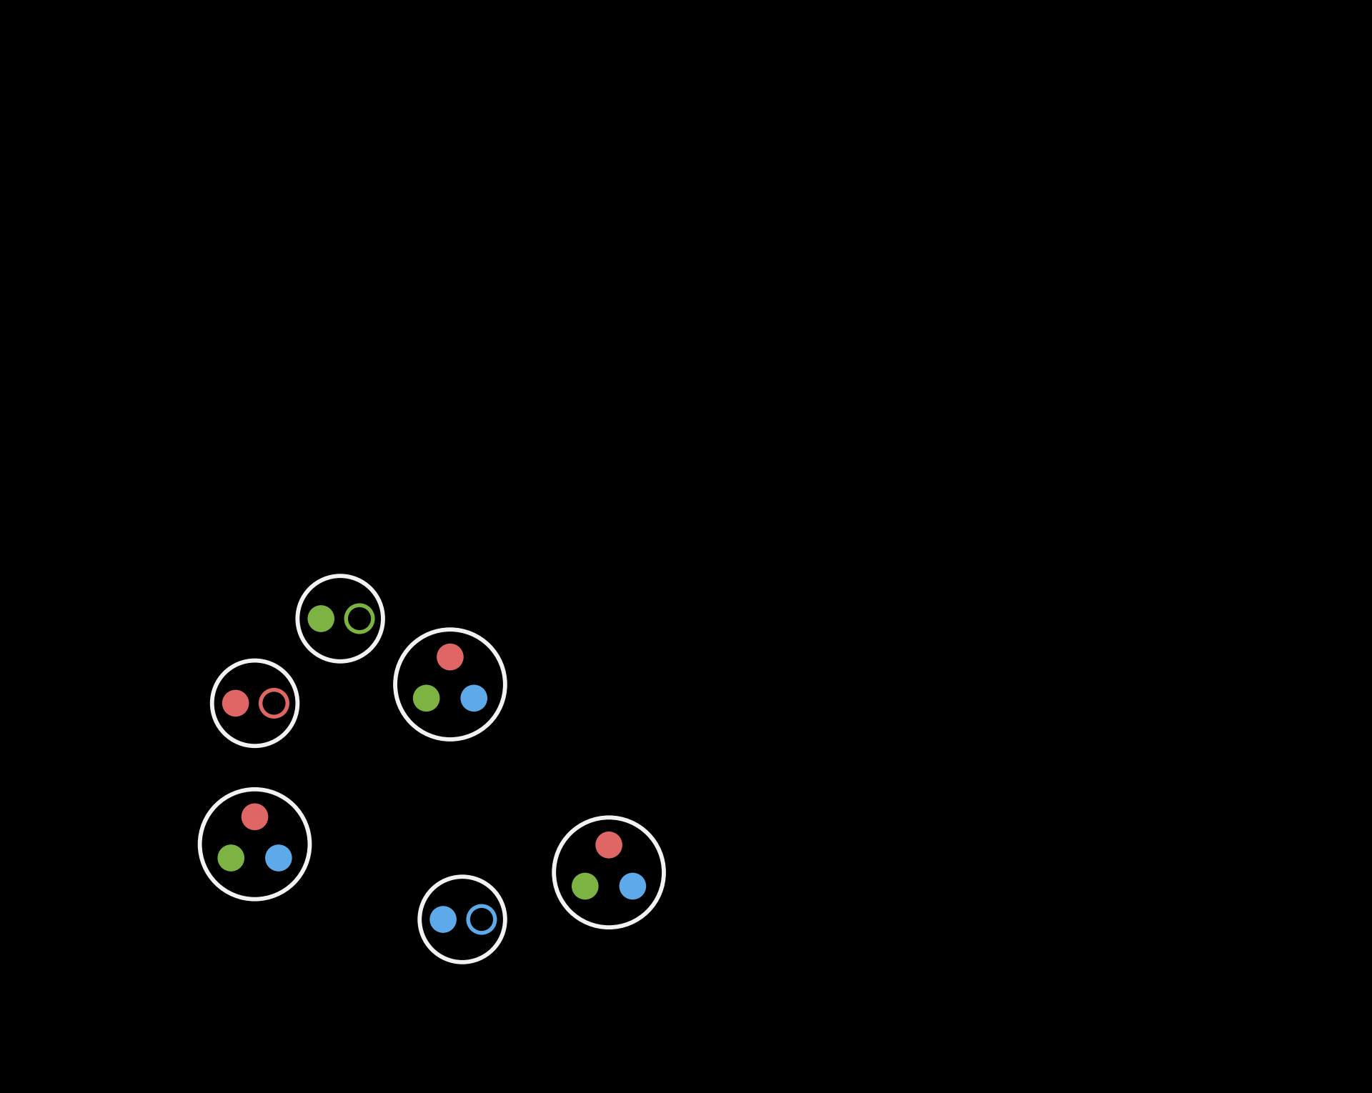
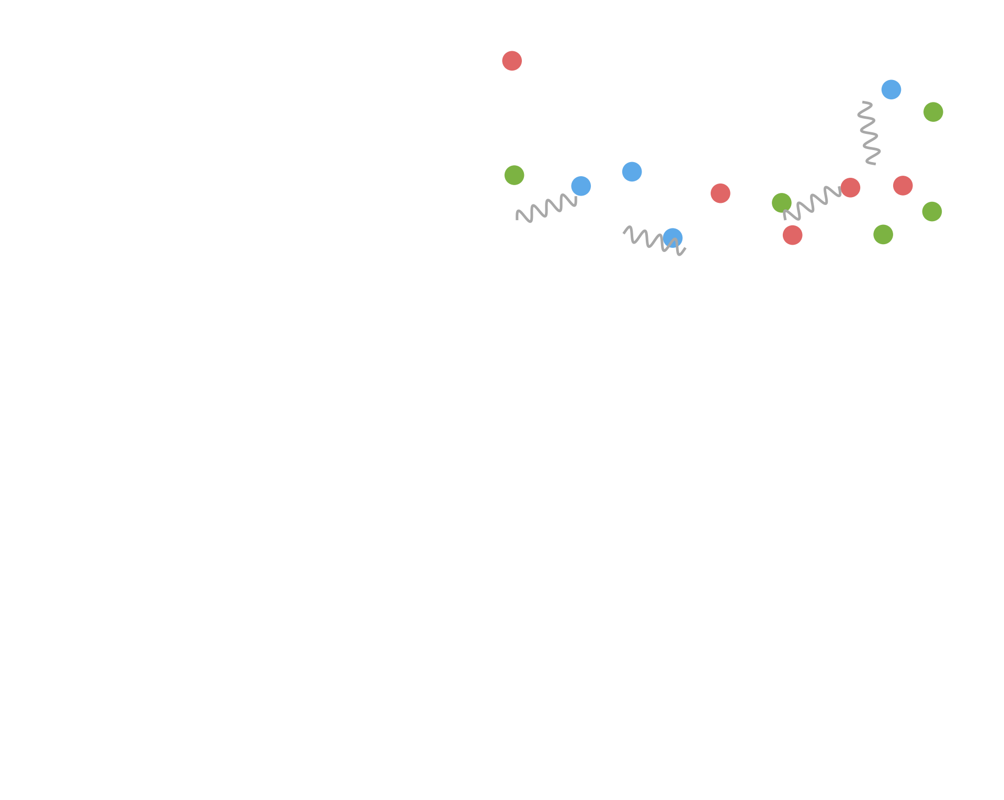
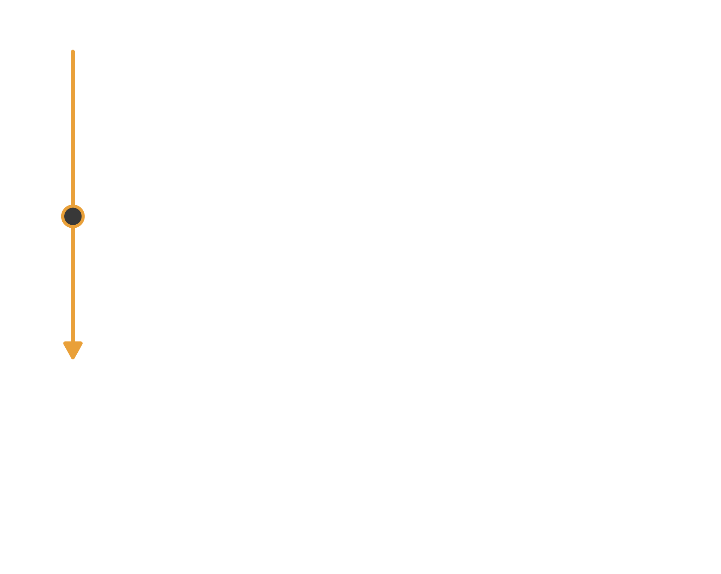
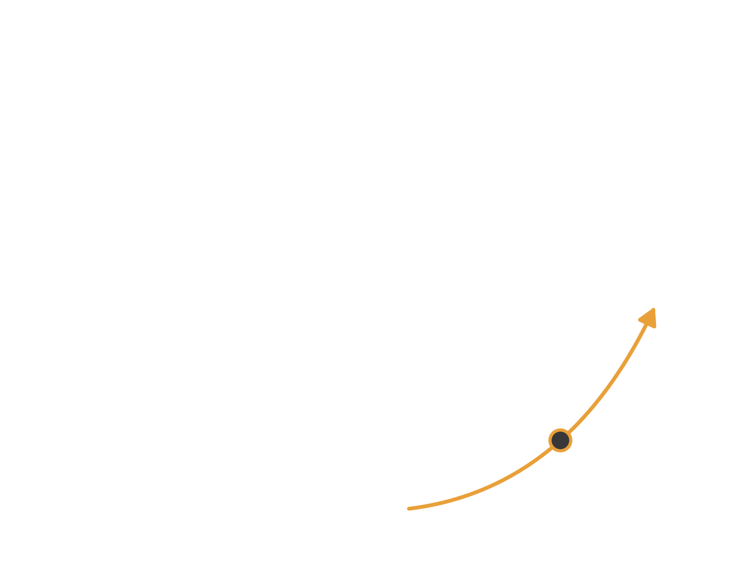

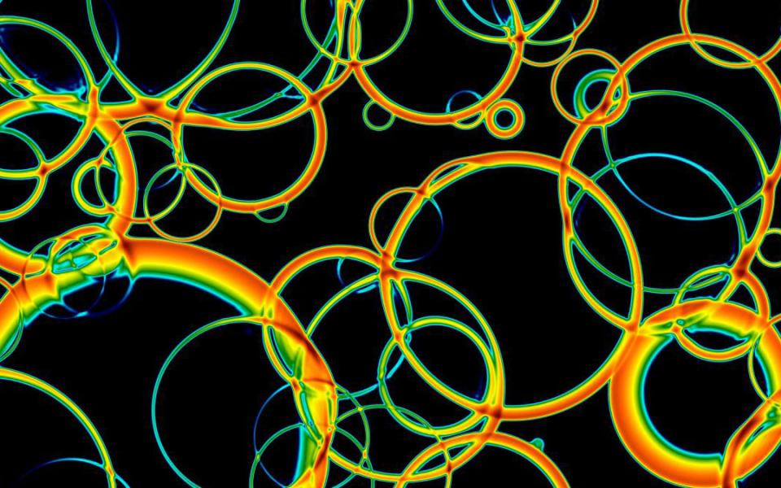
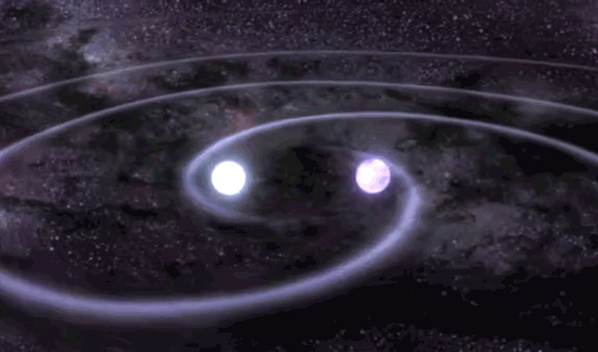




[Aoki et al., Nature 443 (2006) 675]
[Bazavov et al., PLB 795 (2019) 15]
[Borsányi et al., PRD 112 (2025) L111505]
First order phase transitions
T
deconfined
quark–gluon plasma
crossover
critical point?
[D. Weir, University of Helsinki]
confined
hadrons
first order?
[NASA’s Goddard Space Flight Center]
Neutron-star mergers
Early Universe
QCD is a crossover at μ ≈ 0: no first-order transition in the Standard Model
[Kajantie et al., PRL 77 (1996) 2887]
A first-order transition would be a signature of BSM physics, observable through its gravitational-wave background
[Caprini et al., JCAP 03 (2020) 024; Athron et al., Prog. Part. Nucl. Phys. 135 (2024) 104094]
Probe QCD at high density
Constrain the QCD EoS at finite μ
[Most et al., PRL 122 (2019) 061101; Bauswein et al., PRL 122 (2019) 061102; Blas et al., PRL 136 (2026) 101401; Bea et al., PRD 112 (2025) 114041, JHEP 04 (2026) 013]
Core-collapse supernovae
[Sagert et al., PRL 102 (2009) 081101; Fischer et al., Nat. Astron. 2 (2018) 980; Bleau et al., arXiv:2603.18153]
μ

Slide 3

[Athron et al., Prog. Part. Nucl. Phys. 135 (2024) 104094]
[Caprini et al., JCAP 03 (2020) 024]
[Ai et al., JCAP 07 (2023) 002]
[Giese et al., JCAP 07 (2020) 057]
[Hindmarsh et al., SciPost Phys. Lect. Notes 24 (2021) 1]
[Espinosa et al., JCAP 06 (2010) 028]
First order phase transitions
Hubble patch
■ high-energy phase
■ low-energy phase

Slide 4
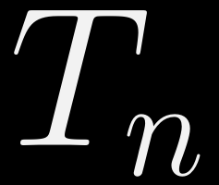

[Athron et al., Prog. Part. Nucl. Phys. 135 (2024) 104094]
[Caprini et al., JCAP 03 (2020) 024]
[Ai et al., JCAP 07 (2023) 002]
[Giese et al., JCAP 07 (2020) 057]
[Hindmarsh et al., SciPost Phys. Lect. Notes 24 (2021) 1]
[Espinosa et al., JCAP 06 (2010) 028]
First order phase transitions
Nucleation
Equation of state
Microscopic
temperature
transition rate
■ high-energy phase
■ low-energy phase

Slide 5



[Athron et al., Prog. Part. Nucl. Phys. 135 (2024) 104094]
[Caprini et al., JCAP 03 (2020) 024]
[Ai et al., JCAP 07 (2023) 002]
[Giese et al., JCAP 07 (2020) 057]
[Hindmarsh et al., SciPost Phys. Lect. Notes 24 (2021) 1]
[Espinosa et al., JCAP 06 (2010) 028]
First order phase transitions
Expansion
Equation of state
Microscopic
temperature
transition rate
strength
wall speed
speed of sound
■ high-energy phase
■ low-energy phase

Slide 6
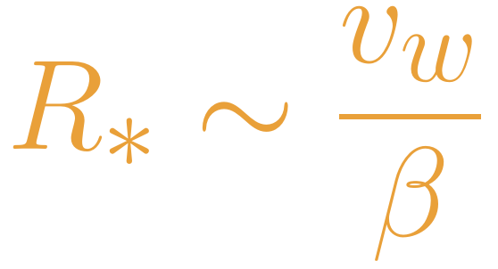
[Athron et al., Prog. Part. Nucl. Phys. 135 (2024) 104094]
[Caprini et al., JCAP 03 (2020) 024]
[Ai et al., JCAP 07 (2023) 002]
[Giese et al., JCAP 07 (2020) 057]
[Hindmarsh et al., SciPost Phys. Lect. Notes 24 (2021) 1]
[Espinosa et al., JCAP 06 (2010) 028]
First order phase transitions
Collision
Equation of state
Microscopic
temperature
transition rate
strength
wall speed
speed of sound
■ high-energy phase
■ low-energy phase

Slide 7

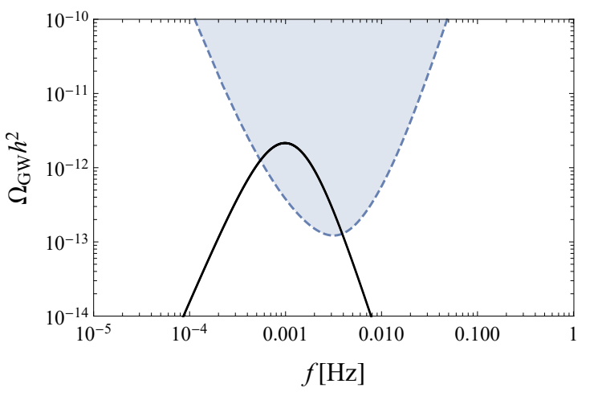
[Athron et al., Prog. Part. Nucl. Phys. 135 (2024) 104094]
[Caprini et al., JCAP 03 (2020) 024]
[Ai et al., JCAP 07 (2023) 002]
[Giese et al., JCAP 07 (2020) 057]
[Hindmarsh et al., SciPost Phys. Lect. Notes 24 (2021) 1]
[Espinosa et al., JCAP 06 (2010) 028]
First order phase transitions
GW emission
Equation of state
Microscopic
Bubble collisions
temperature
transition rate
kinetic energy
strength
wall speed
speed of sound
■ high-energy phase
■ low-energy phase
[Auclair et al., Living Rev. Rel. 26 (2023) 5]

Slide 8
[Athron et al., Prog. Part. Nucl. Phys. 135 (2024) 104094]
[Caprini et al., JCAP 03 (2020) 024]
[Ai et al., JCAP 07 (2023) 002]
[Giese et al., JCAP 07 (2020) 057]
[Hindmarsh et al., SciPost Phys. Lect. Notes 24 (2021) 1]
[Espinosa et al., JCAP 06 (2010) 028]
First order phase transitions
GW emission
Equation of state
Microscopic
Bubble collisions
temperature
transition rate
kinetic energy
strength
wall speed
speed of sound
■ high-energy phase
■ low-energy phase
[Auclair et al., Living Rev. Rel. 26 (2023) 5]

Slide 9
Outlook
Hydrodynamics of expanding bubbles
bubbles in a conformal EoS
Non-conformal obstructions
at the wall and along the flow
1
3
2
Non-conformal equations of state
from bag model to QCD-like
4
Conclusions

Slide 10
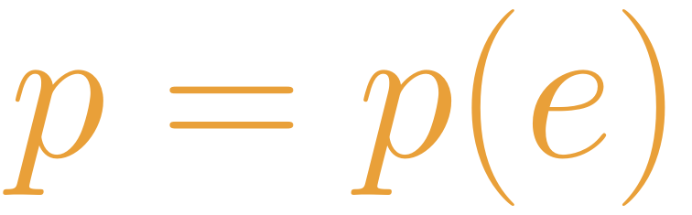


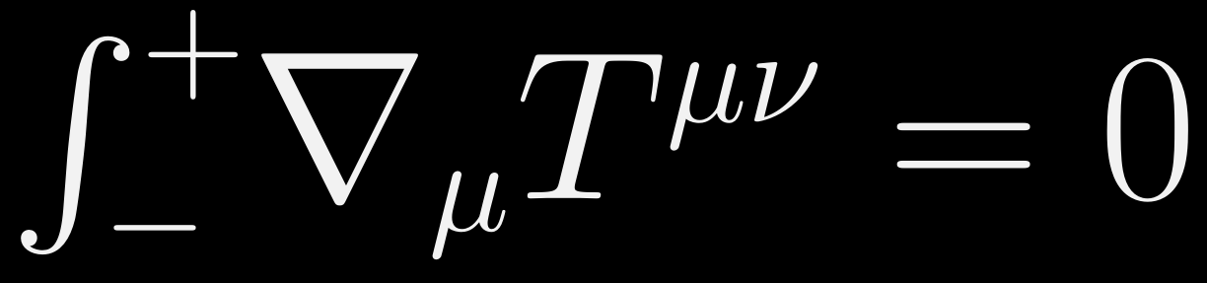
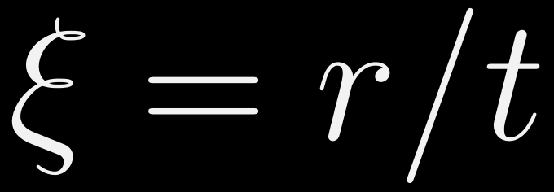




Expansion of a single bubble
Determines the allowed expansion modes: already constrains the wall velocity and kin. energy fraction.
We assume
  Fast transition: flat, static spacetime
  Macroscopic, $R≫T^{−1}$: ideal fluid + discontinuities
  No characteristic scale: self-similar
Each hydro solution is characterized by $e_{N}$ and $ξ_{w}$
Microscopically, they are not independent
Key input: the EoS, which encodes the microphysics

Slide 11
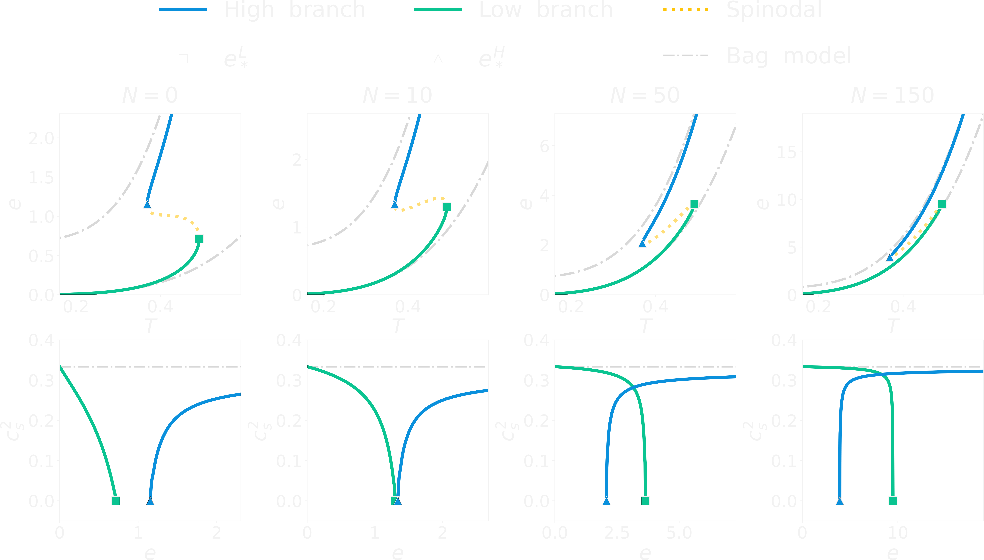


The bag-model
Simple model of FOPT with radiation-type eos
The speed of sound is constant
FOPT coupled to a N>>1 (effectively) massless particle at the critical temperature
[Mateos, Sanchez-Garitaonandia, PTA, arXiv:2607.27874 (2026)]

Slide 12



Expansion modes in the bag model
[Espinosa et al., JCAP 06 (2010) 028]
Deflagration
Hybrid
Detonation

Slide 13
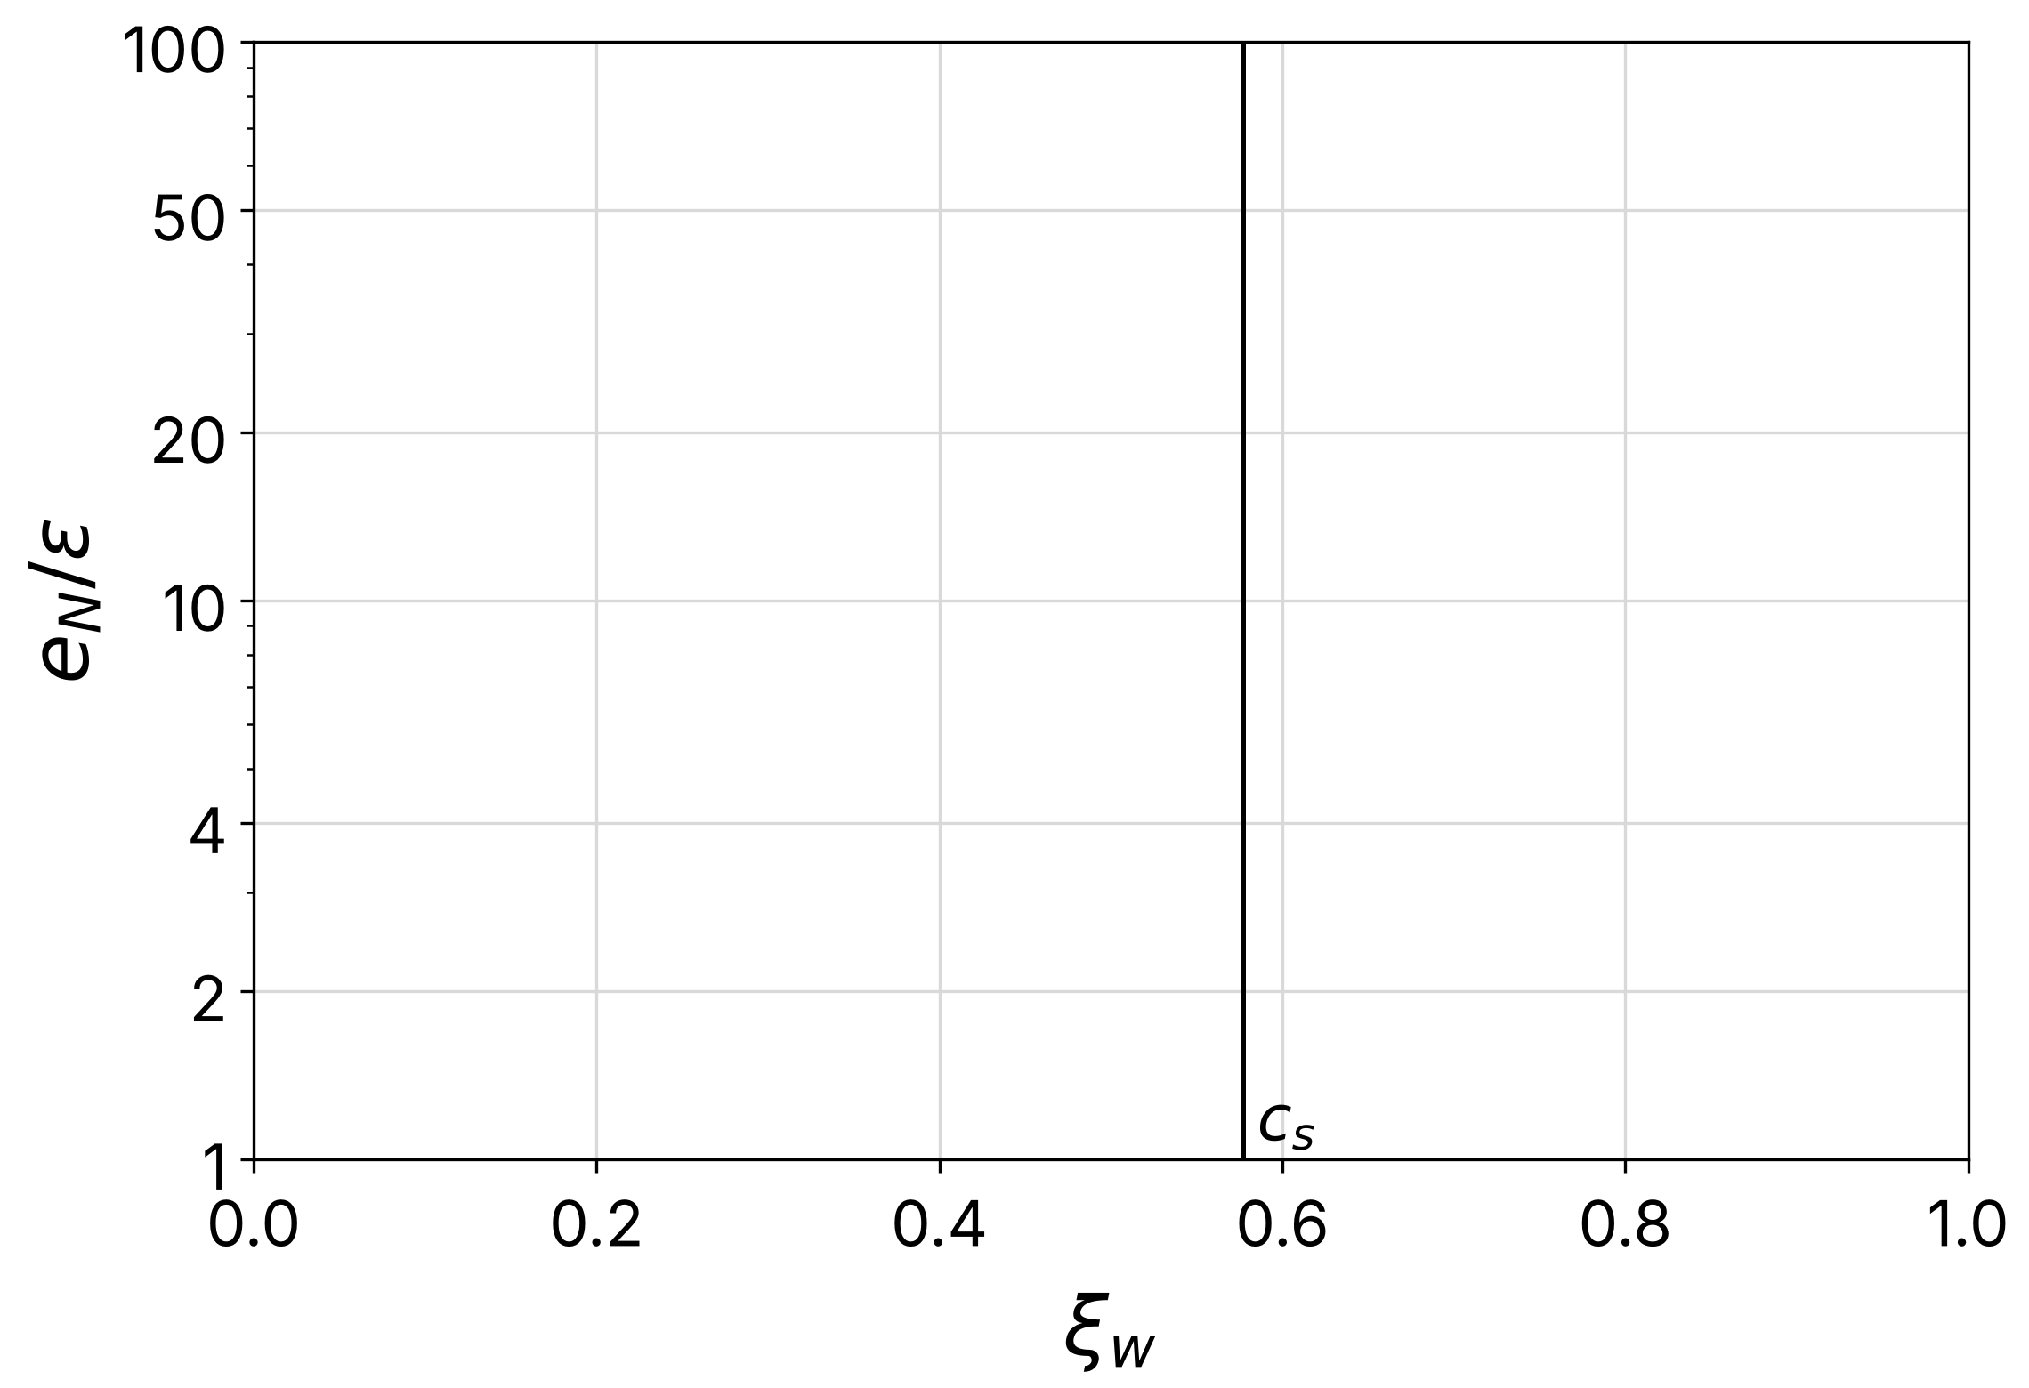
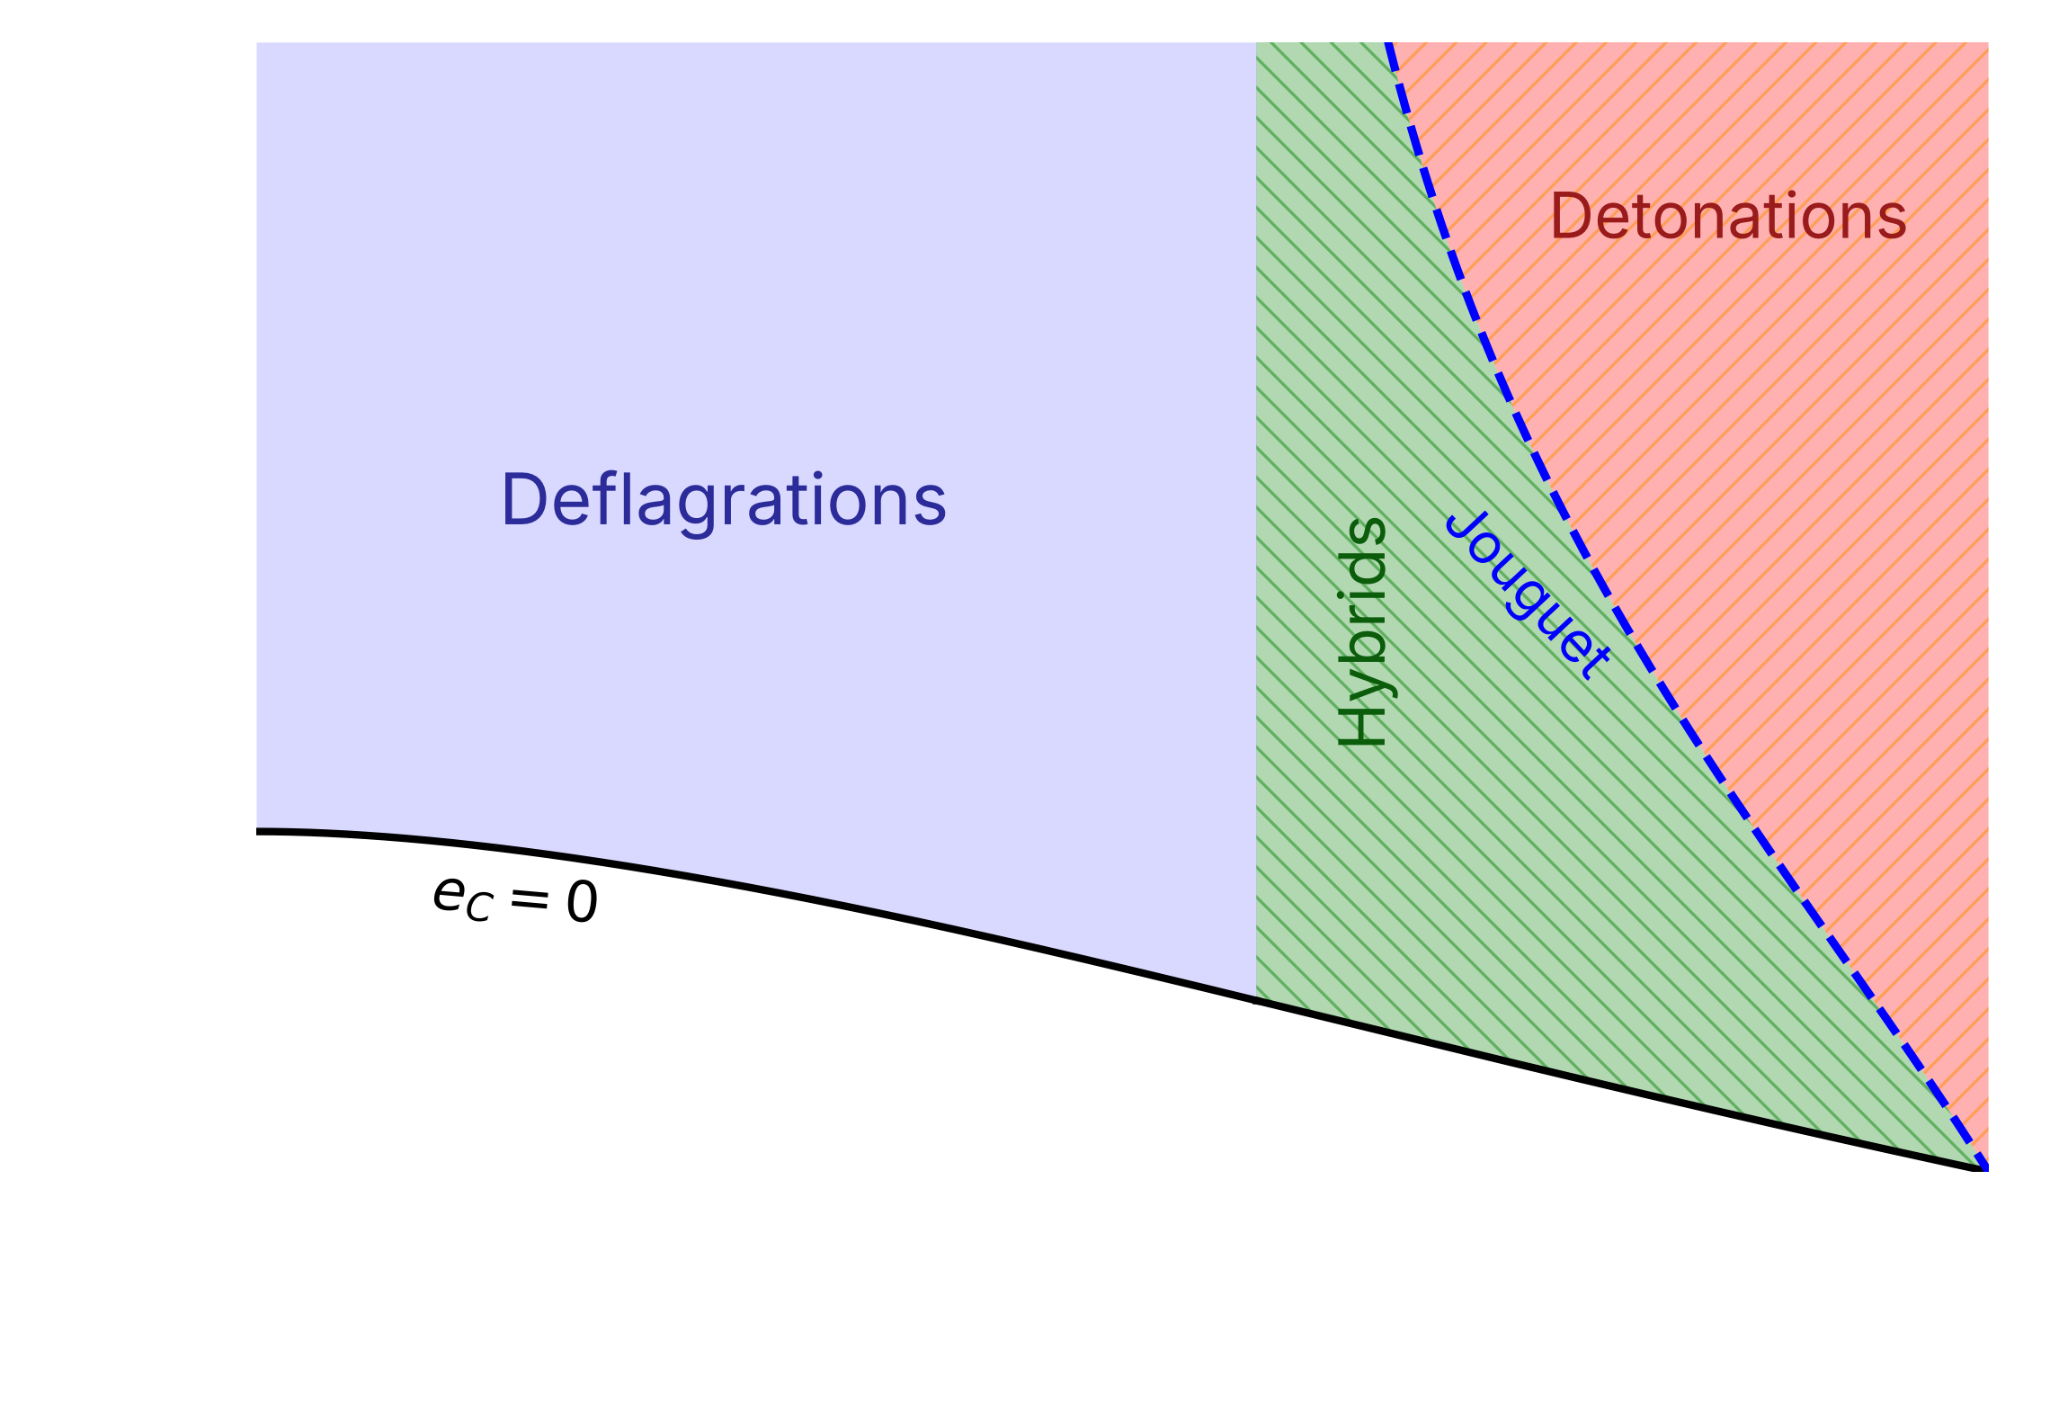
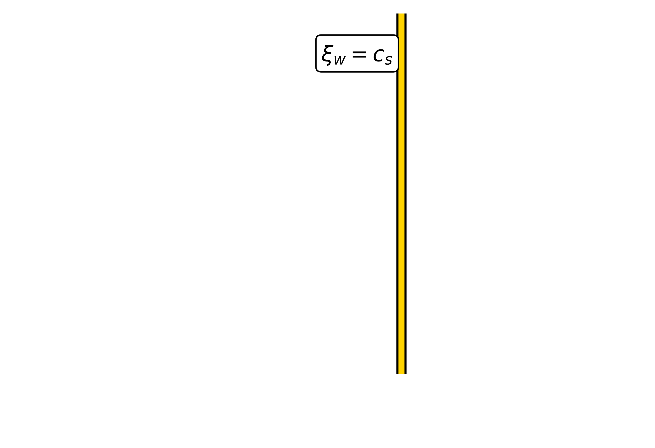
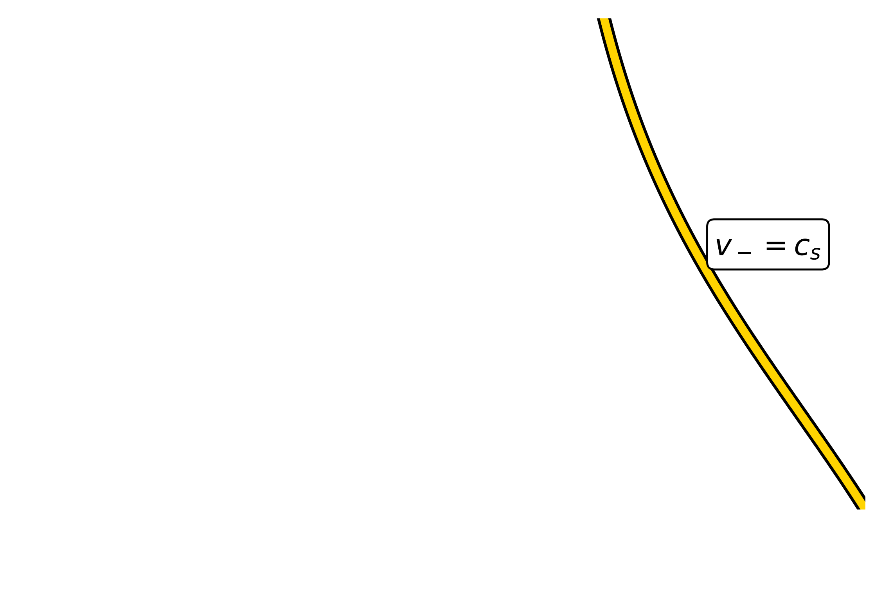
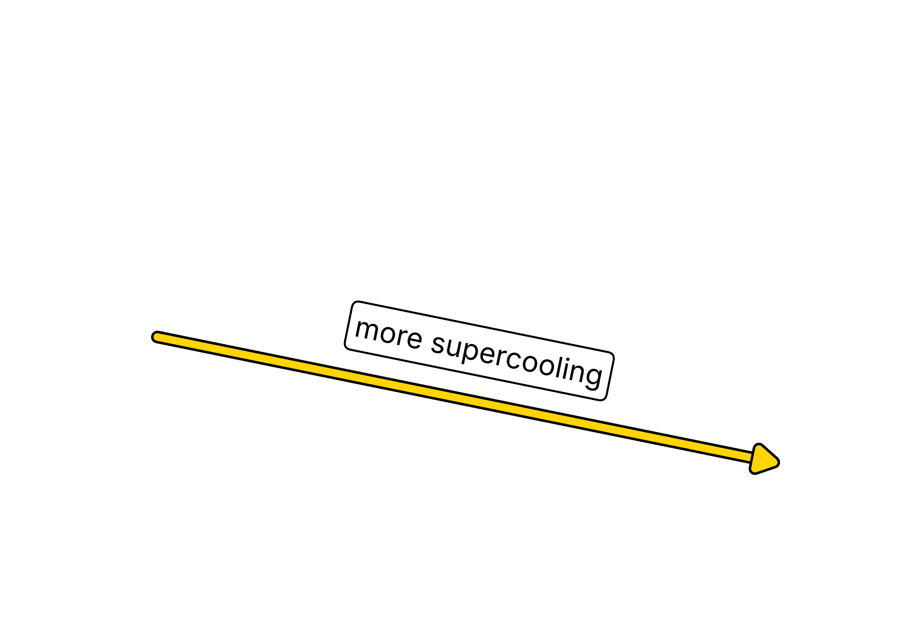
Space of allowed solutions
[Espinosa et al., JCAP 06 (2010) 028; Mateos, Sanchez-Garitaonandia, PTA, arXiv:2607.27874]
Solutions are continuously connected: there are solutions for every $ξ_{w}$
Deflagrations and hybrids are separated by $ξ_{w}=c_{s}$
Hybrids and detonations are separated by the Jouguet condition $v_{−}=c_{s}$
As the supercooling increases (lower $e_{N}$), the wall velocity increases
How does this change for a non-conformal EoS?

Slide 14
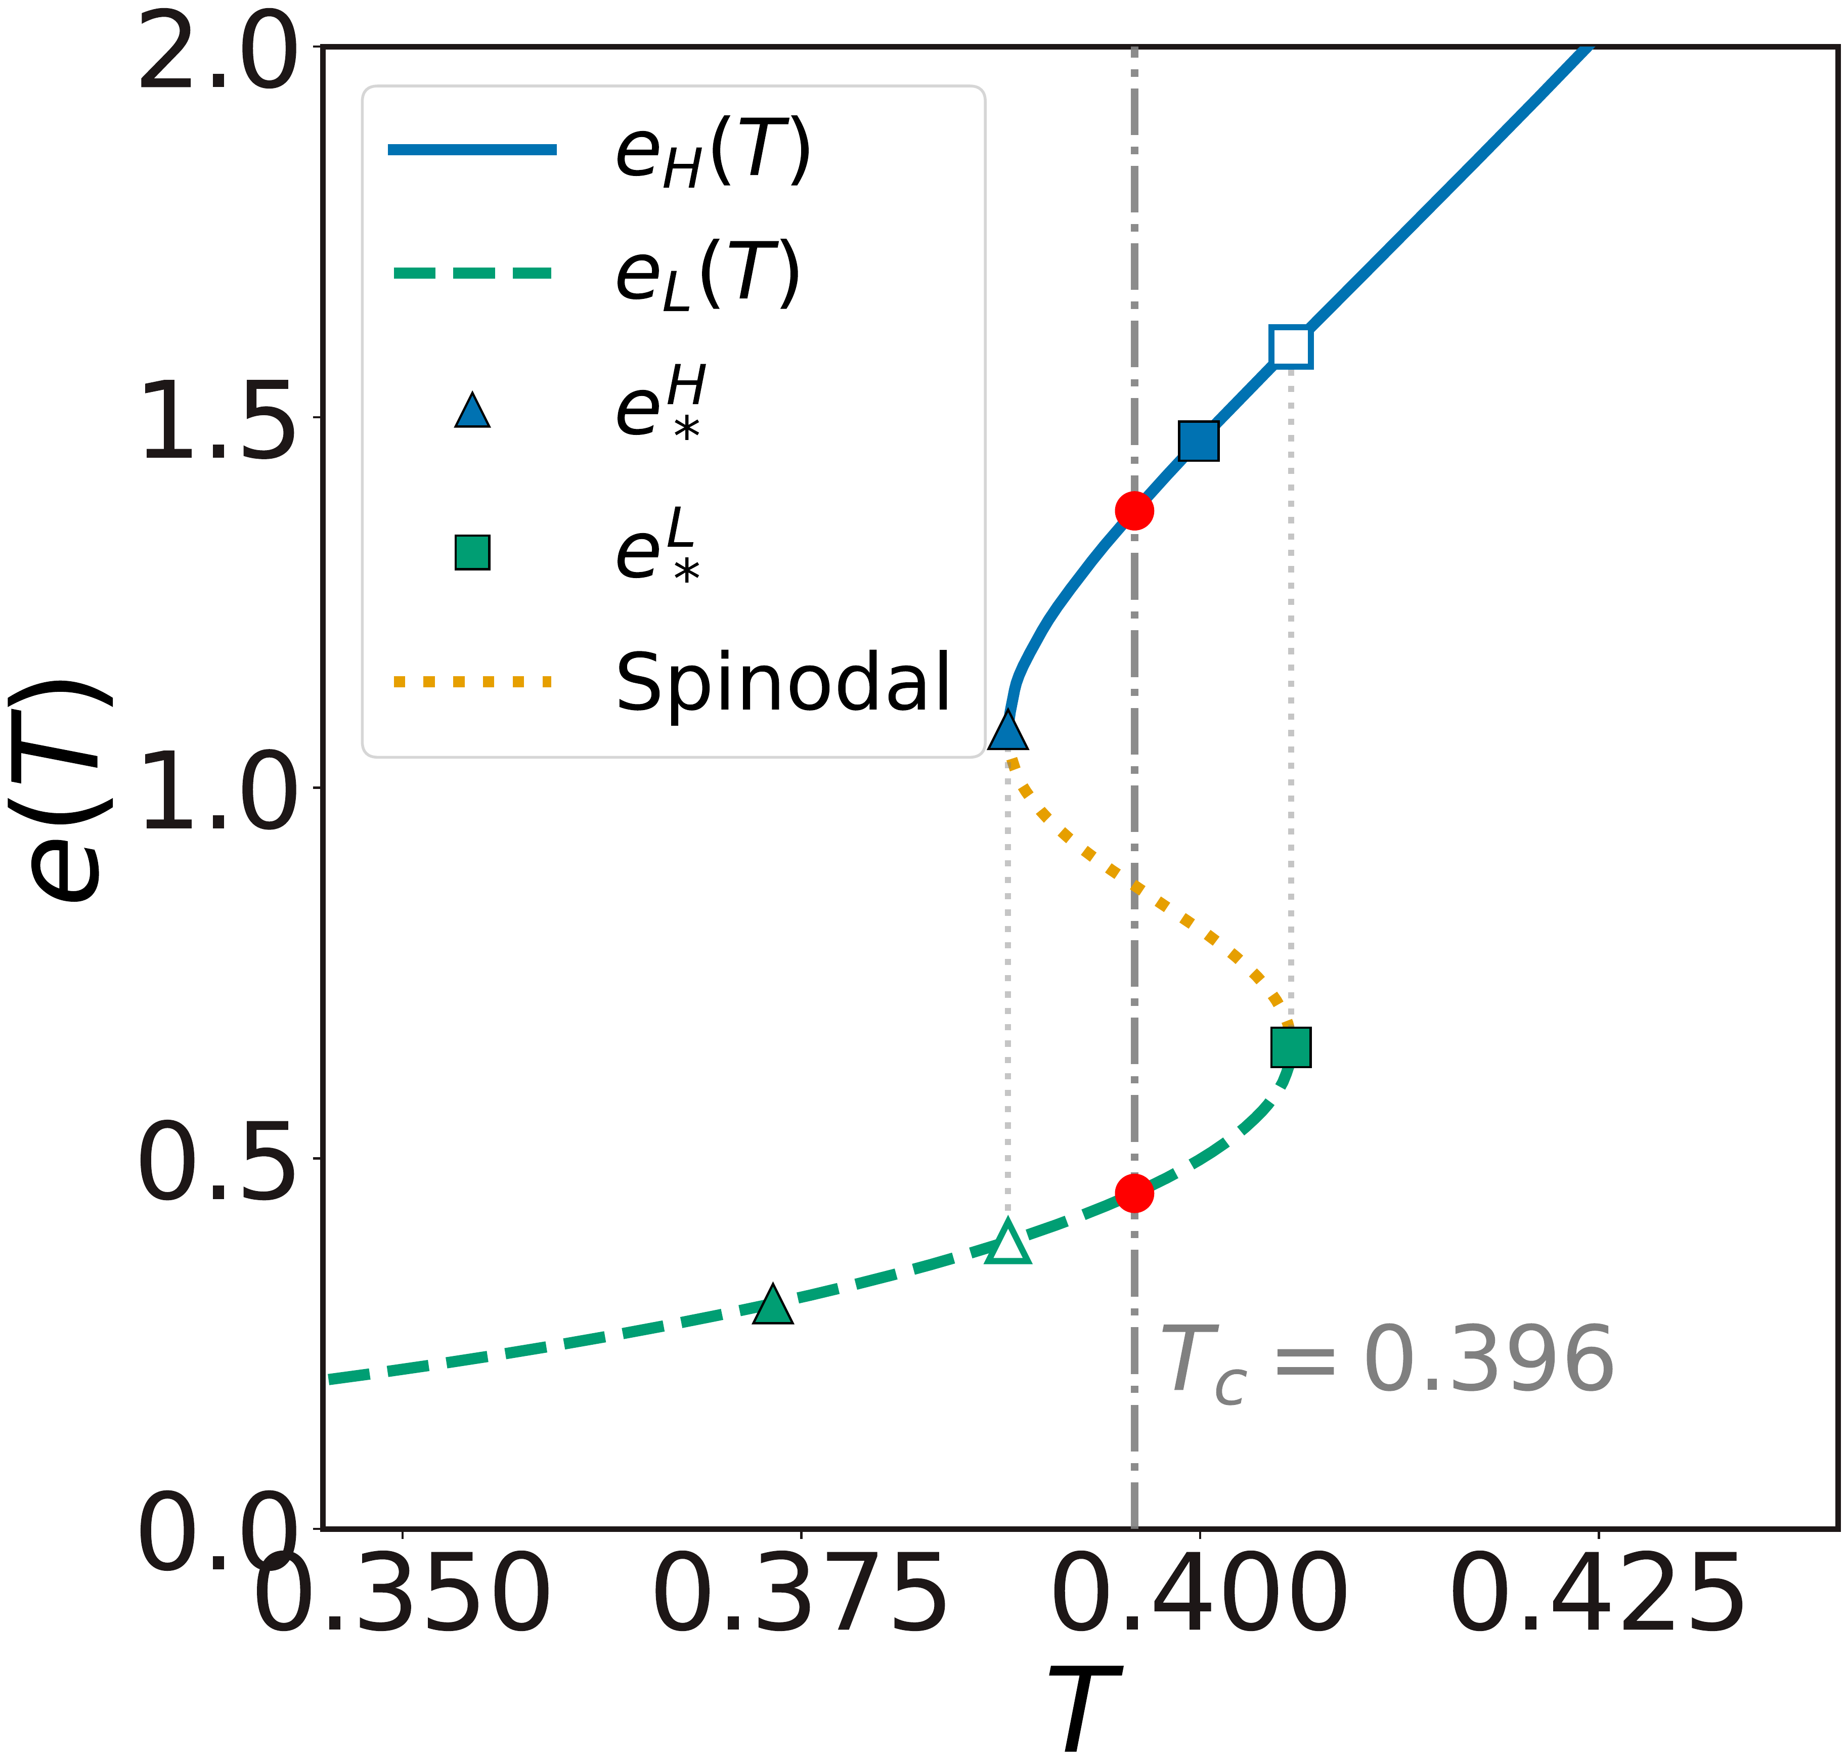
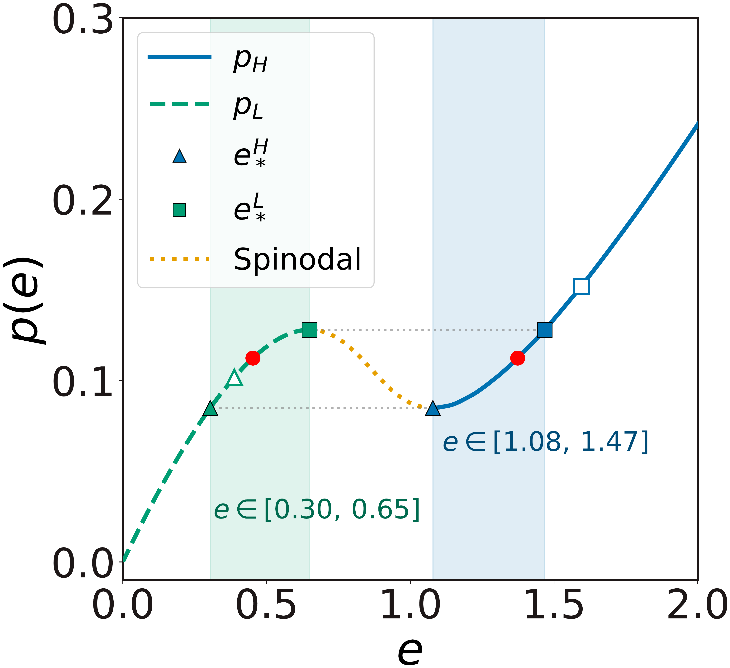
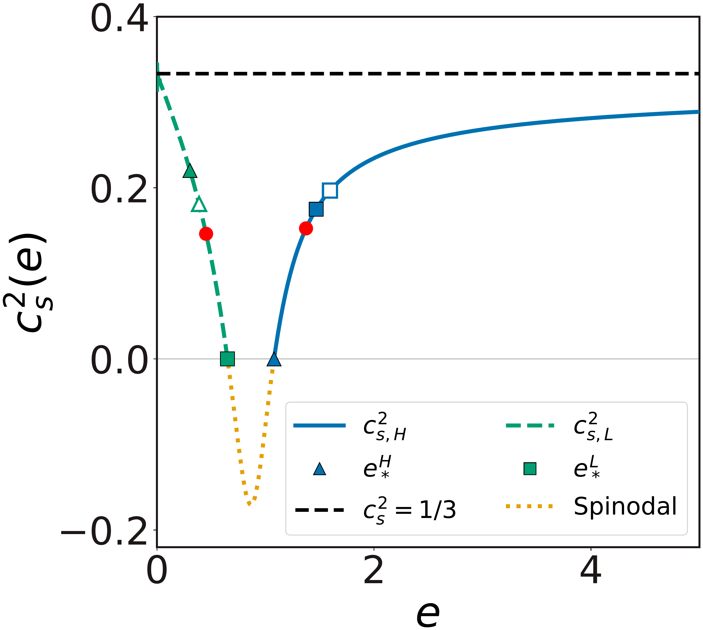
[Bea, Mateos, JHEP 08 (2018) 034; Mateos, Sanchez-Garitaonandia, PTA, arXiv:2607.27874]
“QCD-like” equations of state
one state
supercooling
superheating
Single valued in the energy density: one state per energy density
Strong dependence of the speed of sound on the temperature
Finite amount of supercooling and superheating

Slide 15
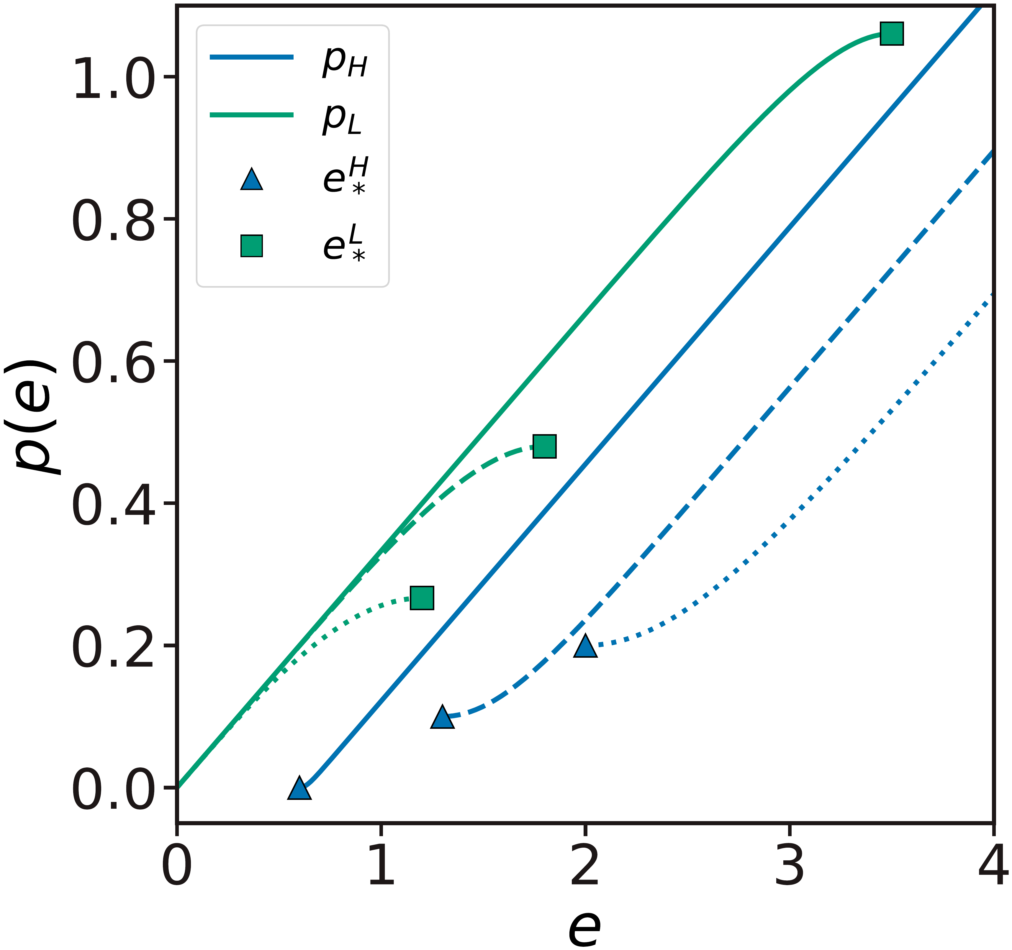
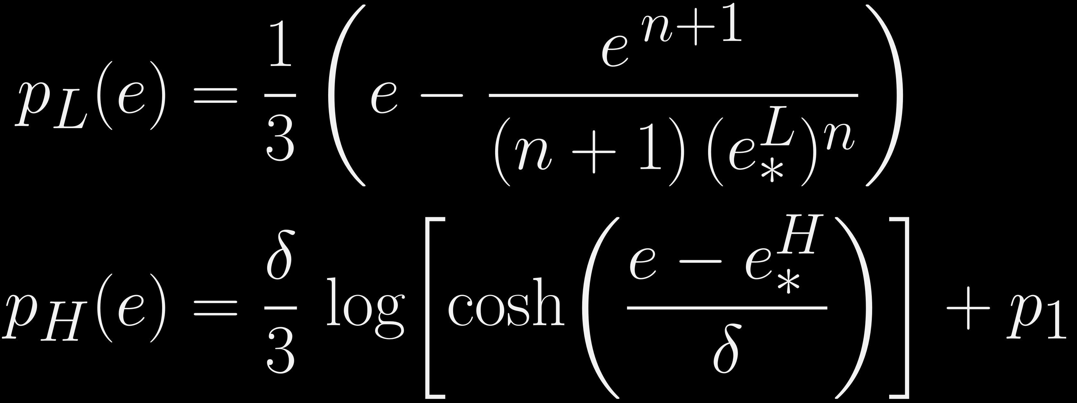
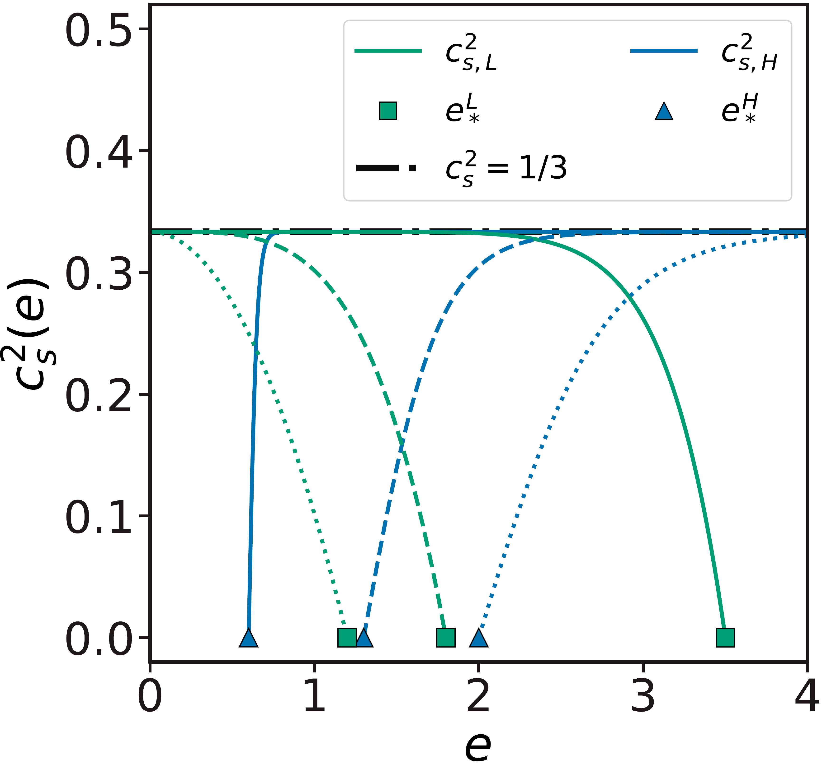
[Mateos, Sanchez-Garitaonandia, PTA, arXiv:2607.27874]
Equation of state ansatz
Bag-model-like
Intermediate
Non-conformal
Ansatz interpolating between QCD-like and bag-model-like (reduced) EoS
✕
Constructed such that:
  No spinodal branch: no ideal-hydro flows
  Conformal at low/high energies: $c_{s}^{2}→1/3$
  $c_{s}^{2}=0$ at the turning points $e_{∗}^{H}$, $e_{∗}^{L}$
  $δ$ and $n$ control how fast $c_{s}$ varies
  $p_{1}$ plays the role of the “bag constant”

Slide 16
Non-conformal obstructions
Wall obstructions
The junction conditions at the wall cannot be solved
Local: only p(e) and c_{s}(e) at the wall matter
Affect deflagrations and detonations
Flow obstructions
No continuous flow can be built along the rarefaction wave
Global: sensitive to how c_{s} varies with e
Affect hybrids and detonations
New solution: shocked-detonations
wall
rarefaction wave

Slide 17
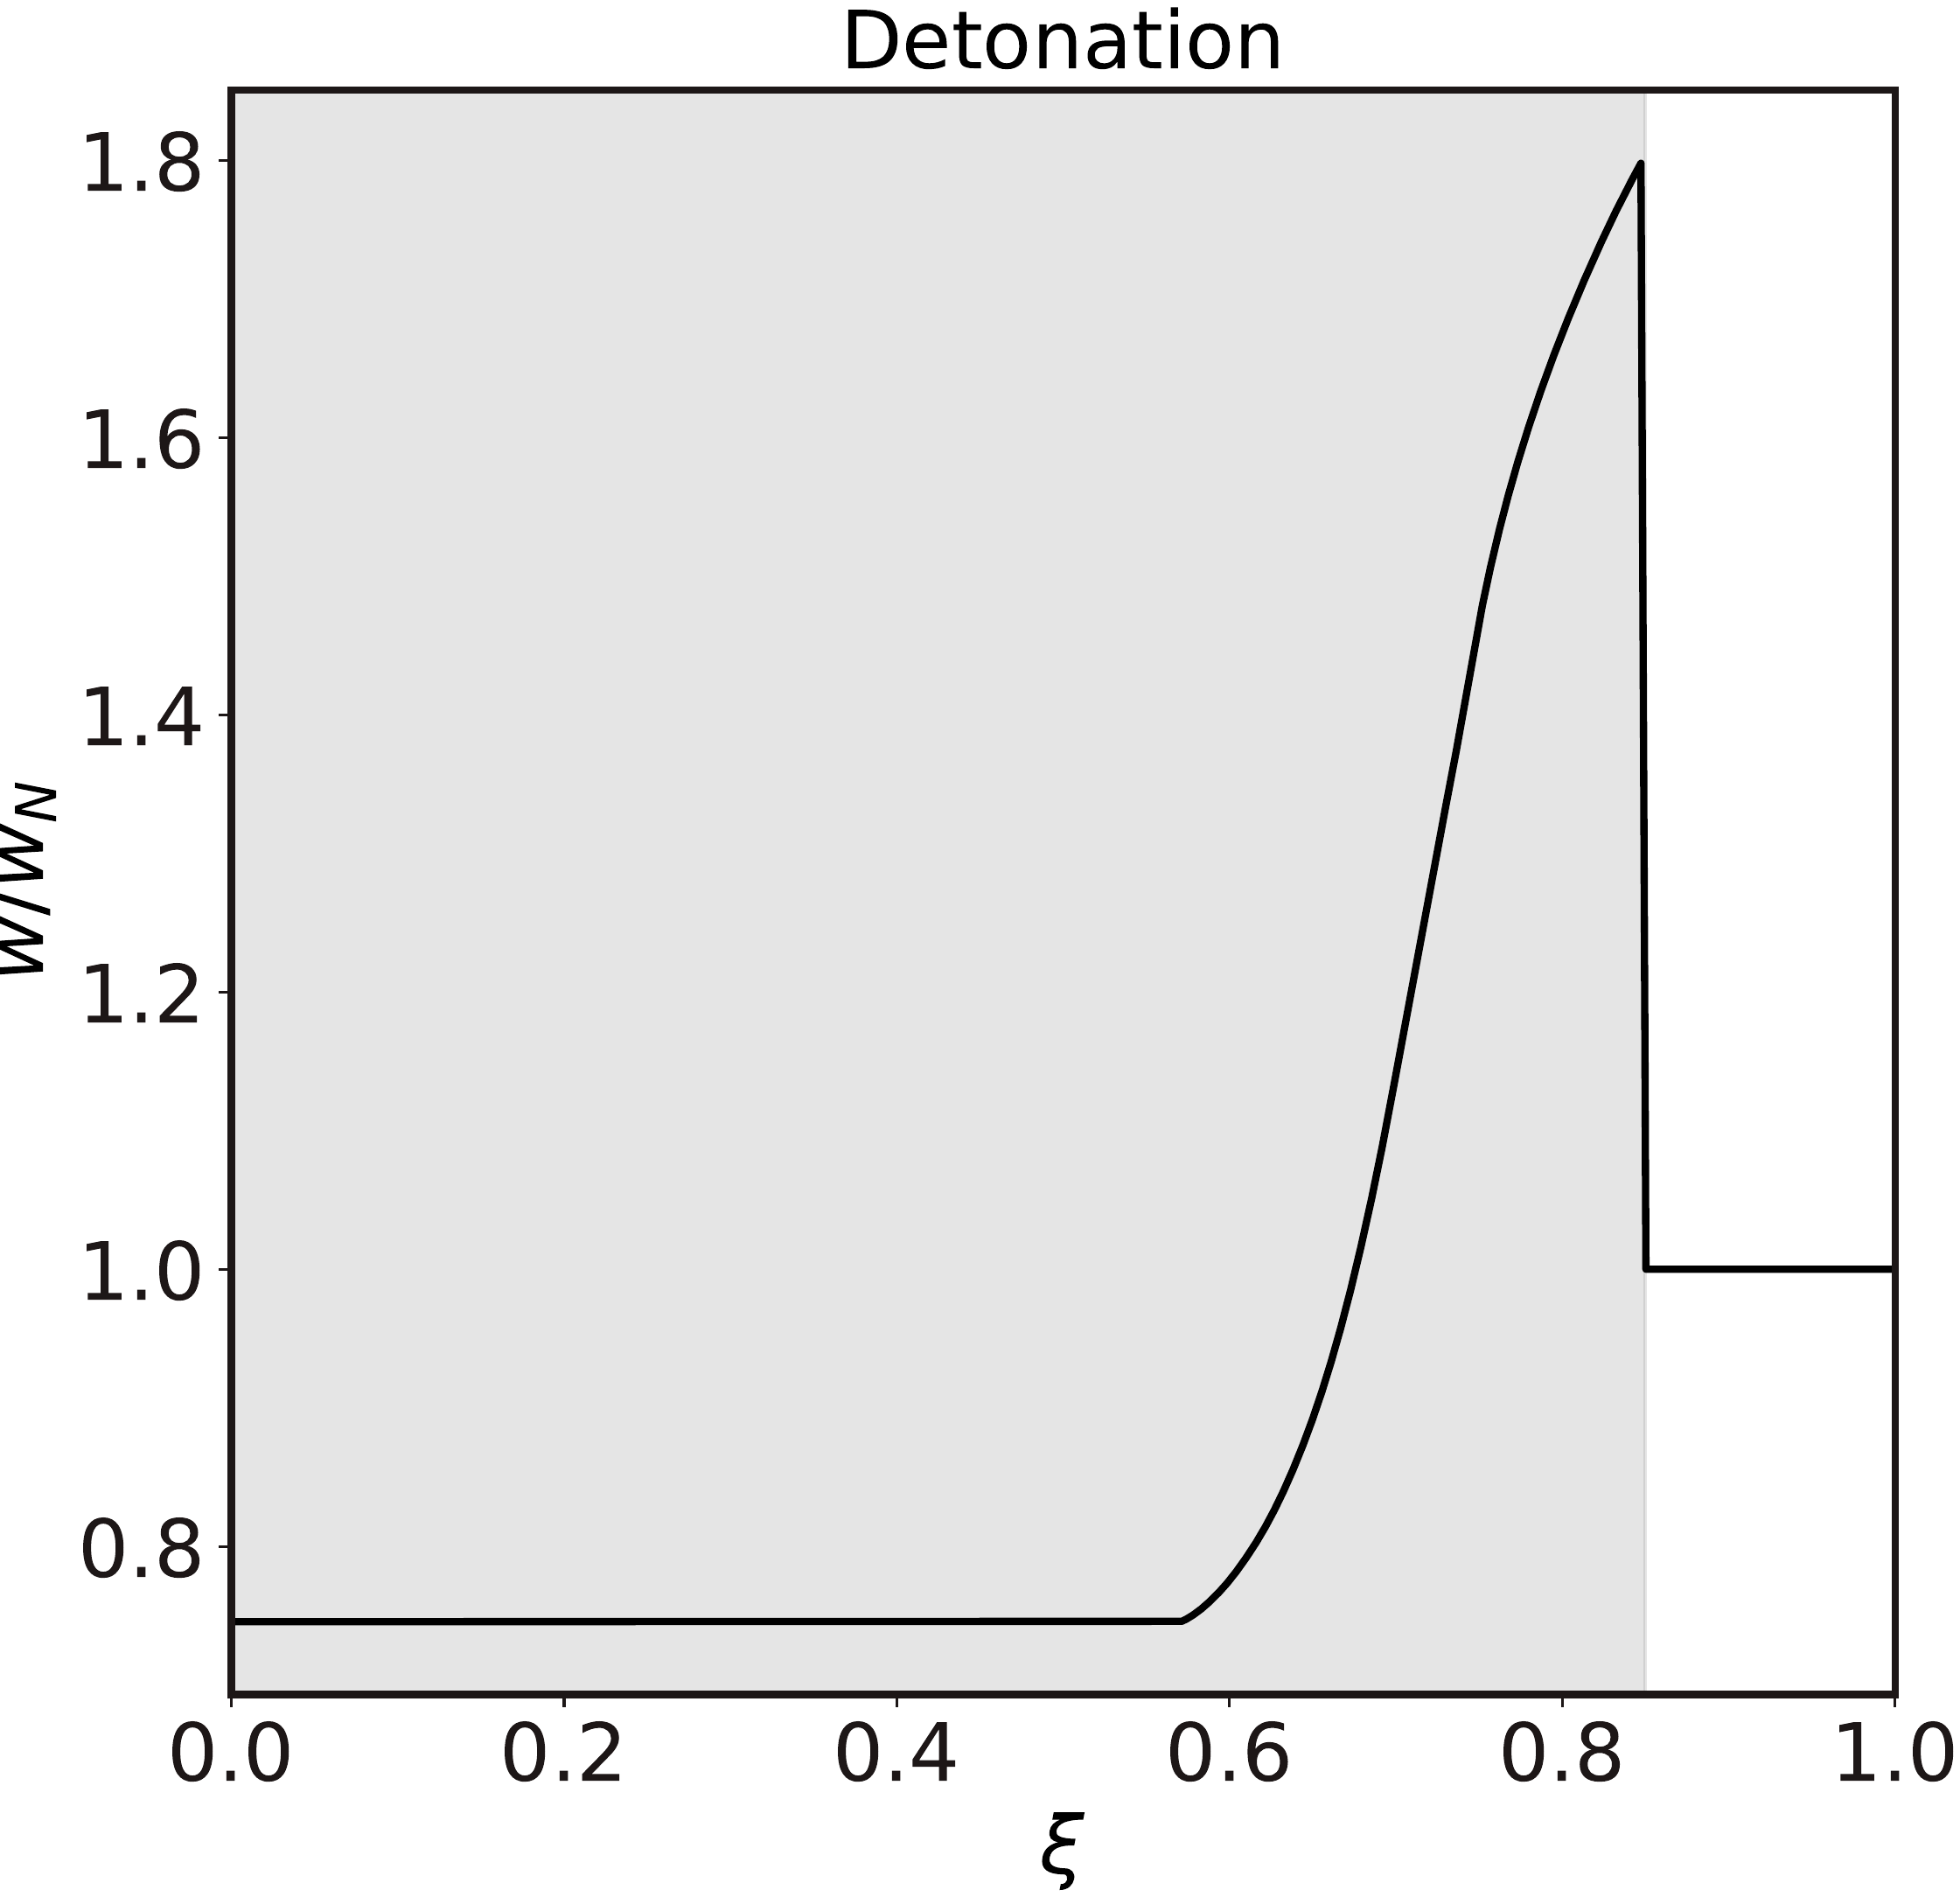
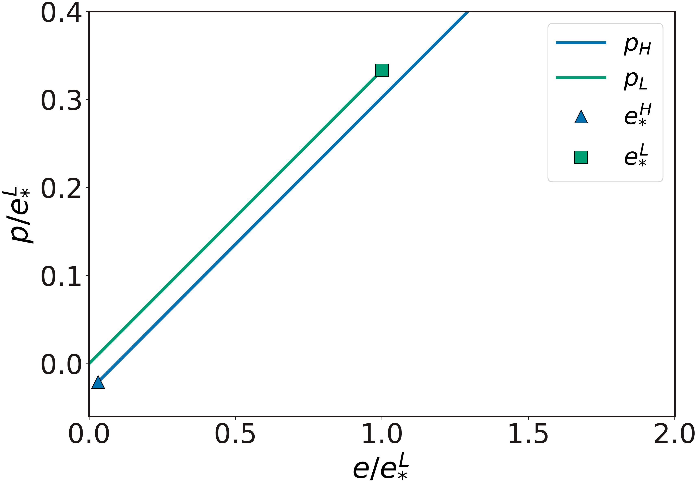

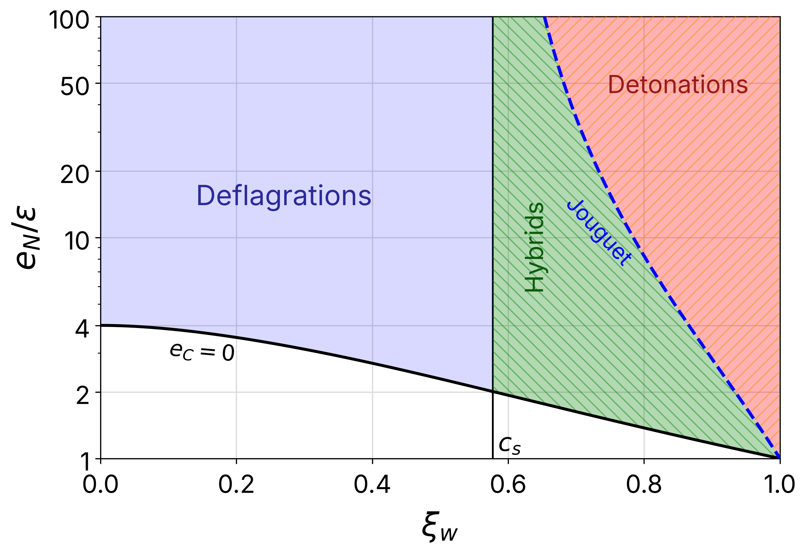
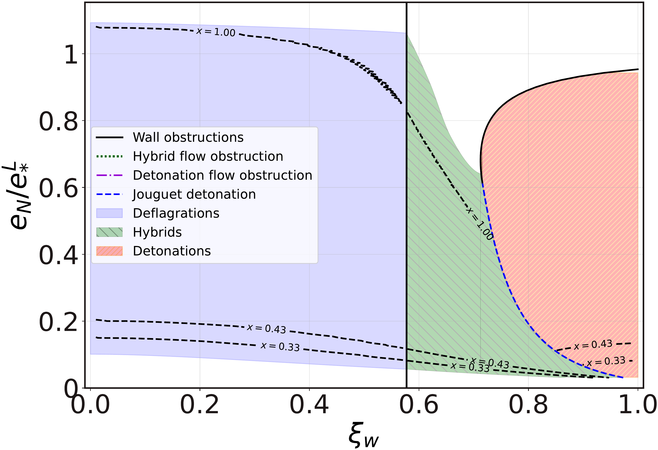

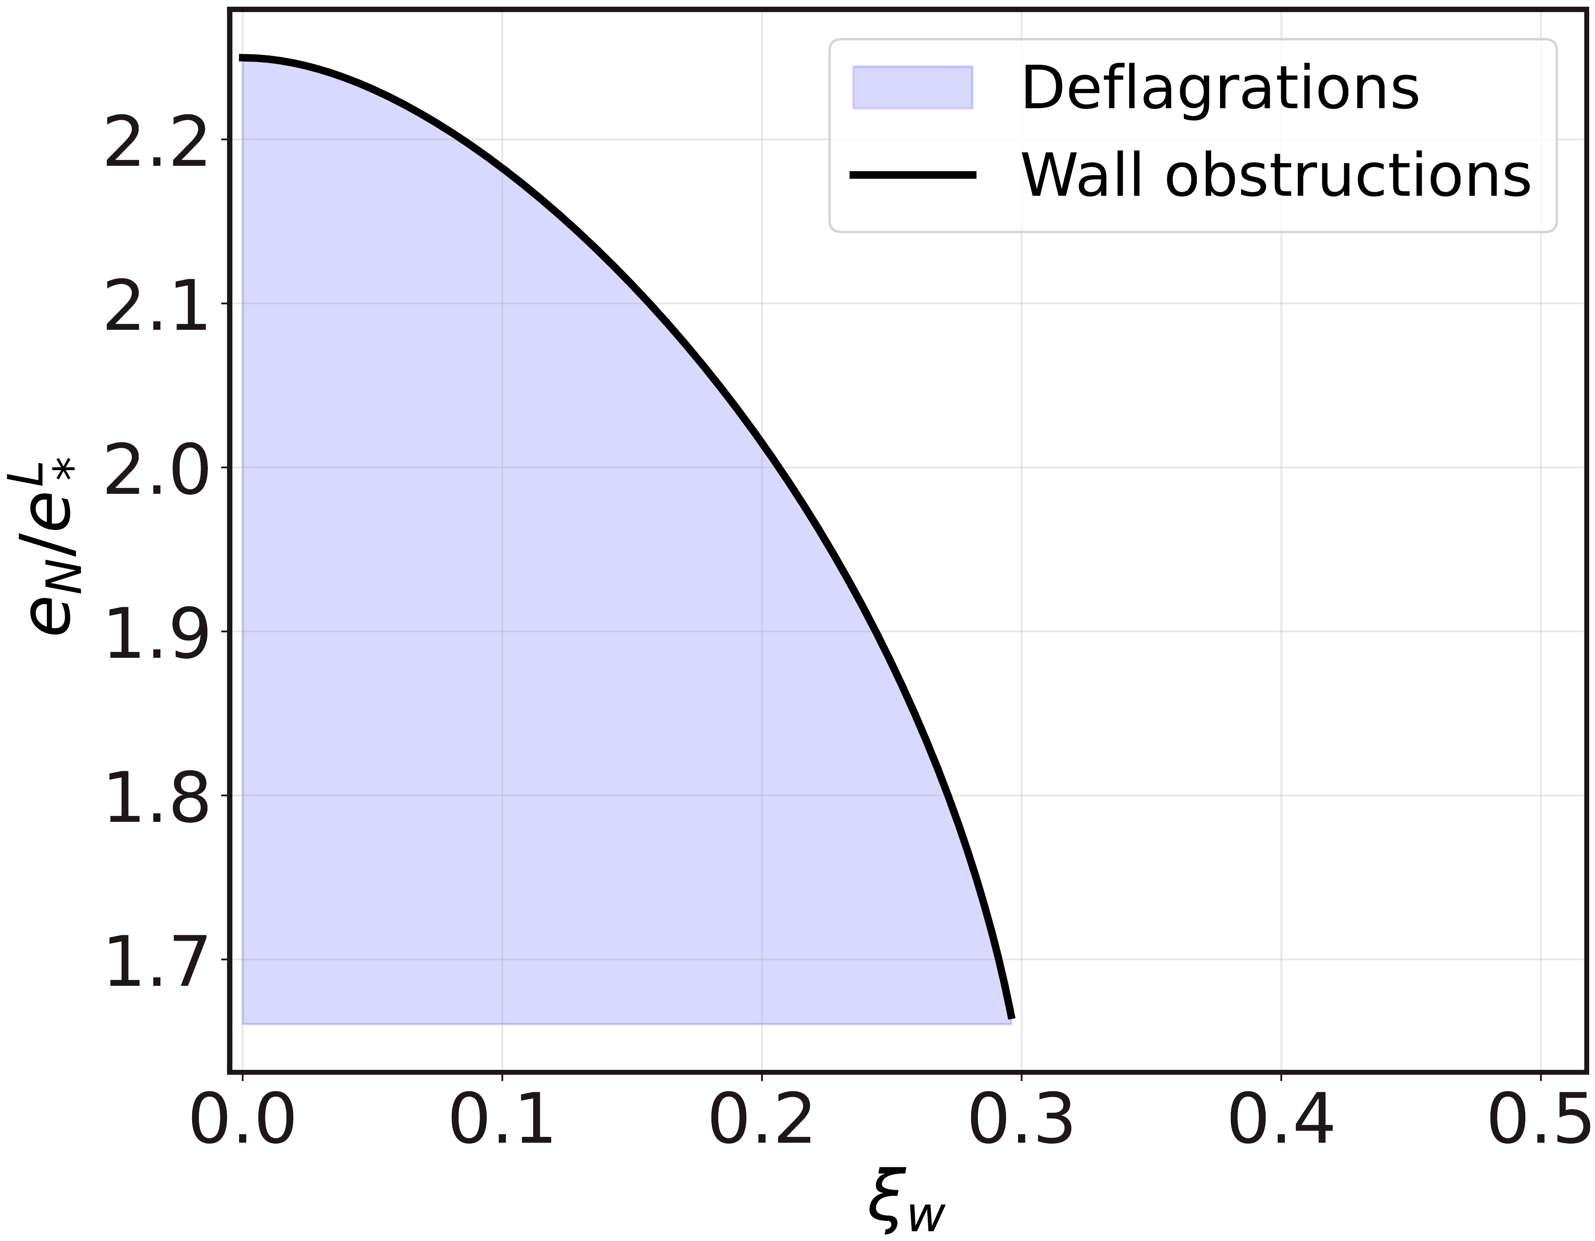


[Mateos, Sanchez-Garitaonandia, PTA, arXiv:2607.27874]
Wall obstructions: detonations
Single detonation
Holographic model: EoS
Bag EoS, finite ranges
Holographic model: solutions
Pure bag model
Bag model, finite ranges
$$w_{−}$$
no low-energy states
$$e_{N}$$
$$w_{+}$$
$$e_{+}=e_{N}$$
Detonation: fluid at rest ahead of a supersonic wall, $v_{+}>v_{−}$ $⇒$ $w_{−}>w_{+}$ (and $p_{−}>p_{+}$, $e_{−}>e_{+}$)
Necessary condition: $max(e_{L})≥min(e_{H})$ $⇒$ no detonations on QCD-like eos.
Finite superheating bounds the detonations
Approaching the wall obstruction at fixed $ξ_{w}$ pushes $e_{−}$ to the low-energy turning point $e_{∗}^{L}$

Slide 18
[Mateos, Sanchez-Garitaonandia, PTA, arXiv:2607.27874]
Wall obstructions: deflagrations
Bag model:
  Deflagrations and hybrids are continuously joined across the boundary $ξ_{w}=c_{s}$
  Deflagrations span all possible energies, $0≤e_{C}≤e_{∗}^{L}$
Non-conformal EoS:
  The boundary becomes $ξ_{w}=c_{s}(e_{C})$
  Deflagrations don’t cover the whole range of available energies
Bag model, finite ranges
Non-conformal EoS

Slide 19
[Espinosa et al., JCAP 06 (2010) 028; Mateos, Sanchez-Garitaonandia, PTA, arXiv:2607.27874]
Flow obstructions
Associated to rarefaction waves: detonations and hybrids
Constant $c_{s}$: the rarefaction wave continiously joins the fluid at rest, $v=0$
Gradients $∂_{ξ}v$ can change sign along the flow because $c_{s}$ depends on $e$ $⇒$ the flow becomes multivalued
They appear when the EoS has a degenerate critical point (DCP), a condition on the EoS only:
Bag model detonation
Detonation beyond the DCP: not allowed

Slide 20
[Mateos, Sanchez-Garitaonandia, PTA, arXiv:2607.27874]
Flow obstructions
Limiting cases give the flow obstruction lines in the space of allowed solutions

Slide 21
[Mateos, Sanchez-Garitaonandia, PTA, arXiv:2607.27874]
New solutions: shocked detonations
Rarefaction waves cannot be continued beyond the flow obstruction
However, new solutions are found by introducing a shock inside the rarefaction wave $⇒$ shocked detonations

Slide 22
[Mateos, Sanchez-Garitaonandia, PTA, arXiv:2607.27874]
Space of solutions
Bag-model-like EoS
QCD-like EoS

Slide 23
[Mateos, Sanchez-Garitaonandia, PTA, arXiv:2607.27874]
Kinetic energy fraction
The kinetic energy fraction gives a proxy for the gravitational-wave emission:

Slide 24
Conclusions
Applying for postdocs!
pedro.tarancon@icc.ub.edu
github.com/pedrota2000
We have studied self-similar bubble solutions in FOPTs with a non-conformal EoS
Hydrodynamics alone constrains the bubble wall velocity: non-conformal effects rule out entire families of solutions
  Wall and flow obstructions open gaps in the allowed wall velocities ⇒ no detonations in QCD-like EoS.
  New solutions avoiding the obstructions: shocked detonations
This impacts the kinetic energy fraction, strongly suppressing the gravitational-wave emission
Future work
Dynamics of the transition: cosmic separation of phases
[Aurrekoetxea, Bea, Luna, Mateos, Sanchez-Garitaonandia, PTA, van de Vis, in progress]
Non-conformal effects in superheated (inverse) FOPTs
Finite chemical potential: non-conformality fully couples the charge equation $⇒$ neutron star mergers
Code: SNOBEX — github.com/pedrota2000/SNOBEX

Slide 25
Thank you!

Slide 26
Backup slides

Slide 27
First order phase transitions
T
vapour
Boiling water
liquid
ice
P

Slide 28
Outlook
Hydrodynamics of expanding bubbles
bubbles in a conformal EoS
Non-conformal obstructions
at the wall and along the flow
1
3
2
Non-conformal equations of state
from bag model to QCD-like
4
Conclusions

Slide 29
Expansion modes in the bag model
[Espinosa et al., JCAP 06 (2010) 028]
Deflagration
Hybrid
Detonation

Slide 30
[Castorina et al., EPJC 66 (2010) 207; Vovchenko et al., PRC 91 (2015) 024905;
Agasian et al., EPJA 53 (2017) 138; Khaidukov et al., PRD 98 (2018) 074031;
Athenodorou, Teper, JHEP 11 (2020) 172; Mason et al., EPJ Web Conf. 274 (2022) 08007;
Mason et al., PoS LATTICE2022 (2023) 216; Lucini et al., PRD 108 (2023) 074517;
Giusti et al., PLB 868 (2025) 139775]
“QCD-like” equations of state
Holographic model
Pure SU(3) YM
In the range relevant for the transition, both are qualitatively similar

Slide 31
[Mateos, Sanchez-Garitaonandia, PTA, arXiv:2607.27874]
Bubbles in QCD-like theories
Holographic model
Pure SU(3) YM

Slide 32
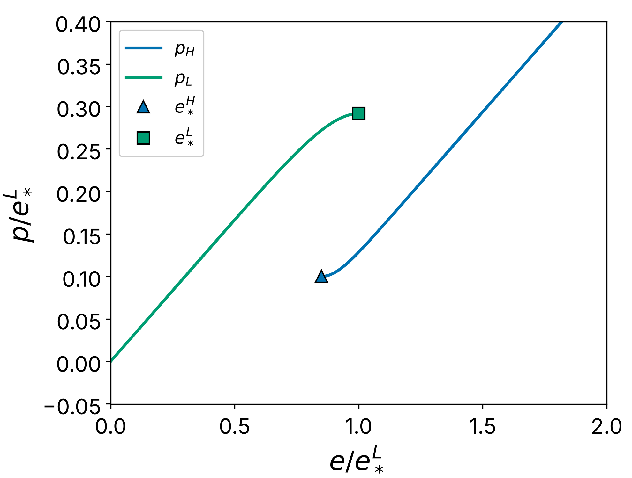
[Mateos, Sanchez-Garitaonandia, PTA, arXiv:2607.27874]
Entropy
Check whether the obstructions we find are more restrictive than the second law
Entropy from the reduced EoS:
Two integration constants, one per branch: $s_{L}\left(e_{∗}^{L}\right)$ and $s_{H}\left(e_{∗}^{H}\right)$
  Only one if the spinodal branch is included
Equivalent to choosing $T_{c}⟹p_{c}$
Label the choices by $x$:

Slide 33
[Espinosa et al., JCAP 06 (2010) 028; Mateos, Sanchez-Garitaonandia, PTA, arXiv:2607.27874]
Velocity profiles: bag model vs QCD-like
Deflagration
Hybrid
Detonation
Bag model
Our ansatz

Slide 34
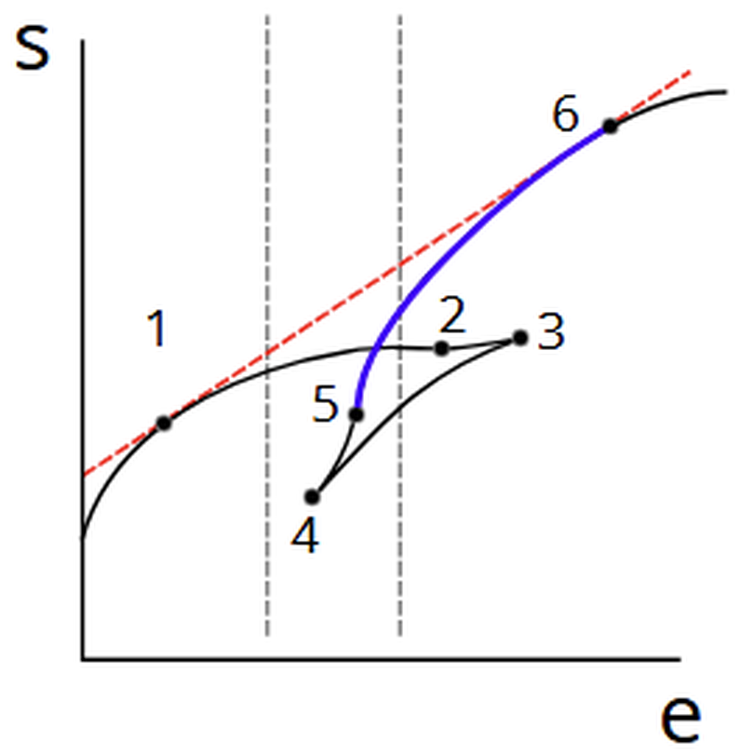
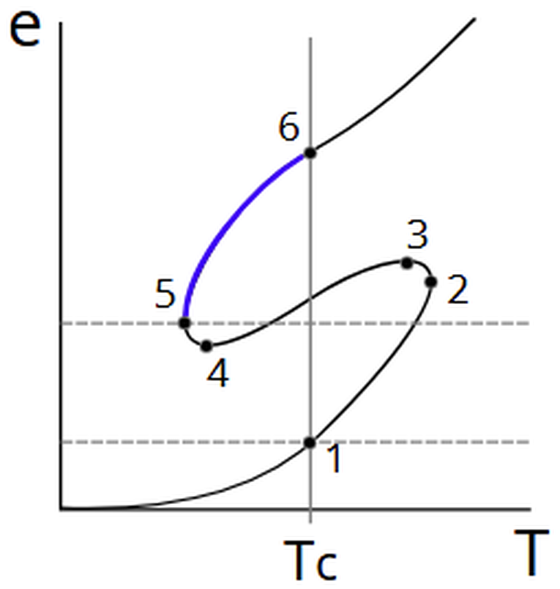
[Aurrekoetxea, Bea, Luna, Mateos, Sanchez-Garitaonandia, PTA, van de Vis, in progress]
Separation of phases
At $T = T_{c}$ the two phases have the same free energy: they can coexist (points 1, 6)
A mixture of 1 and 6 has the entropy of the red line: above any homogeneous state with the same energy
Maximizing the entropy $⇒$ the system separates into domains of the two coexisting phases
Δs > 0

Slide 35
[Aurrekoetxea, Bea, Luna, Mateos, Sanchez-Garitaonandia, PTA, van de Vis, in progress]
Separation of phases
Between the turning points, homogeneous states (blue branch) are thermodynamically unstable
The system can separate into the two phases, which coexist at $T = T_{c}$ with equal free energy (points 1, 6)
Phase separation maximizes the entropy: the mixed state (red dashed line) lies above the homogeneous branch in $s(e)$
Case 1
Case 2
Case 3

Slide 36
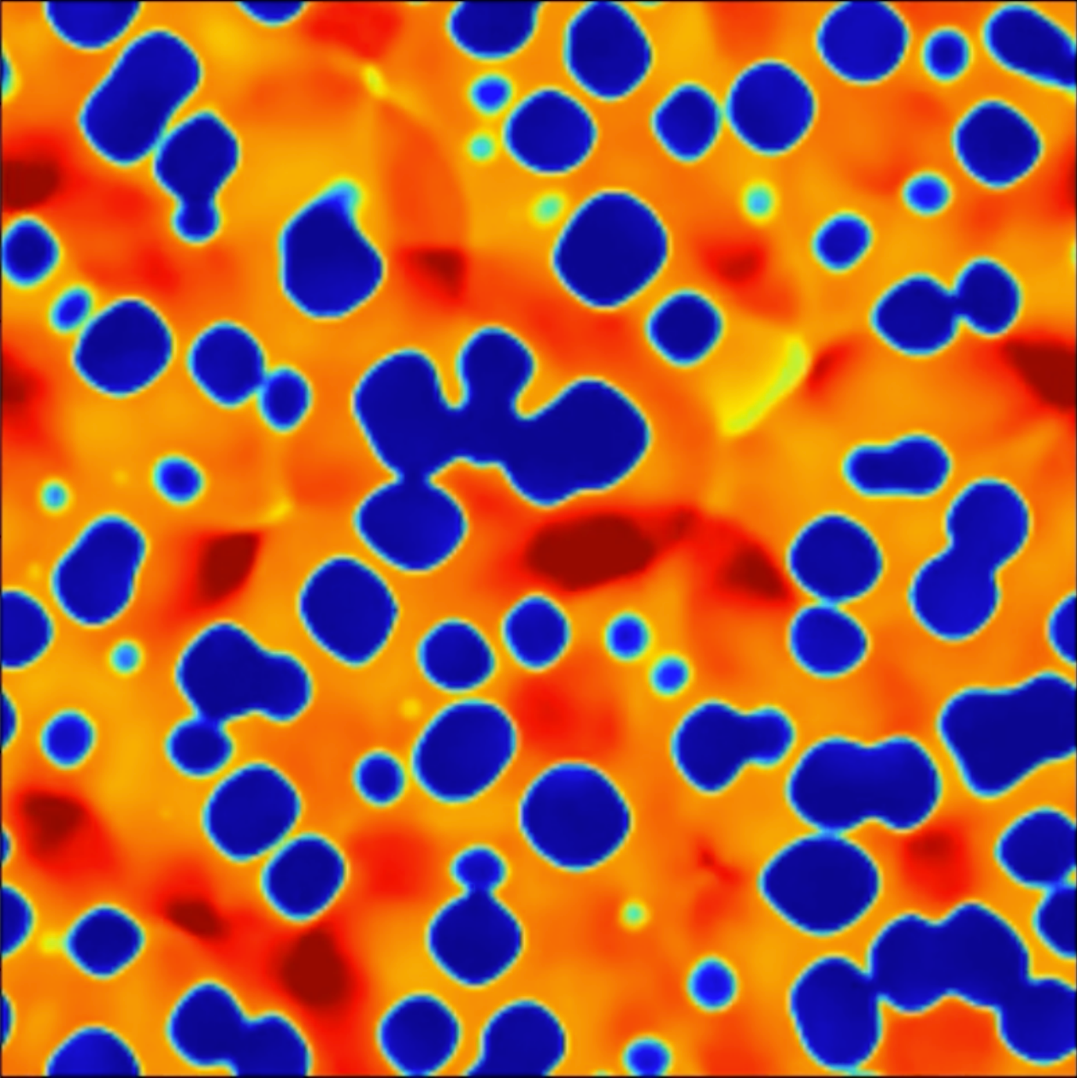
[Aurrekoetxea, Bea, Luna, Mateos, Sanchez-Garitaonandia, PTA, van de Vis, in progress]
Bubble collisions in QCD-like models
Real-time evolution of the hydrodynamic equations in a shock-capturing scheme
For energies inside the coexistence band there is no homogeneous final state
After the collisions the system settles into separated domains of the two phases

Slide 37
[Espinosa et al., JCAP 06 (2010) 028; Mateos, Sanchez-Garitaonandia, PTA, arXiv:2607.27874]
From the bag model to QCD-like
Bag model
Holographic model
?

