Slide 1
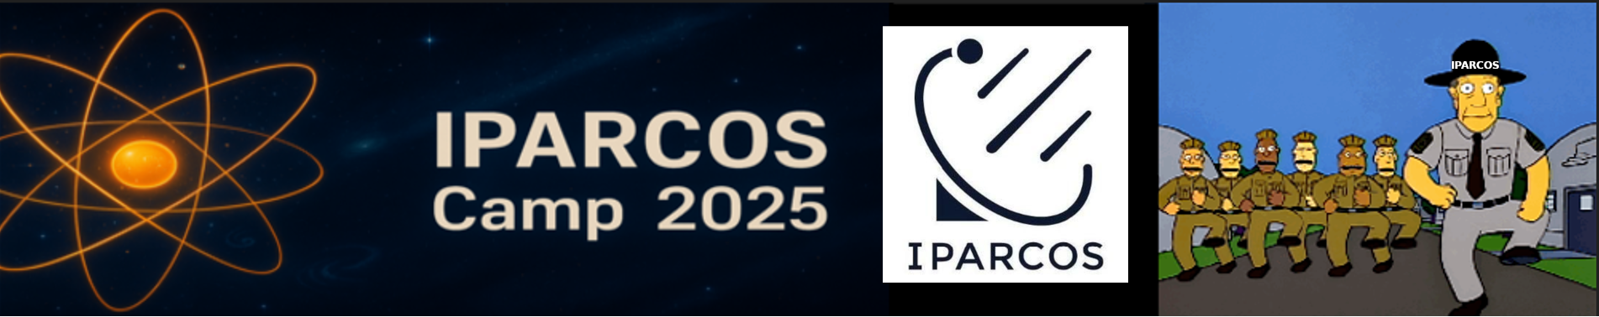
IPARCOS CAMP
J.J. Sanz Cillero , J.L. Contreras

Slide 2
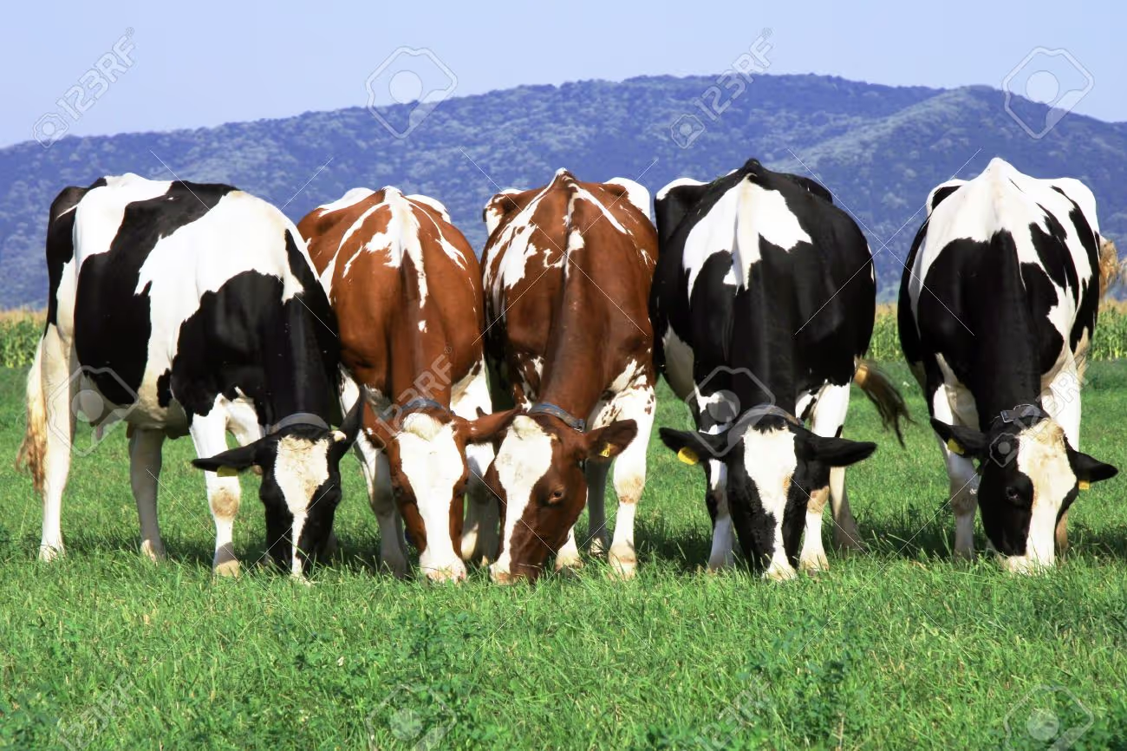
Why?
Problem:IPARCOS students work in isolated boxes
Camps are common in many places: Research Institutes, enterprises, etc. Team building.
One of us (JLC) offered to participated but never really started
Management (IS) added real manpower (JJSC) and it finally took off this year
A well ruminated idea, started in CEC, that took long to fly
Notes:
IPARCOS stuents work in isolated boxes (as seniors did before IPARCOS creation)
I will add that team building sounds posh, but just means knowing each other,

Slide 3
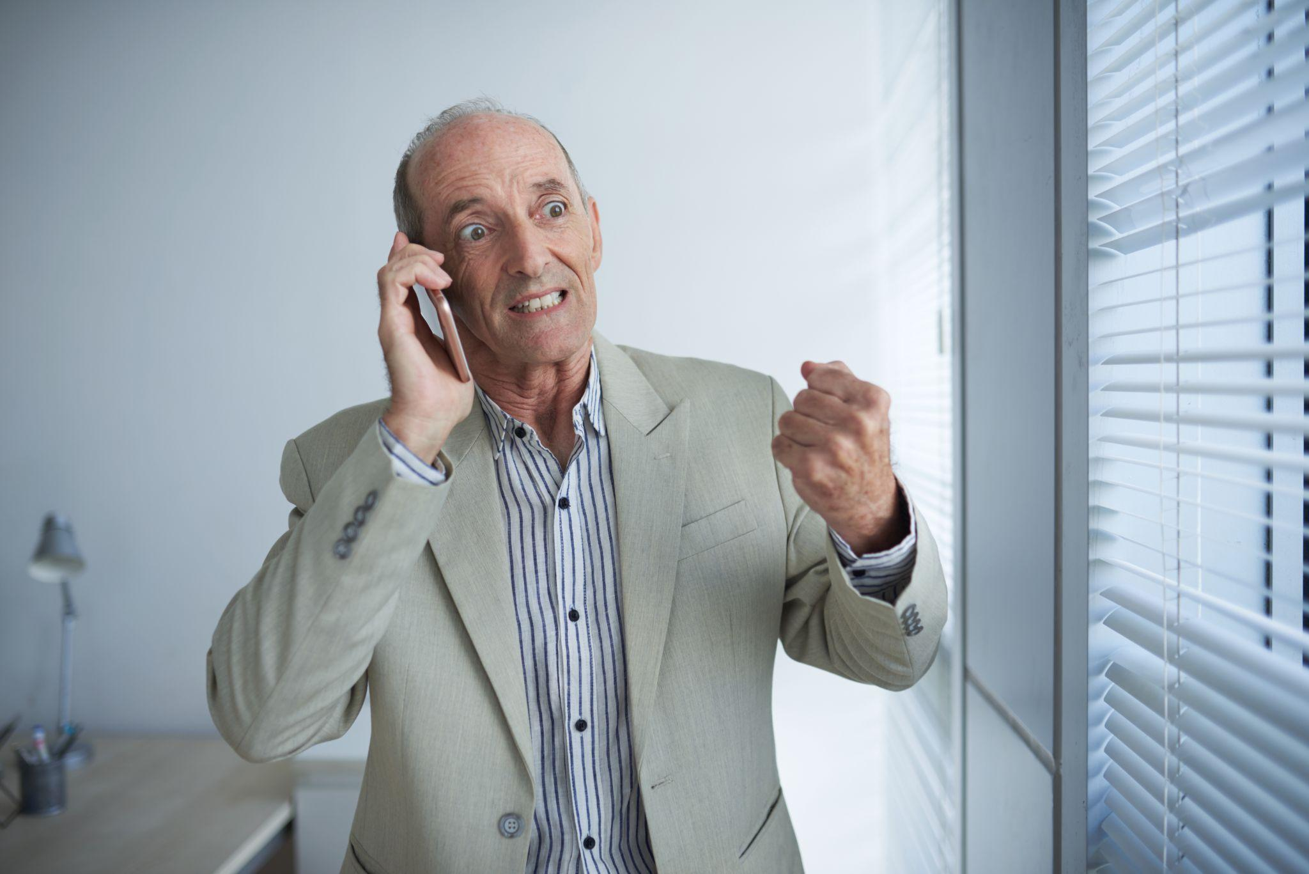
Where, when ?
Requirements
Short 2-3 days
In a place close to Madrid, accessible, with places “to go”
Seminar rooms, lodging
Cheap accommodation
It took us many weeks to find a place, and by then very few time slots were free, 1-2

Slide 4
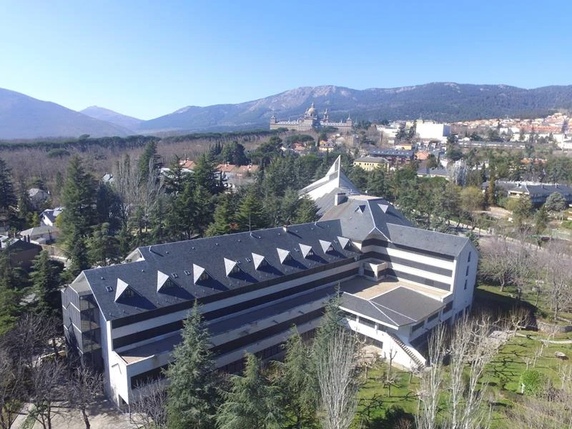
Casa San Jose. San Lorenzo de El Escorial
What a wonderful place !
28 de Mayo 2025 09:00
30 de Mayo 2025 19:00
Notes:
Comentar las ventajas 1) Barato 2) Barato 3) Cerca del tren 5` 4) Cerca del pueblo 10` 5) Maximas 6-7º menos que en Madrid

Slide 5
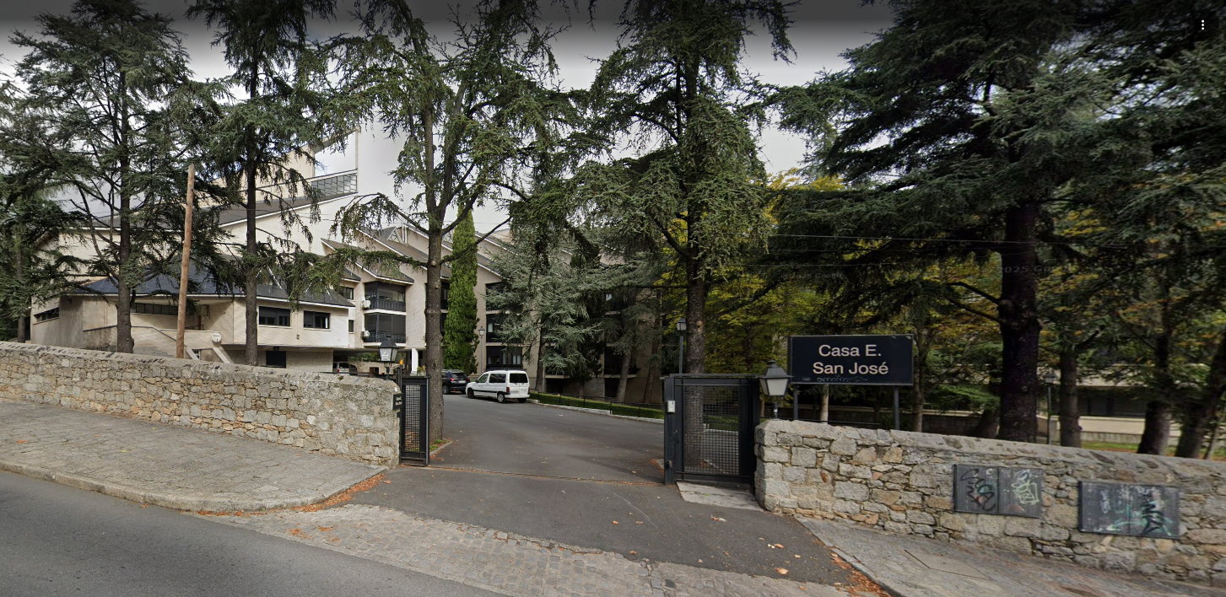

Slide 6
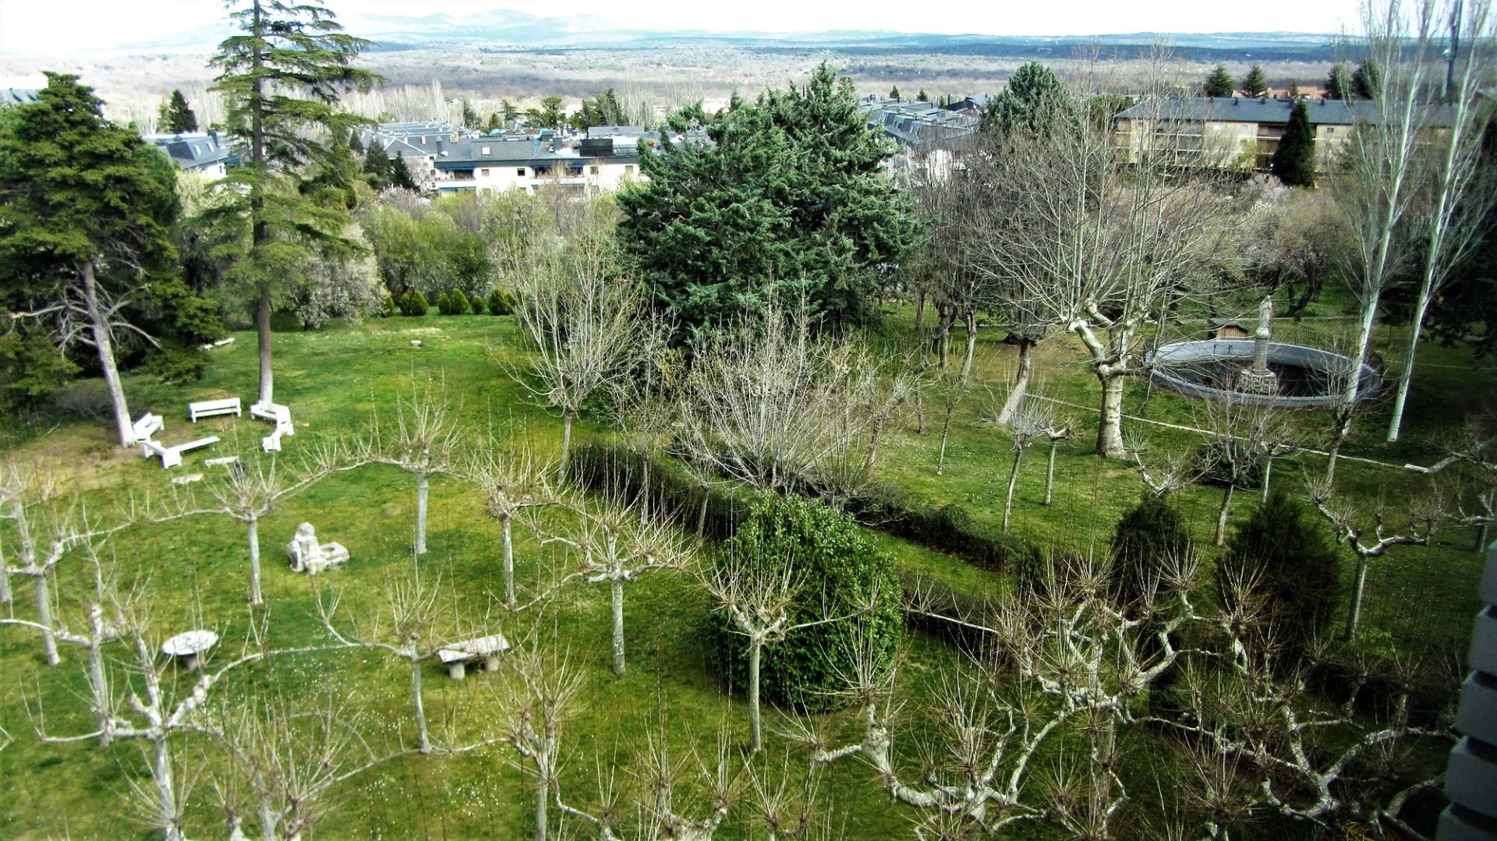

Slide 7
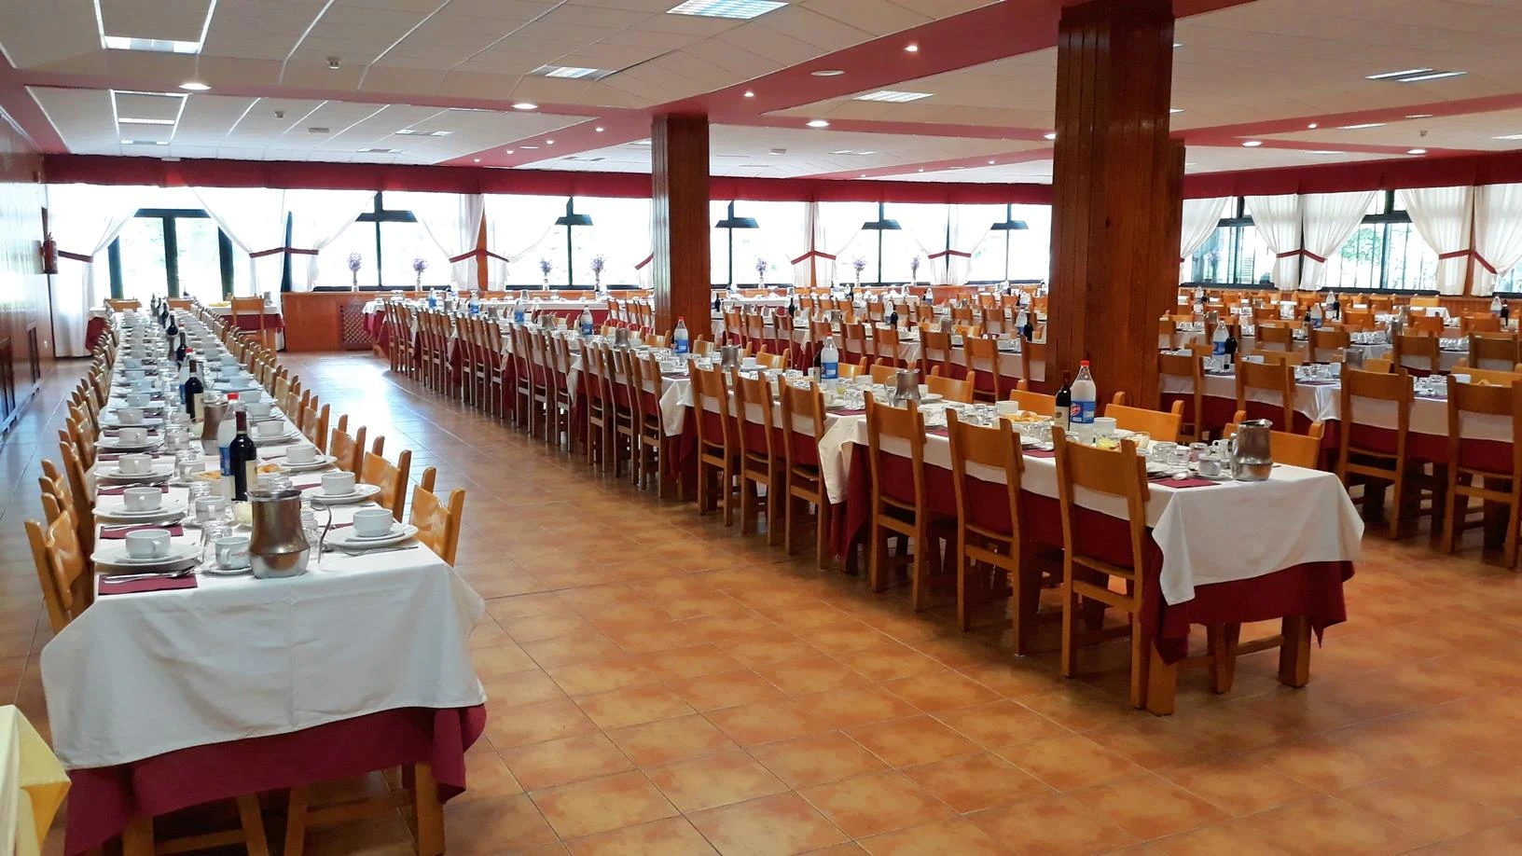
Notes:
We were occupying less that 10% of the beds. Fortunately for most of the meeting we were alone and then with another ~50 people group

Slide 8
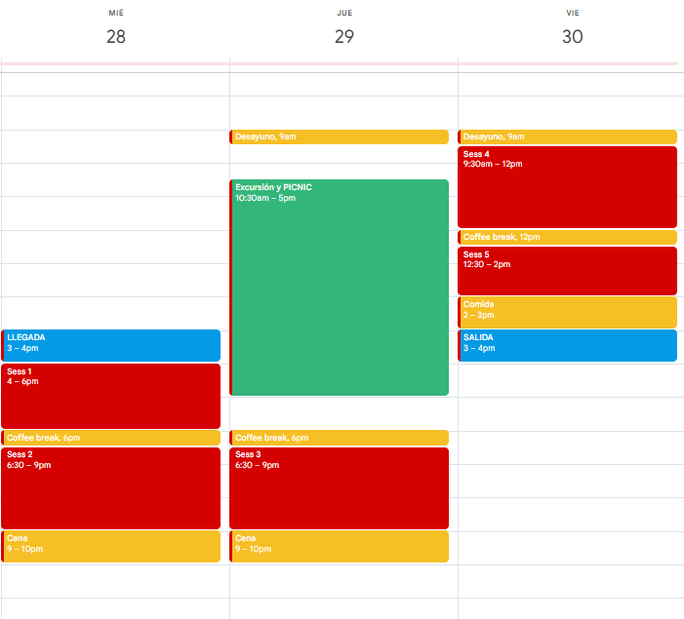
Overview
3 Days, 2 Nights
5 Sessions Work/debate
1 Short trail with pic-nic ( at 30º)
Weekend

Slide 9
Working sessions:
Presentation
“ Introduce yourself in 2 Slides”
“ Introduce yourself in 2 Slides -2 “
What is the postdoc crisis ?
GUAIX communication Plan and Culture Book.
What can we learn from each other? Sharing tools, learning new ways.
Scientific activities.
Wrapup
Notes:
This was the final setup not the planned one, but they were not that far from each other, for example 2. Was “What can we invent together?” and 4 and 5 included round tables

Slide 10
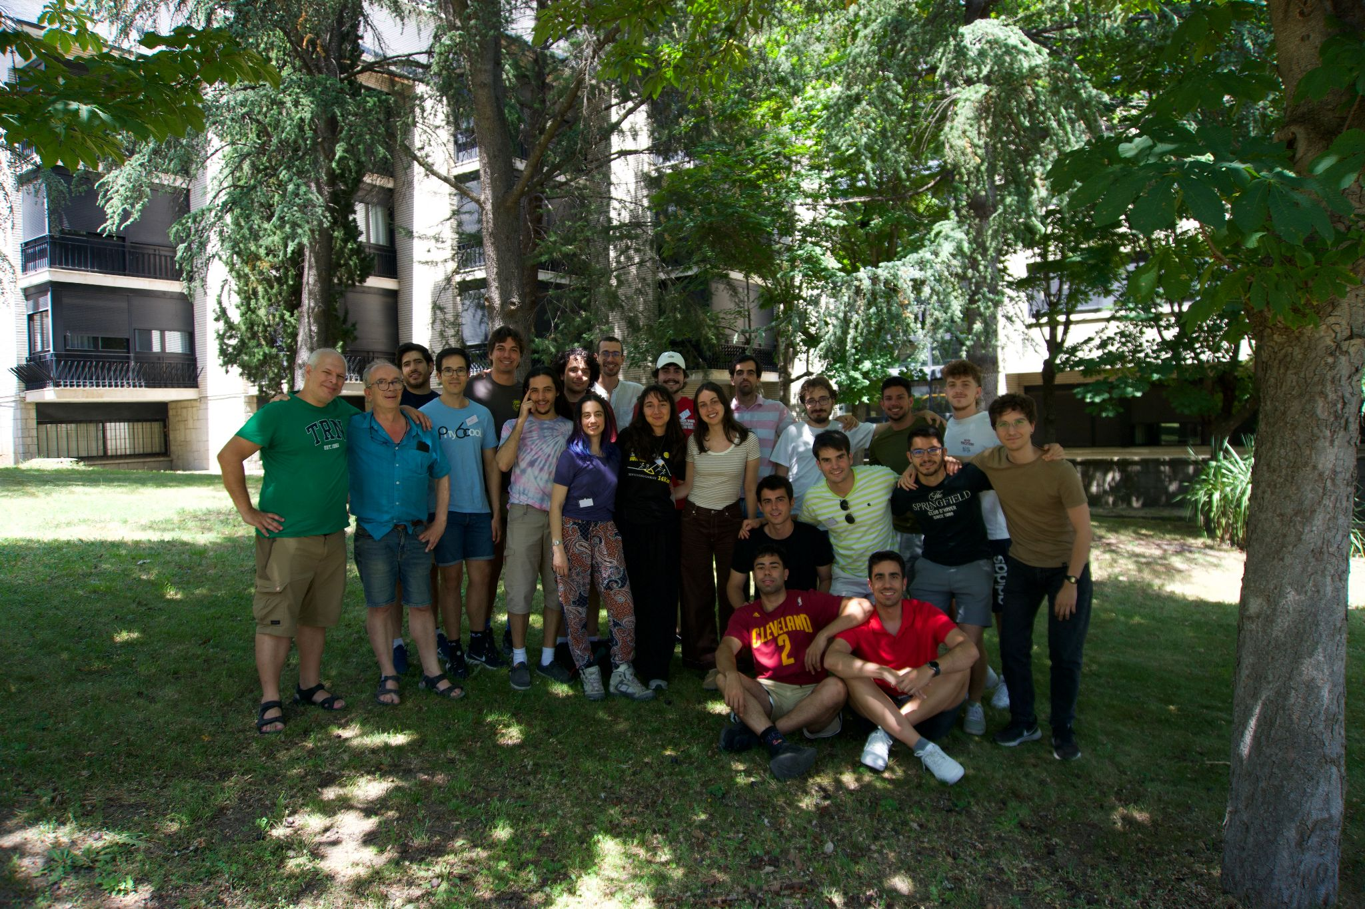
Who did participate?
2 Senior organizers
22 Students:
FISTEO , FISNUC, GUAIX, GAE, STARS
19 Male, 3 Female(!)
Notes:
But remember it was free !

Slide 11
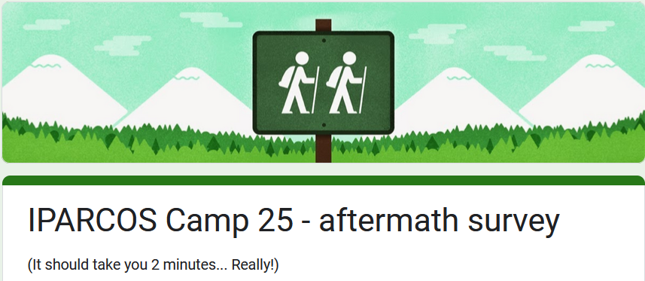
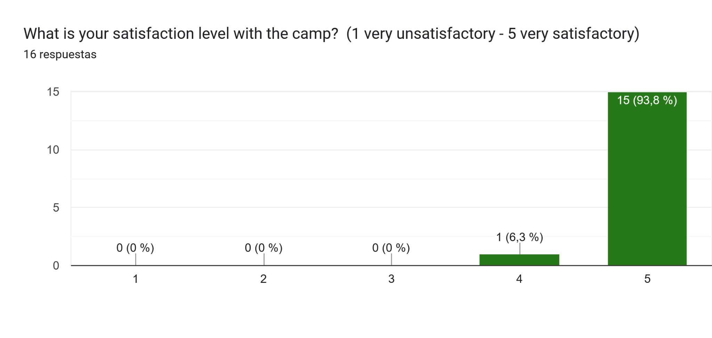
How did it go?
Anonymous
Survey
By the numbers:
We think it went so well…

Slide 12
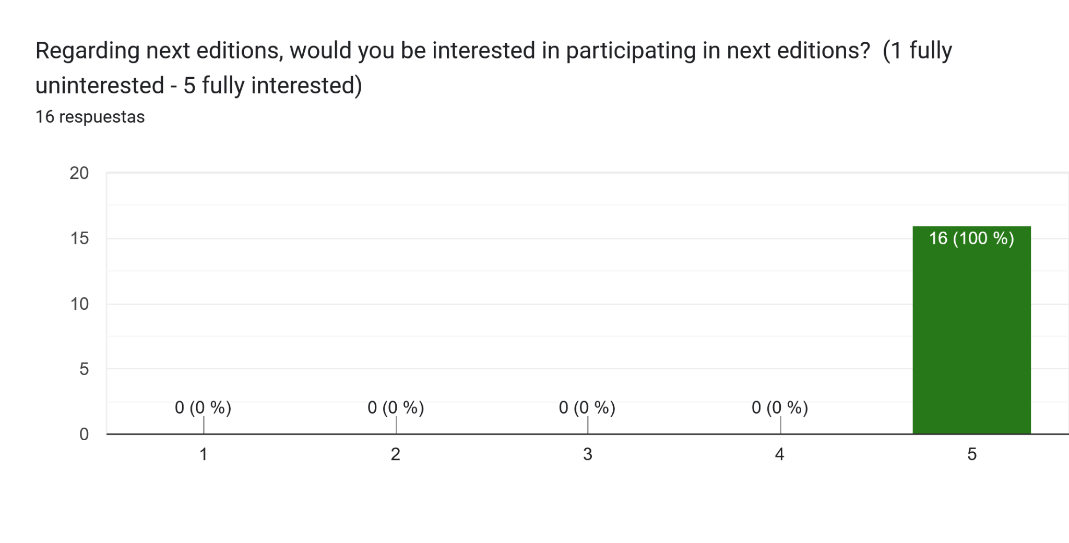
How did it go?
Anonymous
Survey
By the numbers:
…that we should repeat it next years!

Slide 13
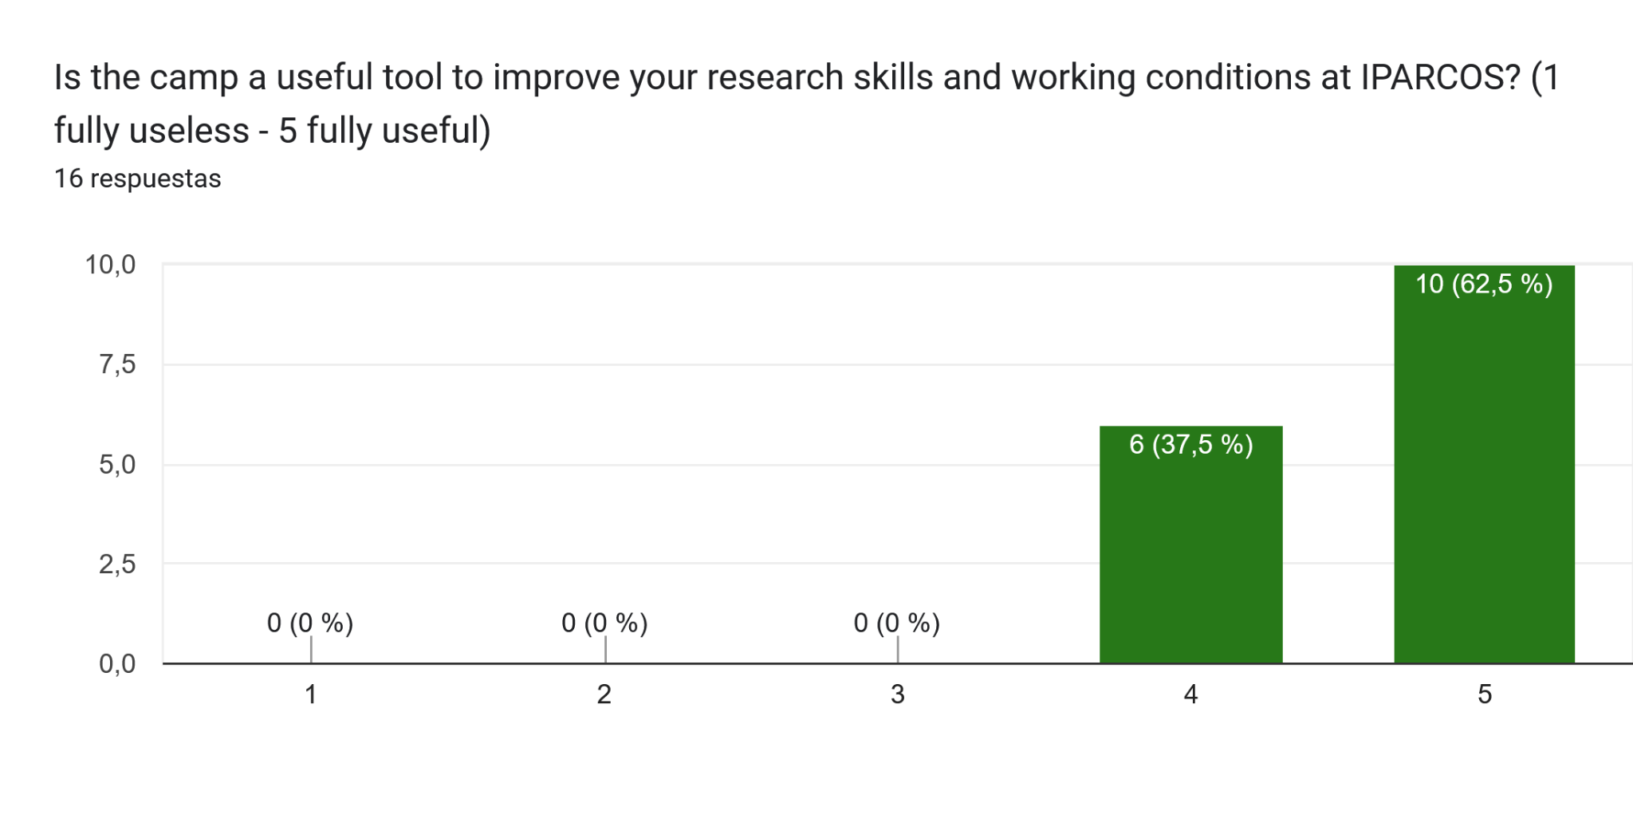
How did it go?
By the numbers:
Furthermore, it was useful:

Slide 14
Pros
Cons
Community and well-being:
- Breaking isolation
- Relaxed atmosphere
- The excursion: favorite activity
2-Slide Presentations & Round Tables:
Knowing each other
- "PhD welfare," "problem management,"
"Research careers in Spain"
⇒ Necessary and highly valued
Space to improve IPARCOS
& their own research groups

Slide 15
Pros
Cons
Community and well-being:
- Breaking isolation
- Relaxed atmosphere
- The excursion: favorite activity
2-Slide Presentations & Round Tables:
Knowing each other
- "PhD welfare," "problem management,"
"Research careers in Spain"
⇒ Necessary and highly valued
Space to improve IPARCOS
& their own research groups

Slide 16
Pros
Cons
Community and well-being:
- Breaking isolation
- Relaxed atmosphere
- The excursion: favorite activity
2-Slide Presentations & Round Tables:
Knowing each other
- "PhD welfare," "problem management,"
"Research careers in Spain"
⇒ Necessary and highly valued
Space to improve IPARCOS
& their own research groups

Slide 17
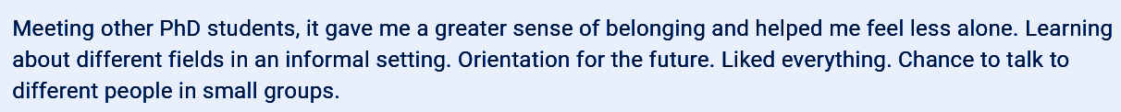
Pros
Cons
Community and well-being:
- Breaking isolation
- Relaxed atmosphere
- The excursion: favorite activity
2-Slide Presentations & Round Tables:
Knowing each other
- "PhD welfare," "problem management,"
"Research careers in Spain"
⇒ Necessary and highly valued
Space to improve IPARCOS
& their own research groups

Slide 18
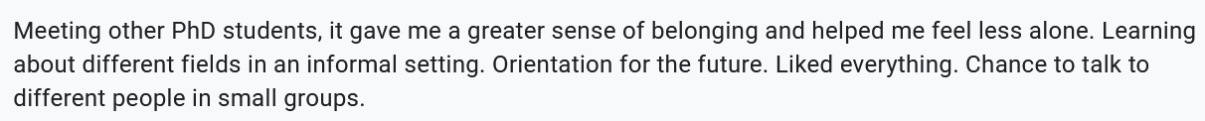
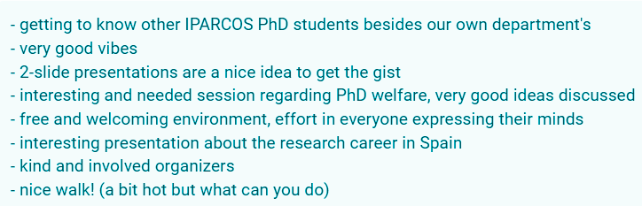
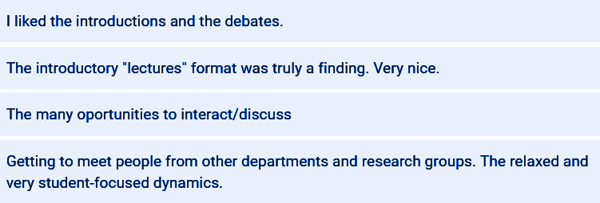
Pros
Cons
Community and well-being:
- Breaking isolation
- Relaxed atmosphere
- The excursion: favorite activity
2-Slide Presentations & Round Tables:
Knowing each other
- "PhD welfare," "problem management,"
"Research careers in Spain"
⇒ Necessary and highly valued
Space to improve IPARCOS
& their own research groups

Slide 19
Pros
Cons
Duration & schedule:
- Too short (48h) ⇒ 1 extra day?
- More often & deeper
- PhD involvement
Structure of the sessions:
Context? ⇒ General Group overview?
Tools session ⇒ Better structured
⇒ Hands-on/practical?
Social:
Natural tendency to stick with own group
⇒ More “mixing” activities?

Slide 20
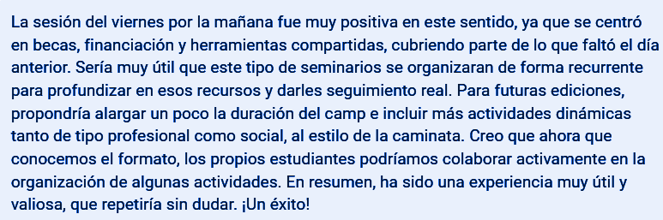

Pros
Cons
Duration & schedule:
- Too short (48h) ⇒ 1 extra day?
- More often & deeper
- PhD involvement
Structure of the sessions:
Context? ⇒ General Group overview?
Tools session ⇒ Better structured
⇒ Hands-on/practical?
Social:
Natural tendency to stick with own group
⇒ More “mixing” activities?

Slide 21

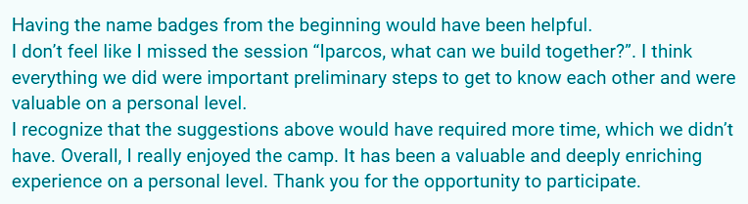
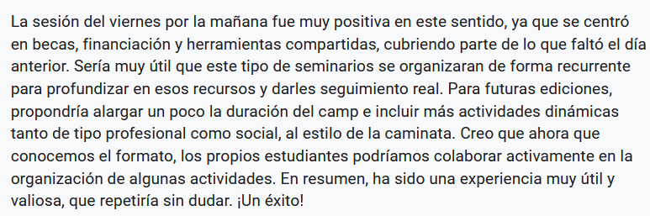


Pros
Cons
Duration & schedule:
- Too short (48h) ⇒ 1 extra day?
- More often & deeper
- PhD involvement
Structure of the sessions:
Context? ⇒ General Group overview?
Tools session ⇒ Better structured
⇒ Hands-on/practical?
Social:
Natural tendency to stick with own group
⇒ More “mixing” activities?

Slide 22

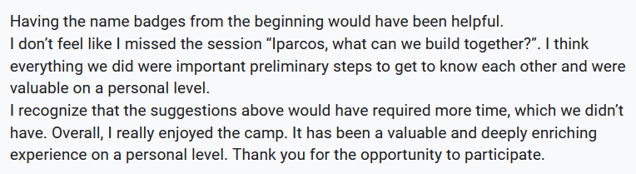
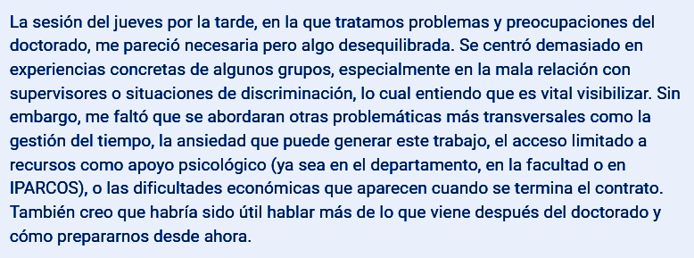

Pros
Cons
Duration & schedule:
- Too short (48h) ⇒ 1 extra day?
- More often & deeper
- PhD involvement
Structure of the sessions:
Context? ⇒ General Group overview?
Tools session ⇒ Better structured
⇒ Hands-on/practical?
Social:
Natural tendency to stick with own group
⇒ More “mixing” activities?

Slide 23


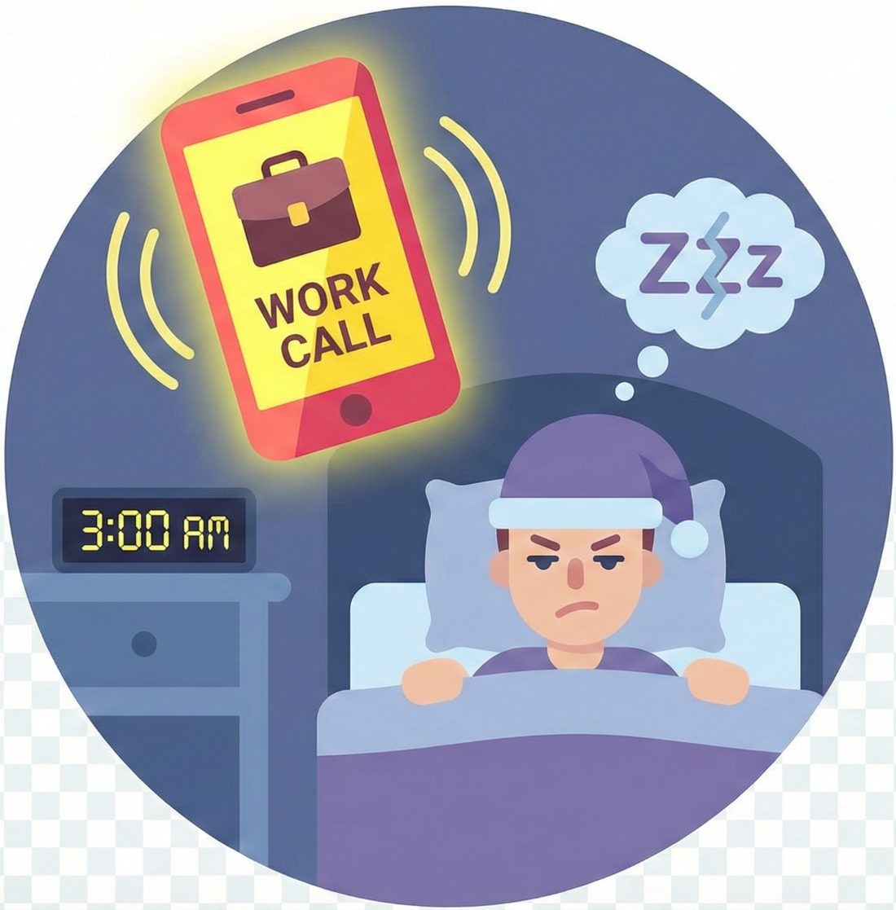
Some important indications to remark:
Senior ⇔ Junior relation should be respectful
The working time of the others should be respected
The non-working time of the others should be respected

Slide 24
How was it ? (In our humble opinion)
It felt good,
It felt like a team of highly motivated people,
It felt like belonging to a group,
It felt like our young researchers are expecting more from us
and they are ready and want to do more

Slide 25
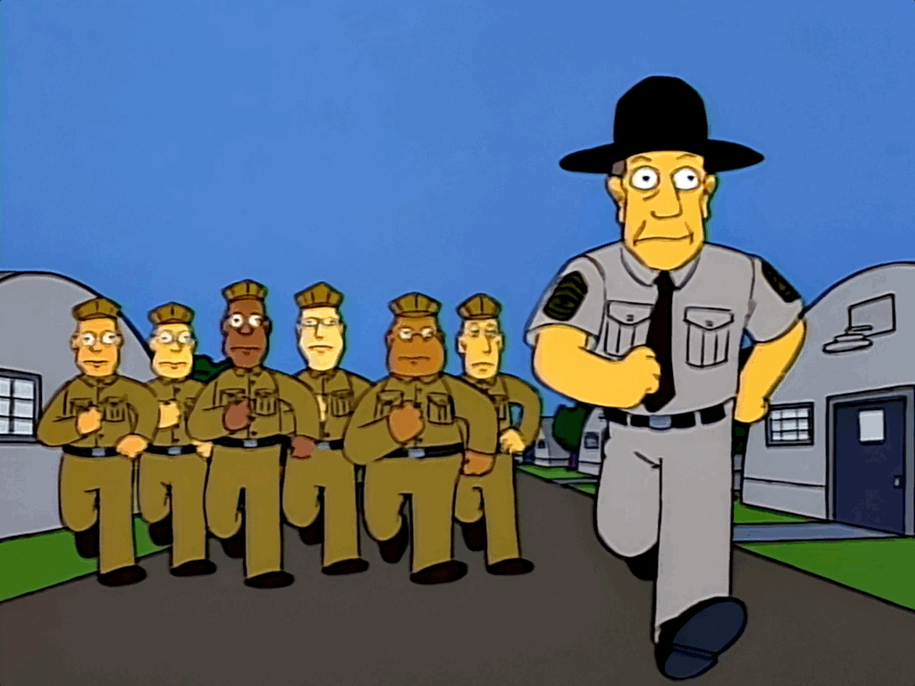
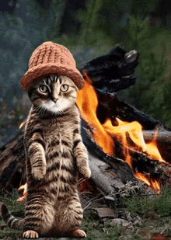
Next editions?
IPARCOS
Clearly in favour
IPARCOS Camp 2026?
Intellectual authorship:
J.Martínez Martín

Slide 26
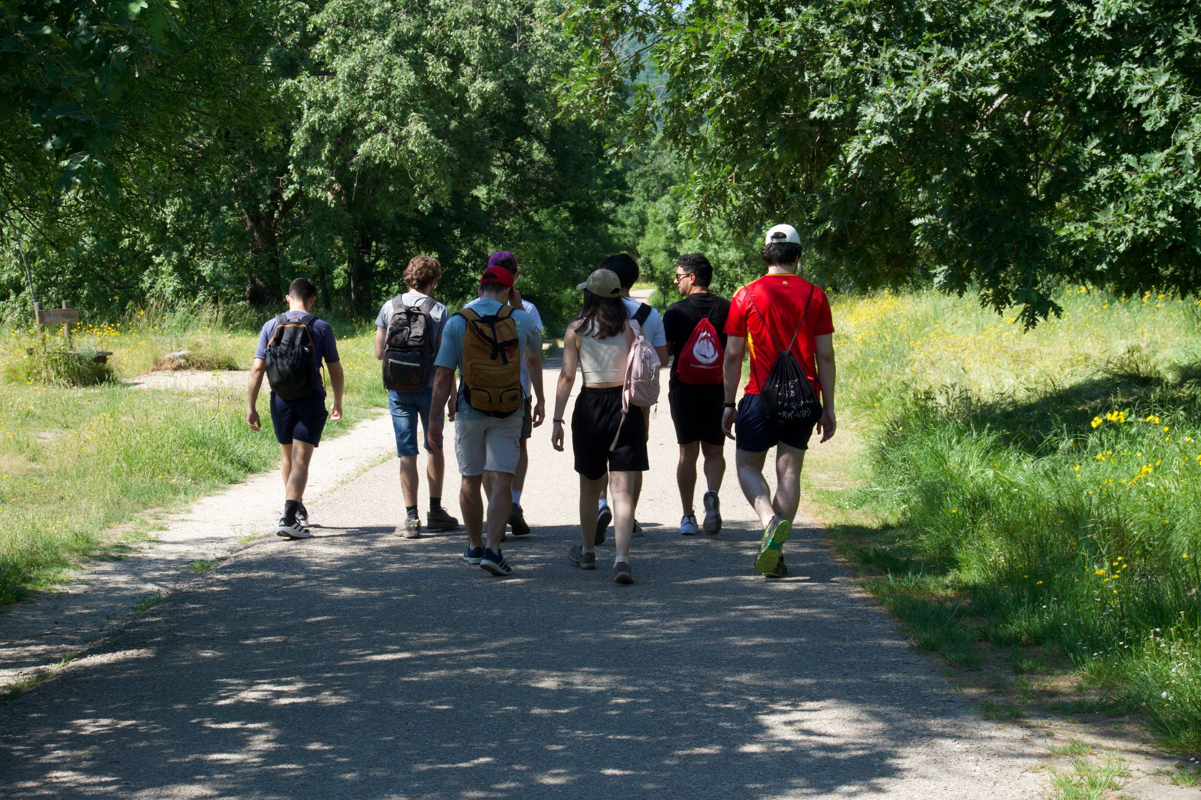
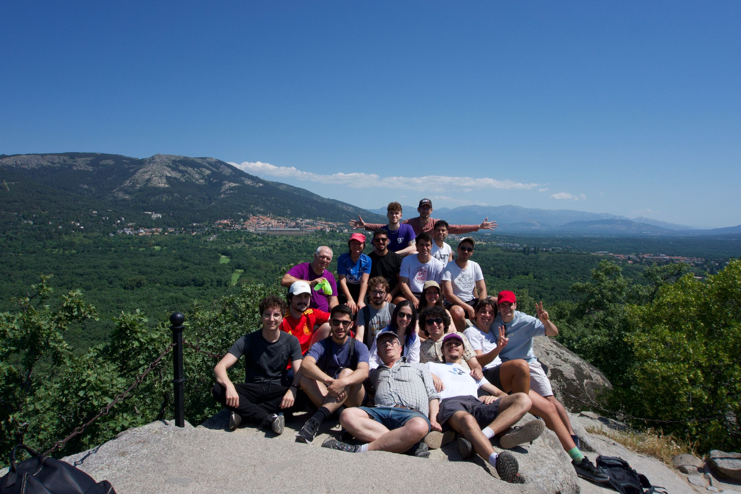
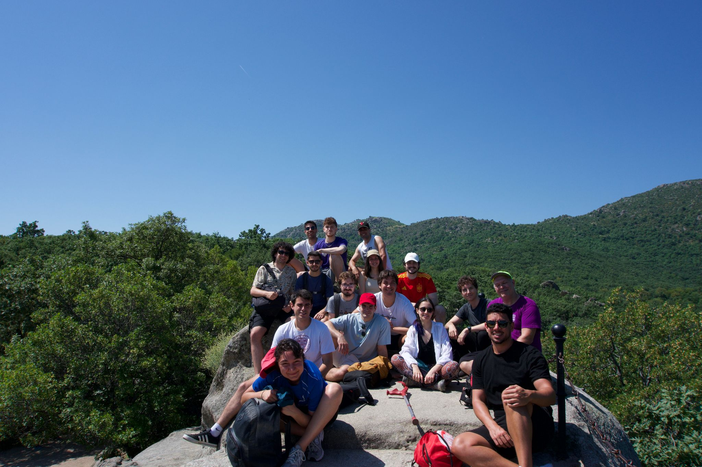
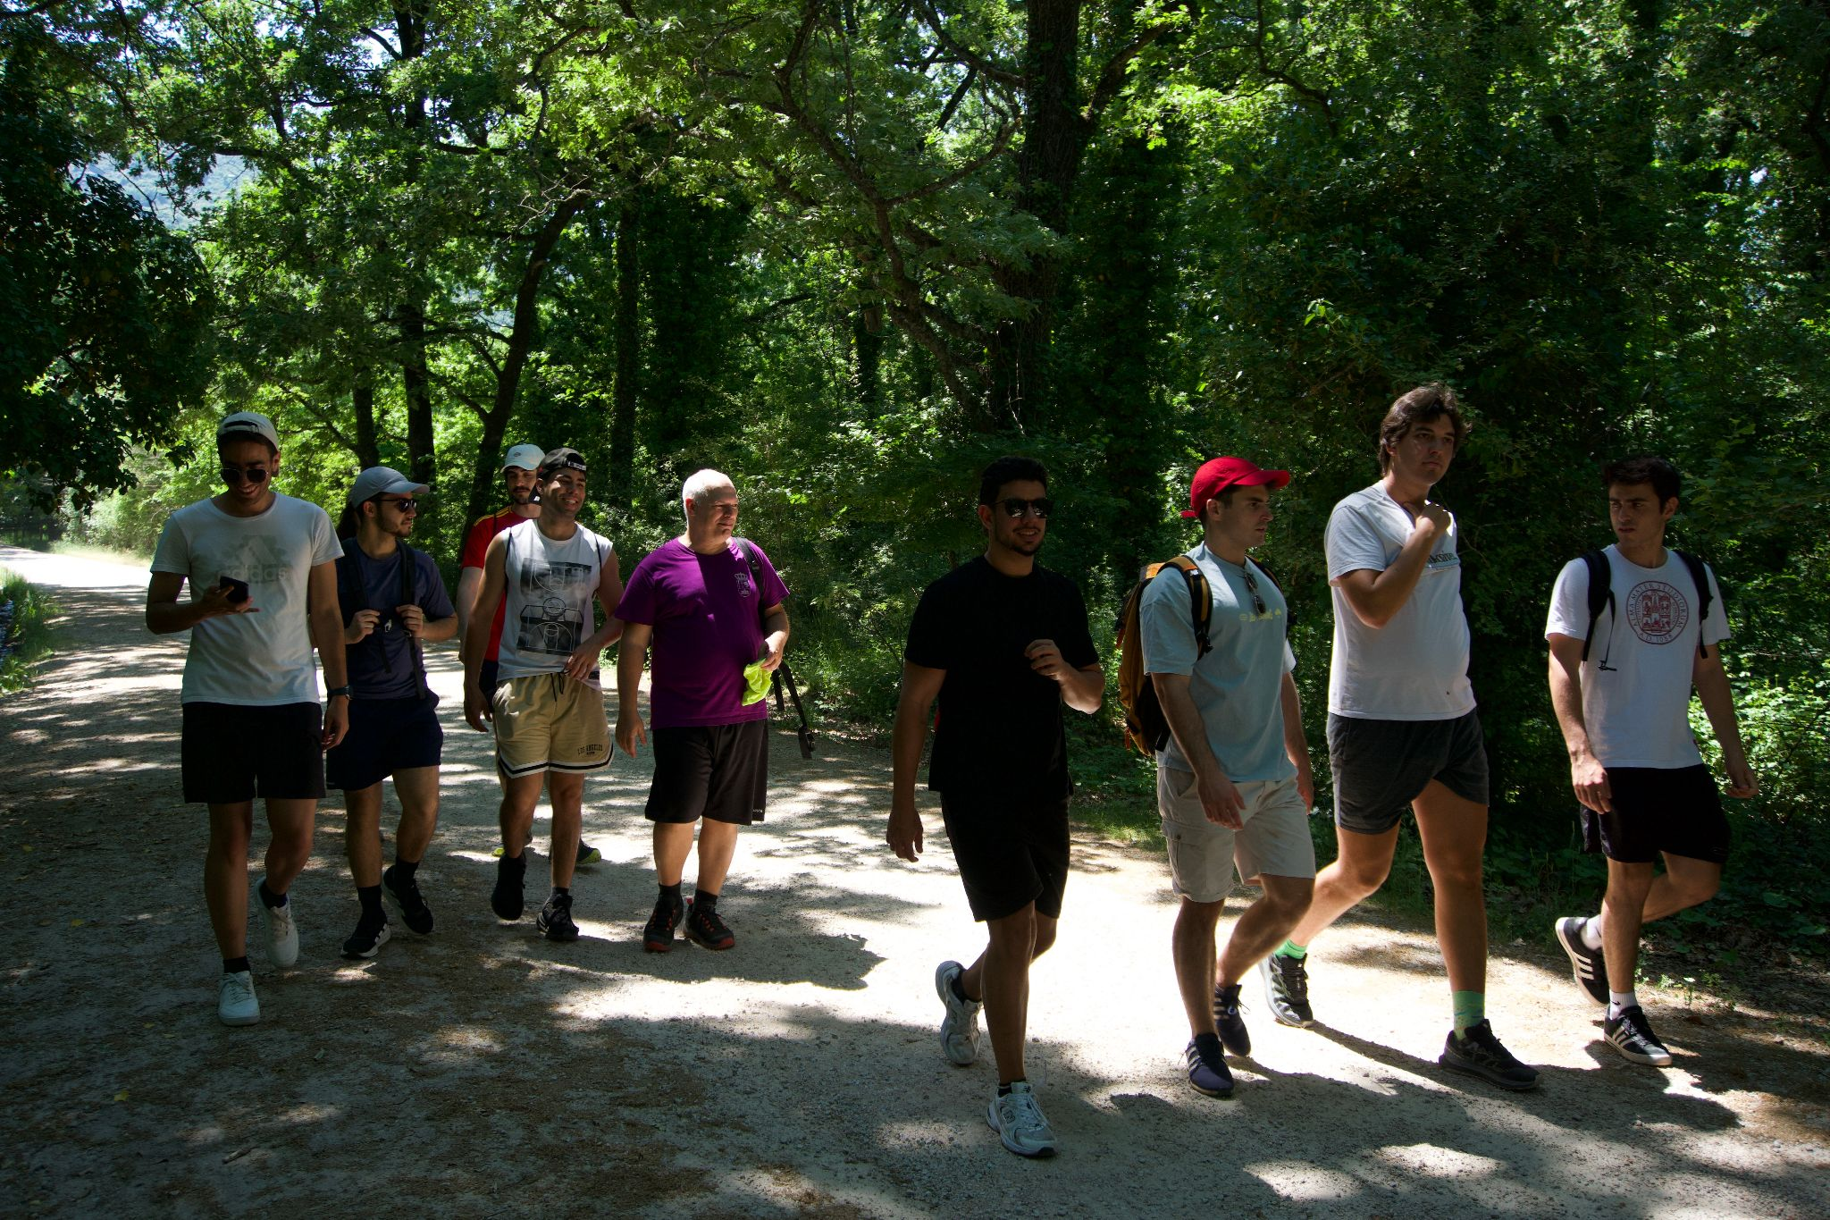
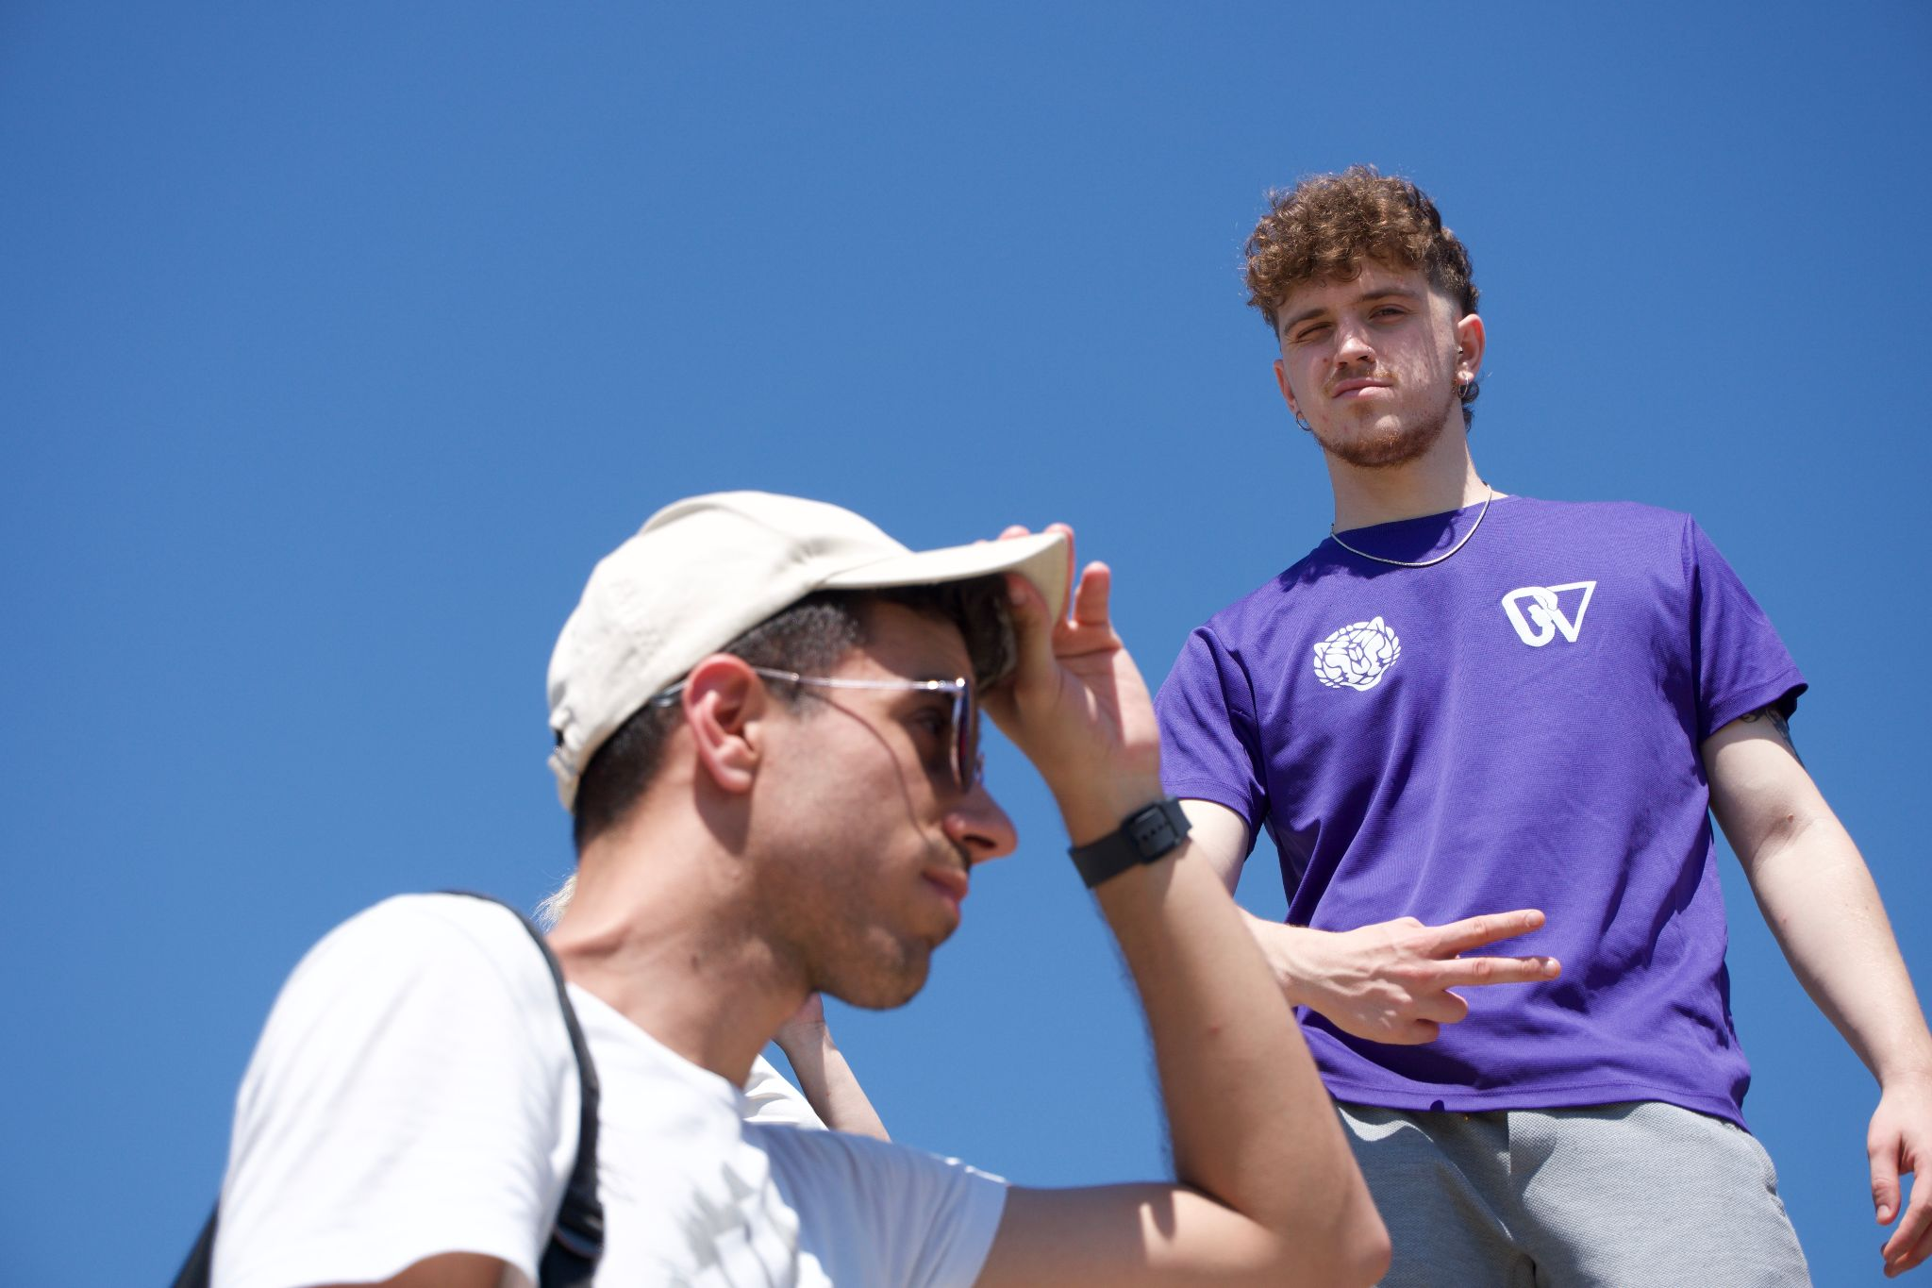
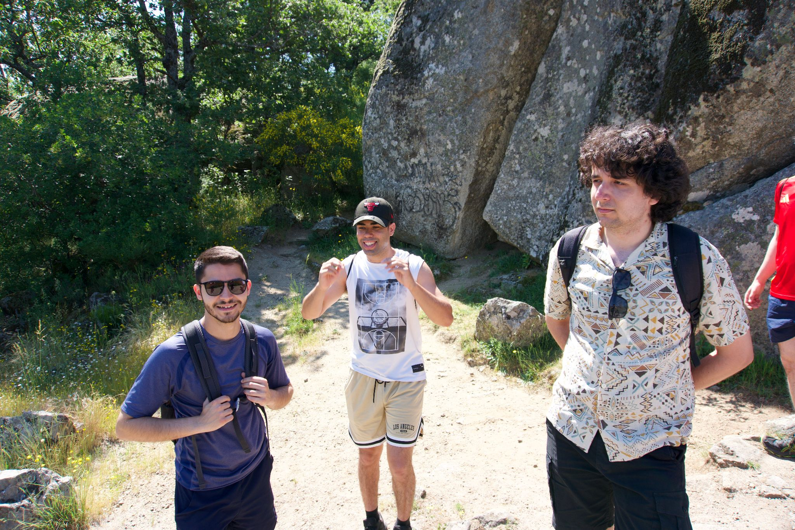
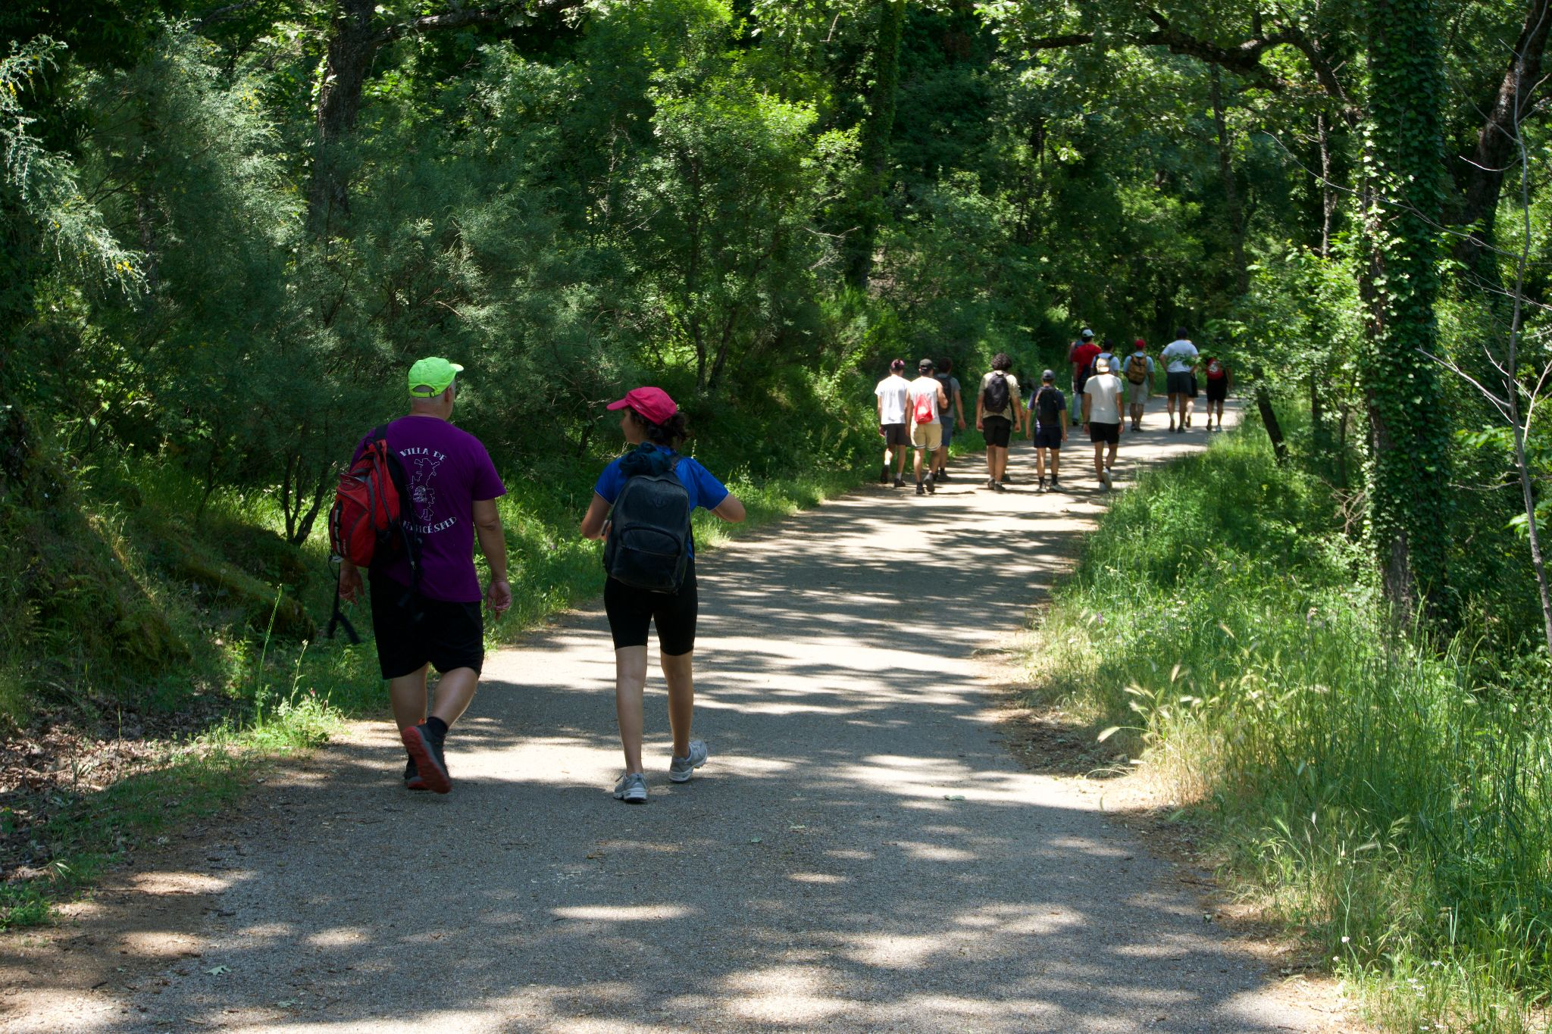
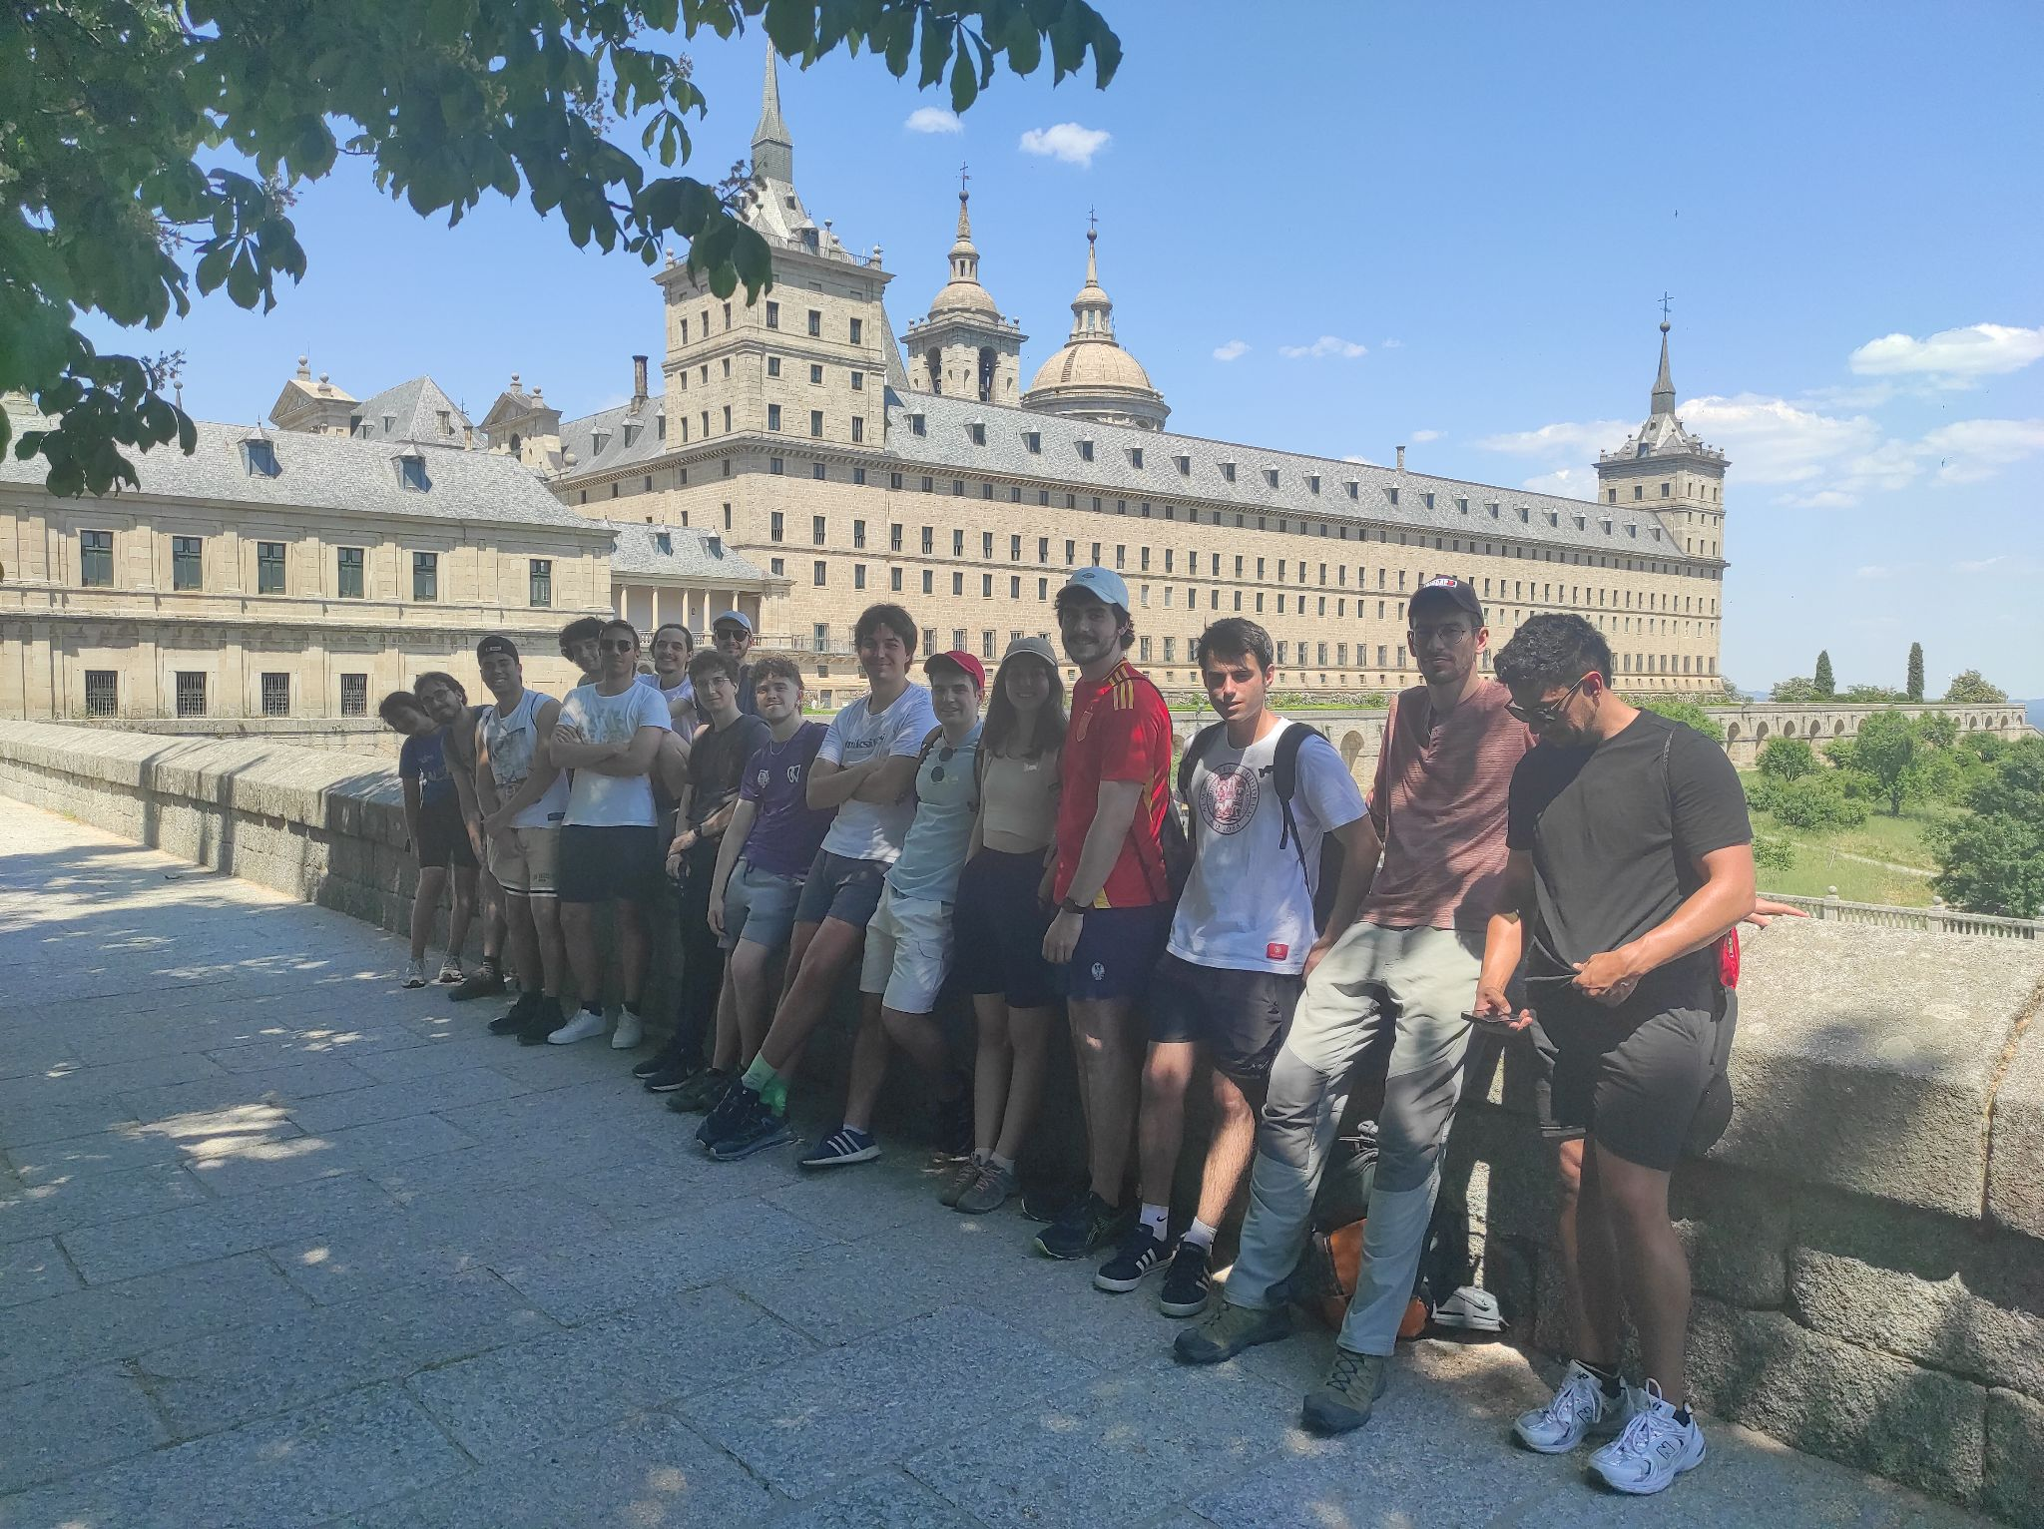
Photocall
(Especial thanks
to Guillermo)

Slide 27
Backup

