Slide 1


Chemical
characterization
of M dwarfs
Christian Duque Arribas
* * * * * *
2025
Wrapped
T h e s i s e d i t i o n

Slide 2
Chemical
characterization
of M dwarfs
Christian Duque Arribas
* * * * * *
2025
Wrapped
T h e s i s e d i t i o n

Slide 3





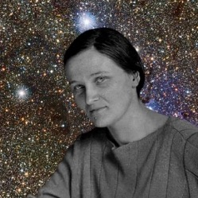
01:00
Solar composition
Metals
1.39%
Top researcher
Cecilia Payne-Gaposchkin
#1 to discover that stars are
mainly composed of H and He.
Asplund et al. (2021)
PhD thesis – 1925
Christian Duque Arribas

Slide 4

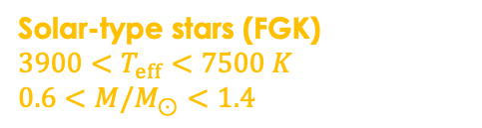
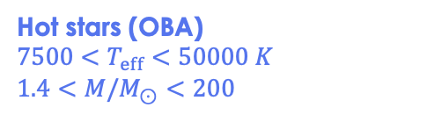
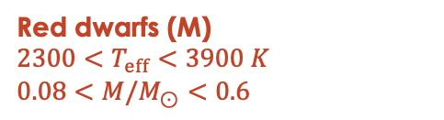
In the 10pc sample (Reyle et al. 2021)
249
Hot stars (OBA)
$$7500<T_{eff}<50000 K$$
$$1.4<{M/M}_{⊙}<200$$
Solar neighbourhood
Solar-type stars (FGK)
$$3900<T_{eff}<7500 K$$
$$0.6<{M/M}_{⊙}<1.4$$
Red dwarfs (M)
$$2300<T_{eff}<3900 K$$
$$0.08<{M/M}_{⊙}<0.6$$
out of the 317 stars are M-type stars.
Your stars are trending.
Share this story
Christian Duque Arribas

Slide 5
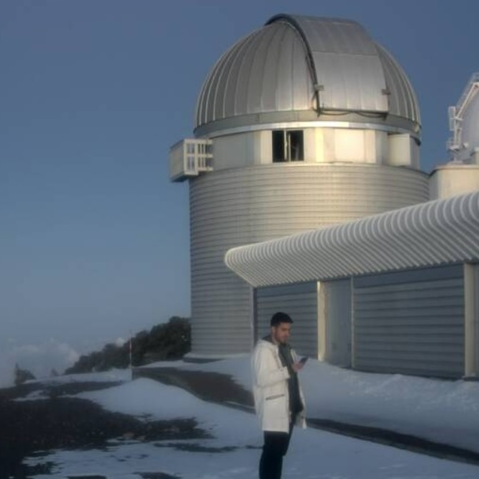
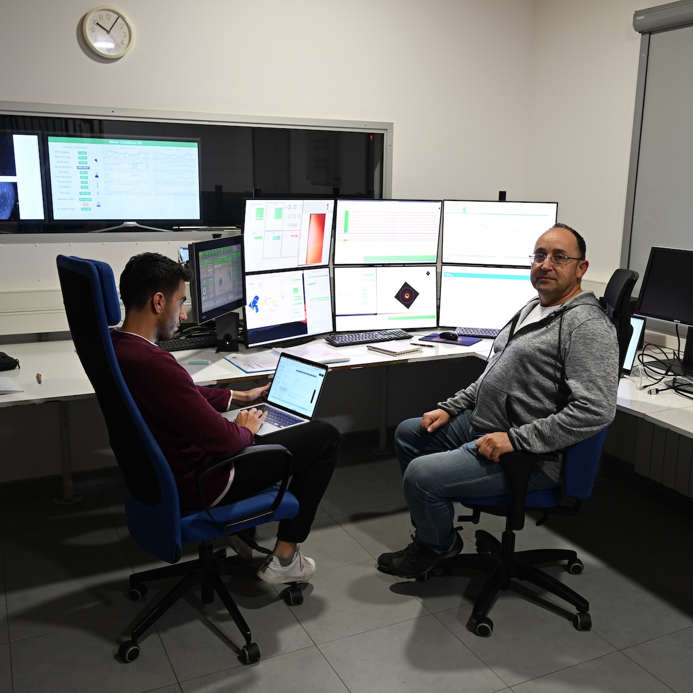
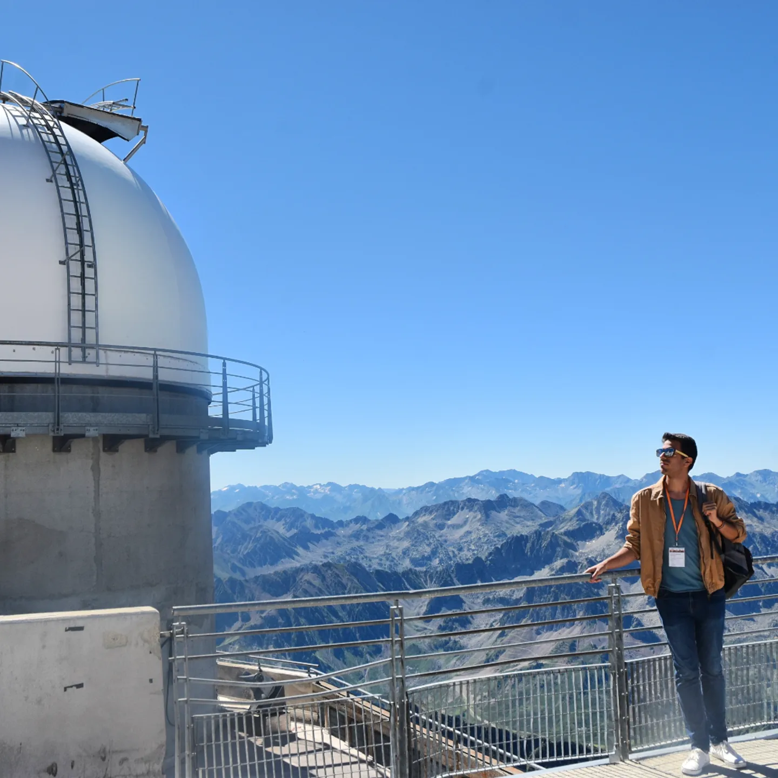
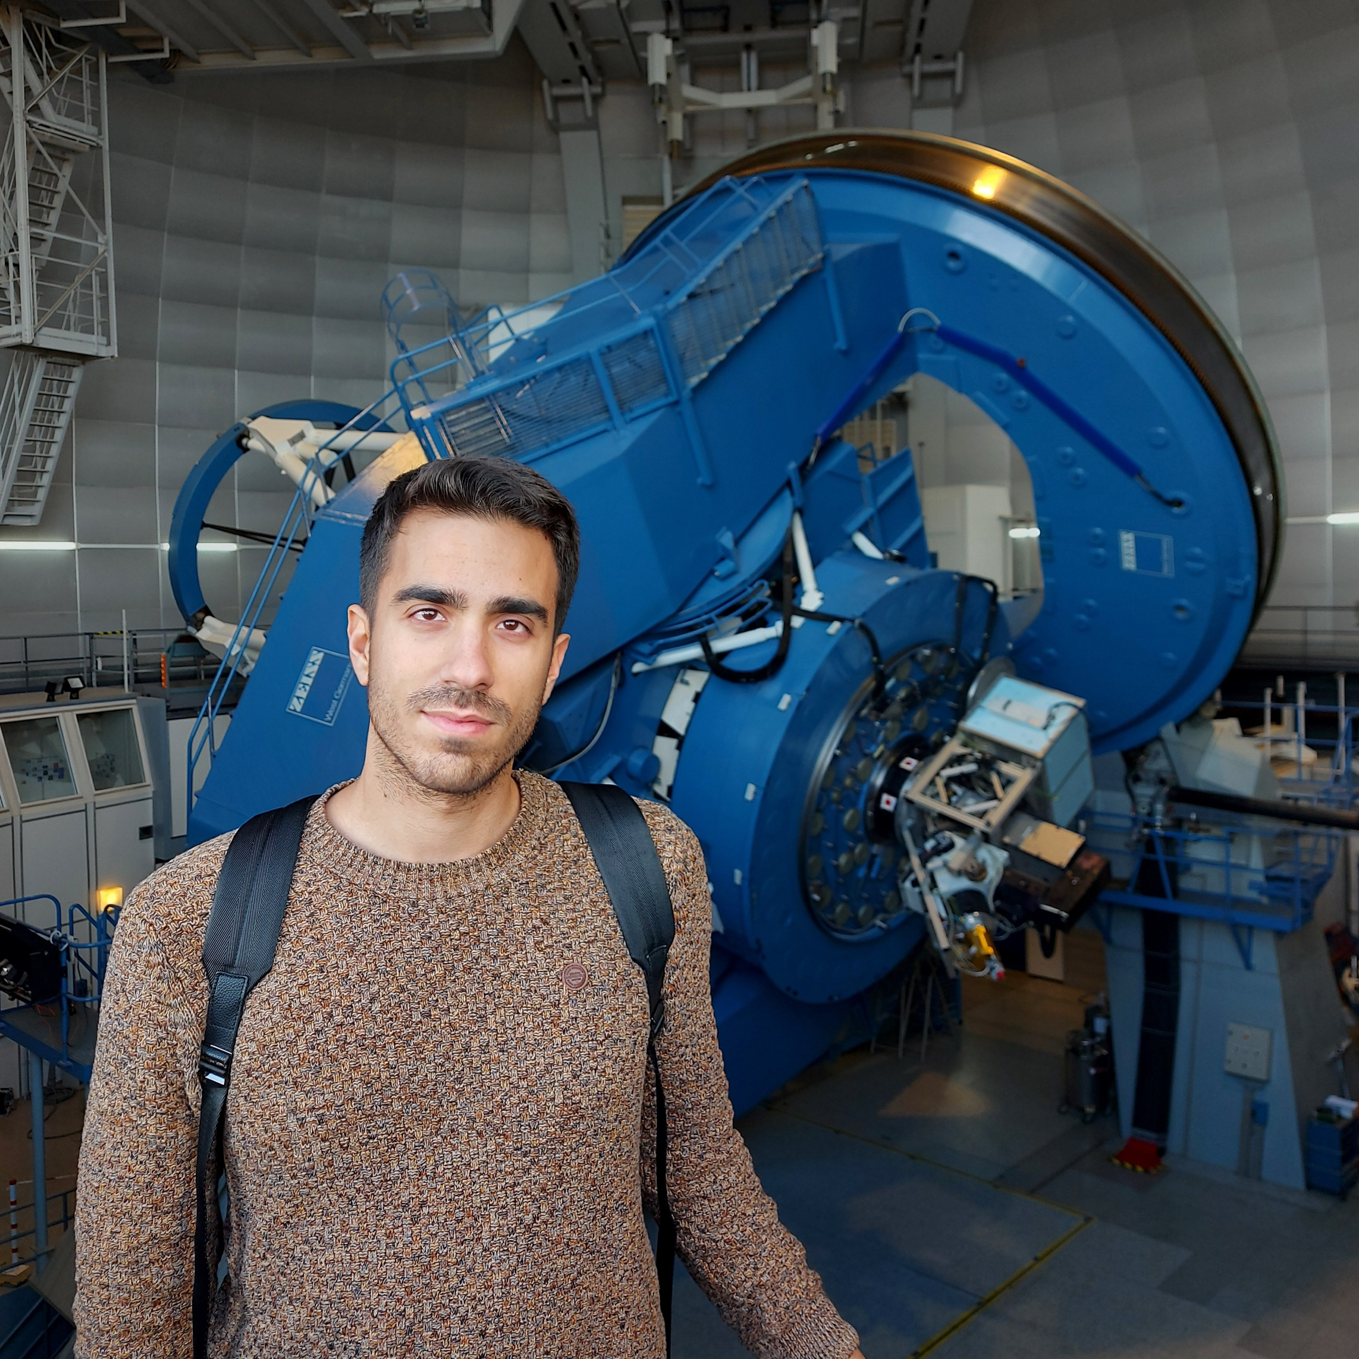



03:00
2024
2025
2026
202X
Top instrument
Top abundances
Top surveys
Top methodologies
Top instrument
Top R packages
Top instrument
Top proposals
HERMES
@Mercator
Carbon
Oxygen
Scandium
Vanadium
Manganese
Cobalt
Gaia DR3
2MASS
CatWISE
Bayesian fits
Neural Networks
CAFOS
@ 2.2m CAHA
projpred
brms
loo
bayesplot
CARMENES
@ 3.5m CAHA
23A-3.5-010 (36h)
23B-3.5-009 (23h)
24A-3.5-007 (20h)
24B-3.5-008 (29h)
Stars analysed
Top Genre
Stars included
Top Genre
Stars analysed
Top Genre
New observations
Top Genre
179
High-res
+4900
Photometry
+770
Low-res
+200 spectra
44 stars
High-res
DUQUE-ARRIBAS ET AL. 2024
DUQUE-ARRIBAS ET AL. 2023, 2025
DUQUE-ARRIBAS ET AL. (IN PREP)
WORK IN PROGRESS
Christian Duque Arribas

Slide 6
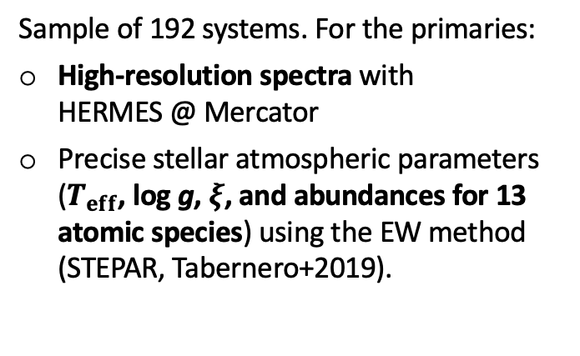

04:00
Sample of 192 systems. For the primaries:
High-resolution spectra with HERMES @ Mercator
Precise stellar atmospheric parameters ($T_{eff}$, log g, $ξ$, and abundances for 13 atomic species) using the EW method (STEPAR, Tabernero+2019).
Your Top Literature
2024
2025
2026
202X
2006
Woolf & Wallerstein
2006
Bean et al.
2010
Rojas-Ayala et al.
2012
Terrien et al.
Top instrument
Top abundances
2013
Mann et al.
Top surveys
Top methodologies
Top instrument
Top R packages
Top instrument
Top proposals
HERMES
@Mercator
Carbon
Oxygen
Scandium
Vanadium
Manganese
Cobalt
Gaia DR3
2MASS
CatWISE
Bayesian fits
Neural Networks
CAFOS
@ 2.2m CAHA
projpred
brms
loo
bayesplot
CARMENES
@ 3.5m CAHA
23A-3.5-010 (36h)
23B-3.5-009 (23h)
24A-3.5-007 (20h)
24B-3.5-008 (29h)
2014
Newton et al.
2018
Montes et al.
2020
Ishikawa et al.
Stars analysed
Top Genre
2020
Souto et al.
Determine new abundances of C and O
Update the abundances of Sc, V, Mn, Co taking into account HFS and NLTE effects.
Stars included
Top Genre
Stars analysed
Top Genre
New observations
Top Genre
179
High-res
+4900
Photometry
+770
Low-res
+200 spectra
44 stars
High-res
2024
Duque-Arribas et al.
DUQUE-ARRIBAS ET AL. 2024
DUQUE-ARRIBAS ET AL. 2023, 2025
DUQUE-ARRIBAS ET AL. (IN PREP)
WORK IN PROGRESS
Christian Duque Arribas

Slide 7
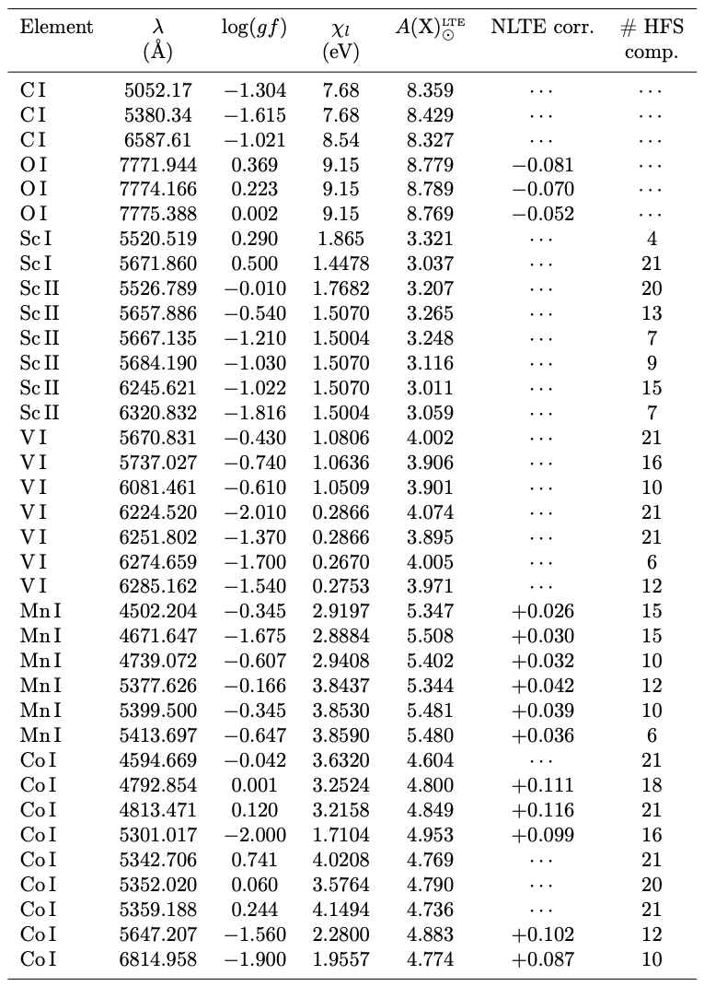
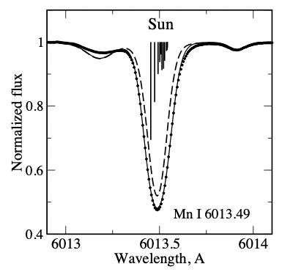
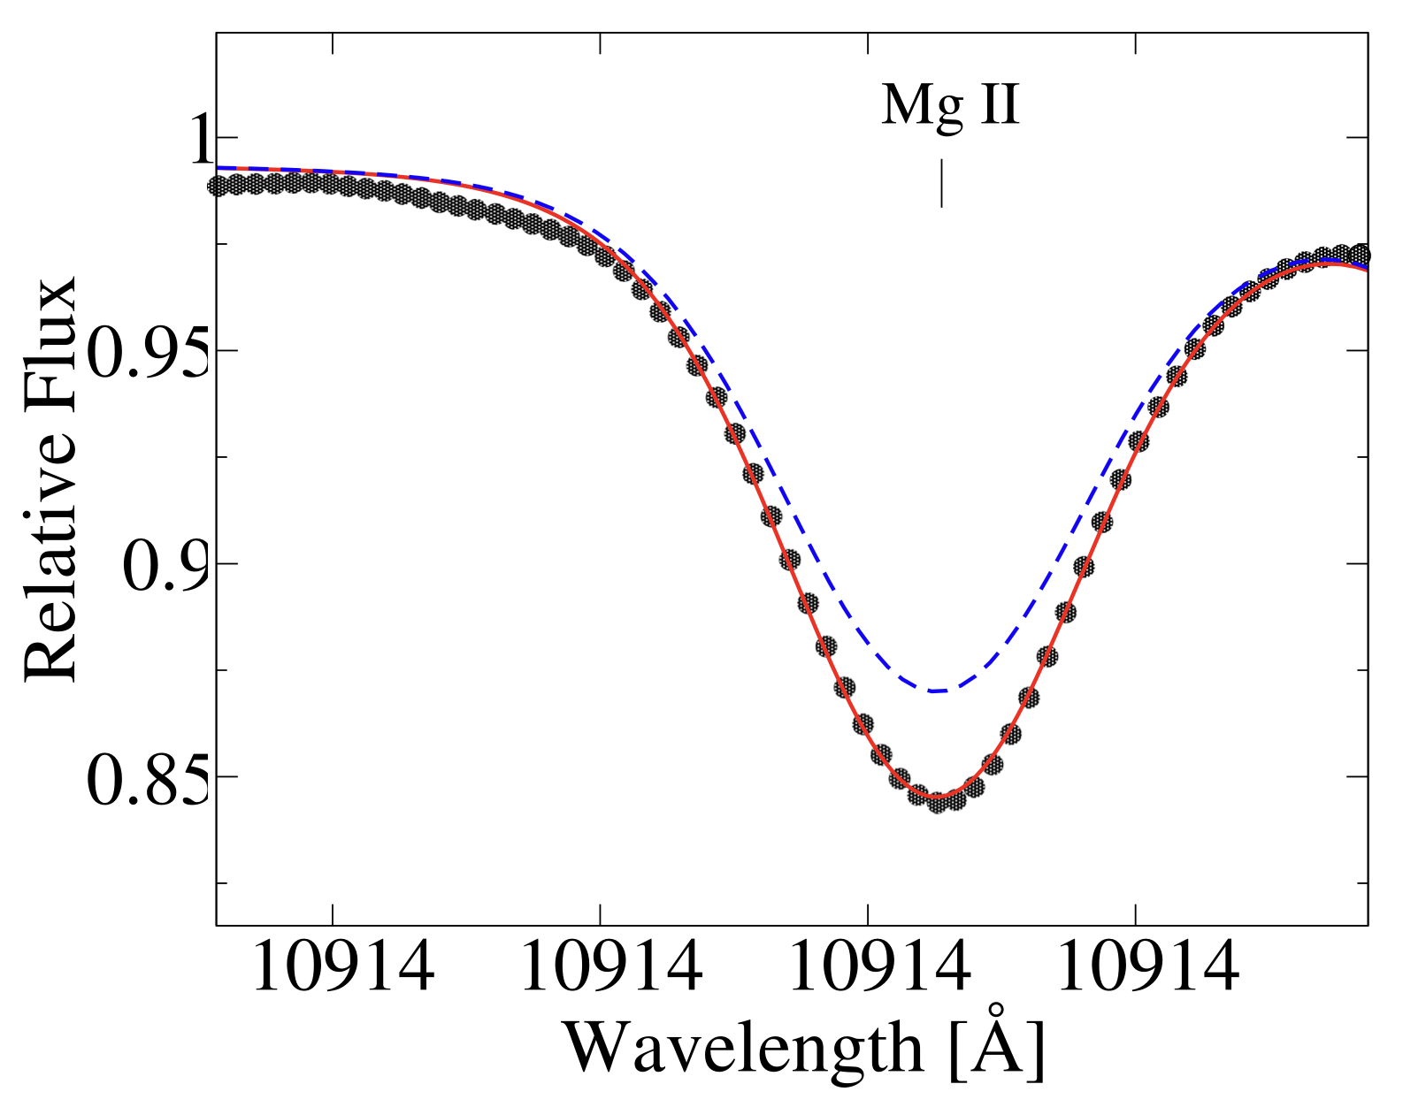
05:00
Line list
HFS and NLTE effects in Mn I and Mn II lines
2024
2025
2026
202X
LTE
NLTE
Top instrument
Top abundances
Top surveys
Top methodologies
Top instrument
Top R packages
Top instrument
Top proposals
HERMES
@Mercator
Carbon
Oxygen
Scandium
Vanadium
Manganese
Cobalt
Gaia DR3
2MASS
CatWISE
Bayesian fits
Neural Networks
CAFOS
@ 2.2m CAHA
projpred
brms
loo
bayesplot
CARMENES
@ 3.5m CAHA
23A-3.5-010 (36h)
23B-3.5-009 (23h)
24A-3.5-007 (20h)
24B-3.5-008 (29h)
High-resolution spectra
Stars analysed
Top Genre
Minutes Listened
Top Genre
Stars analysed
Top Genre
New observations
Top Genre
179
High-res
21,971
Photometry
+700?
Low-res
+200 spectra
44 stars
High-res
DUQUE-ARRIBAS ET AL. 2024
DUQUE-ARRIBAS ET AL. 2023, 2025
DUQUE-ARRIBAS ET AL. (IN PREP)
WORK IN PROGRESS
Christian Duque Arribas

Slide 8
06:00
C
O
C/O
2024
2025
2026
202X
Top instrument
Top abundances
Sc
Mn
Top surveys
Top methodologies
Top instrument
Top R packages
Top instrument
Top proposals
HERMES
@Mercator
Carbon
Oxygen
Scandium
Vanadium
Manganese
Cobalt
Gaia DR3
2MASS
CatWISE
Bayesian fits
Neural Networks
CAFOS
@ 2.2m CAHA
projpred
brms
loo
bayesplot
CARMENES
@ 3.5m CAHA
23A-3.5-010 (36h)
23B-3.5-009 (23h)
24A-3.5-007 (20h)
24B-3.5-008 (29h)
Stars analysed
Top Genre
Minutes Listened
Top Genre
Stars analysed
Top Genre
New observations
Top Genre
179
High-res
21,971
Photometry
+700?
Low-res
+200 spectra
44 stars
High-res
DUQUE-ARRIBAS ET AL. 2024
DUQUE-ARRIBAS ET AL. 2023, 2025
DUQUE-ARRIBAS ET AL. (IN PREP)
WORK IN PROGRESS
Christian Duque Arribas

Slide 9
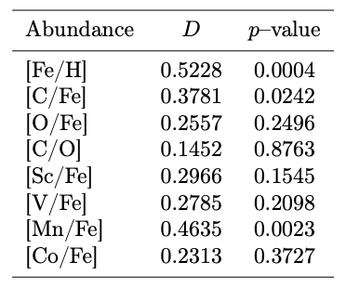
07:00
Exoplanets
2024
We have 24 exoplanets in 17 planetary systems around the FGK primaries.
We perform a K-S test to evaluate the disparity between stars with and without exoplanets, finding that only the [Fe/H], [C/Fe] and [Mn/Fe] distributions of host and single stars are different.
It might indicate that other species than iron also play an important role in the planet formation mechanisms.
2025
2026
202X
Top instrument
Top abundances
Top surveys
Top methodologies
Top instrument
Top R packages
Top instrument
Top proposals
HERMES
@Mercator
Carbon
Oxygen
Scandium
Vanadium
Manganese
Cobalt
Gaia DR3
2MASS
CatWISE
Bayesian fits
Neural Networks
CAFOS
@ 2.2m CAHA
projpred
brms
loo
bayesplot
CARMENES
@ 3.5m CAHA
23A-3.5-010 (36h)
23B-3.5-009 (23h)
24A-3.5-007 (20h)
24B-3.5-008 (29h)
Stars analysed
Top Genre
Stars included
Top Genre
Stars analysed
Top Genre
New observations
Top Genre
179
High-res
+4900
Photometry
+770
Low-res
+200 spectra
44 stars
High-res
DUQUE-ARRIBAS ET AL. 2024
DUQUE-ARRIBAS ET AL. 2023, 2025
DUQUE-ARRIBAS ET AL. (IN PREP)
WORK IN PROGRESS
Christian Duque Arribas

Slide 10
08:00
Your Top Photometric bands
2024
2025
Multi-colour photometry measures the energy output of a star across several wavebands
2026
202X
Top instrument
Top abundances
Top surveys
Top methodologies
Top instrument
Top R packages
Top instrument
Top proposals
HERMES
@Mercator
Carbon
Oxygen
Scandium
Vanadium
Manganese
Cobalt
Gaia DR3
2MASS
CatWISE
Bayesian fits
Neural Networks
CAFOS
@ 2.2m CAHA
projpred
brms
loo
bayesplot
CARMENES
@ 3.5m CAHA
23A-3.5-010 (36h)
23B-3.5-009 (23h)
24A-3.5-007 (20h)
24B-3.5-008 (29h)
Stars analysed
Top Genre
Stars included
Top Genre
Stars analysed
Top Genre
New observations
Top Genre
179
High-res
+4900
Photometry
+770
Low-res
+200 spectra
44 stars
High-res
DUQUE-ARRIBAS ET AL. 2024
DUQUE-ARRIBAS ET AL. 2023, 2025
DUQUE-ARRIBAS ET AL. (IN PREP)
WORK IN PROGRESS
Christian Duque Arribas

Slide 11
09:00
Your Top Literature
2024
2025
1986
Stauffer & Hartmann
2026
202X
2005
Bonfils et al.
2009
Johnson & Apps
2010
Schlaufman & Laughlin
2012
Neves et al. / Johnson et al.
Top instrument
Top abundances
Top surveys
Top methodologies
2013
Mann et al.
Top instrument
Top R packages
Top instrument
Top proposals
HERMES
@Mercator
Carbon
Oxygen
Scandium
Vanadium
Manganese
Cobalt
Gaia DR3
2MASS
CatWISE
Bayesian fits
Neural Networks
2015
Hejazi et al.
CAFOS
@ 2.2m CAHA
projpred
brms
loo
bayesplot
CARMENES
@ 3.5m CAHA
23A-3.5-010 (36h)
23B-3.5-009 (23h)
24A-3.5-007 (20h)
24B-3.5-008 (29h)
2016
Dittmann et al. / Schmidt et al.
2019
Davenport & Dorn-Wallenstein
Stars analysed
Top Genre
Stars included
Top Genre
2021
Medan et al. / Rains et al.
Stars analysed
Top Genre
New observations
Top Genre
179
High-res
+4900
Photometry
2023
Duque-Arribas et al.
+770
Low-res
+200 spectra
44 stars
High-res
2025
Duque-Arribas et al.
DUQUE-ARRIBAS ET AL. 2024
DUQUE-ARRIBAS ET AL. 2023, 2025
DUQUE-ARRIBAS ET AL. (IN PREP)
WORK IN PROGRESS
Christian Duque Arribas

Slide 12

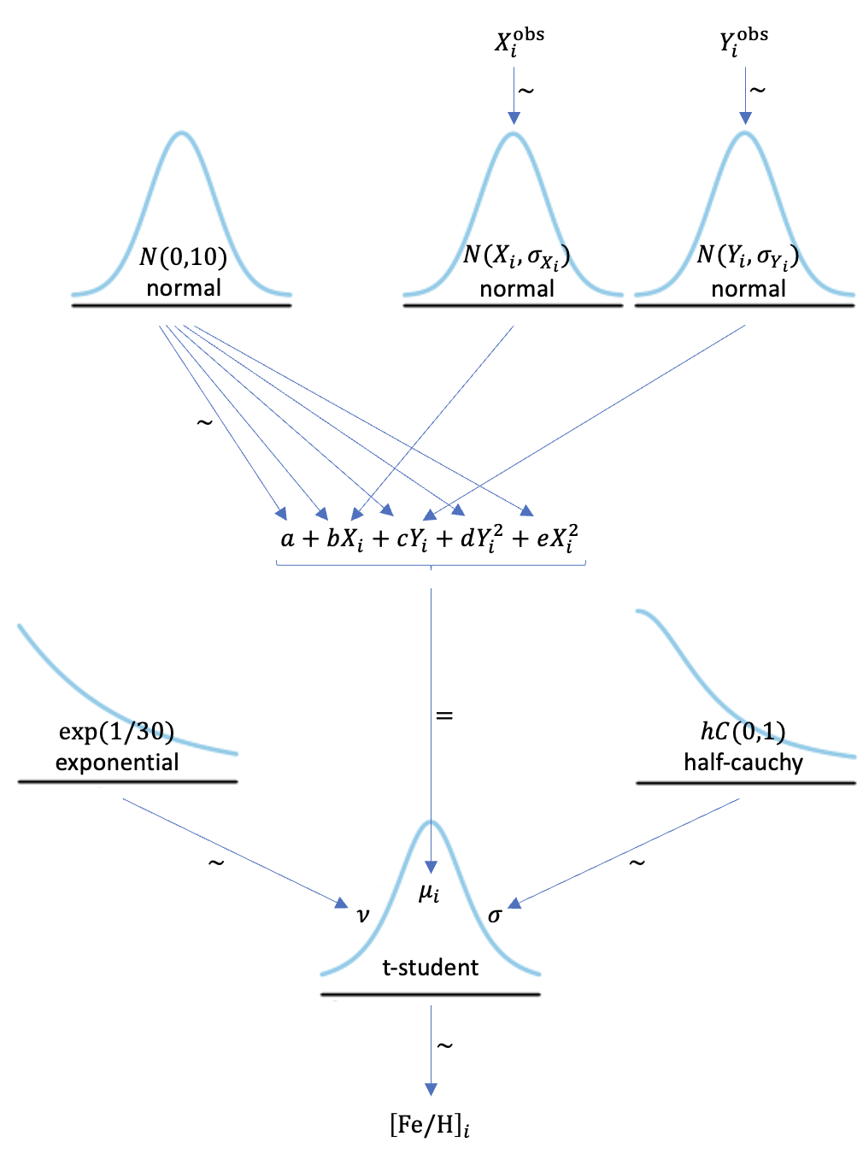
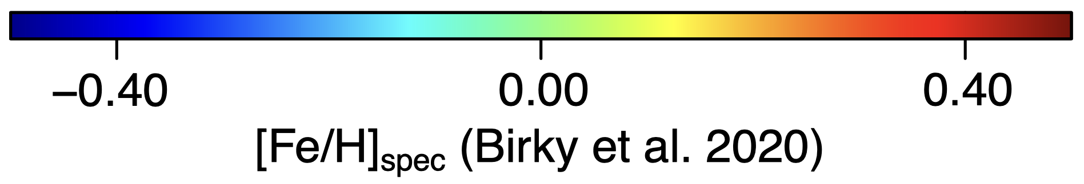
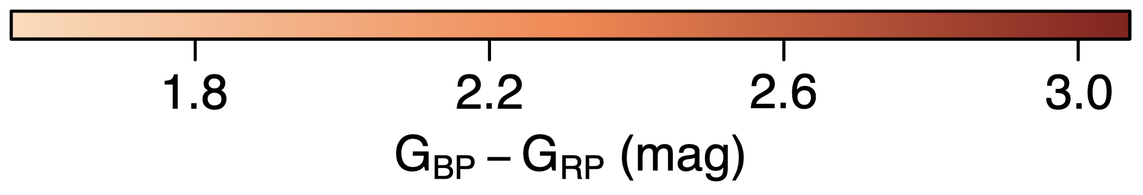
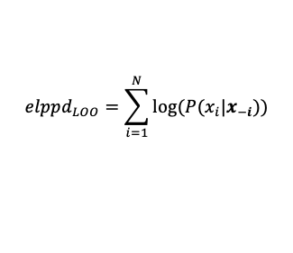
10:00
HR
diagram
Bayesian statistics
2024
2025
Results
2026
202X
$$elppd_{LOO}=\sum_{i=1}^{N}{\log{(P(x_{i}|x_{−i}))}}$$
Top instrument
Top abundances
Top surveys
Top methodologies
Top instrument
Top R packages
Top instrument
Top proposals
HERMES
@Mercator
Carbon
Oxygen
Scandium
Vanadium
Manganese
Cobalt
Gaia DR3
2MASS
CatWISE
Bayesian fits
Neural Networks
CAFOS
@ 2.2m CAHA
projpred
brms
loo
bayesplot
CARMENES
@ 3.5m CAHA
23A-3.5-010 (36h)
23B-3.5-009 (23h)
24A-3.5-007 (20h)
24B-3.5-008 (29h)
Stars analysed
Top Genre
Stars included
Top Genre
Stars analysed
Top Genre
New observations
Top Genre
179
High-res
+4900
Photometry
+770
Low-res
+200 spectra
44 stars
High-res
DUQUE-ARRIBAS ET AL. 2024
DUQUE-ARRIBAS ET AL. 2023, 2025
DUQUE-ARRIBAS ET AL. (IN PREP)
WORK IN PROGRESS
Christian Duque Arribas

Slide 13
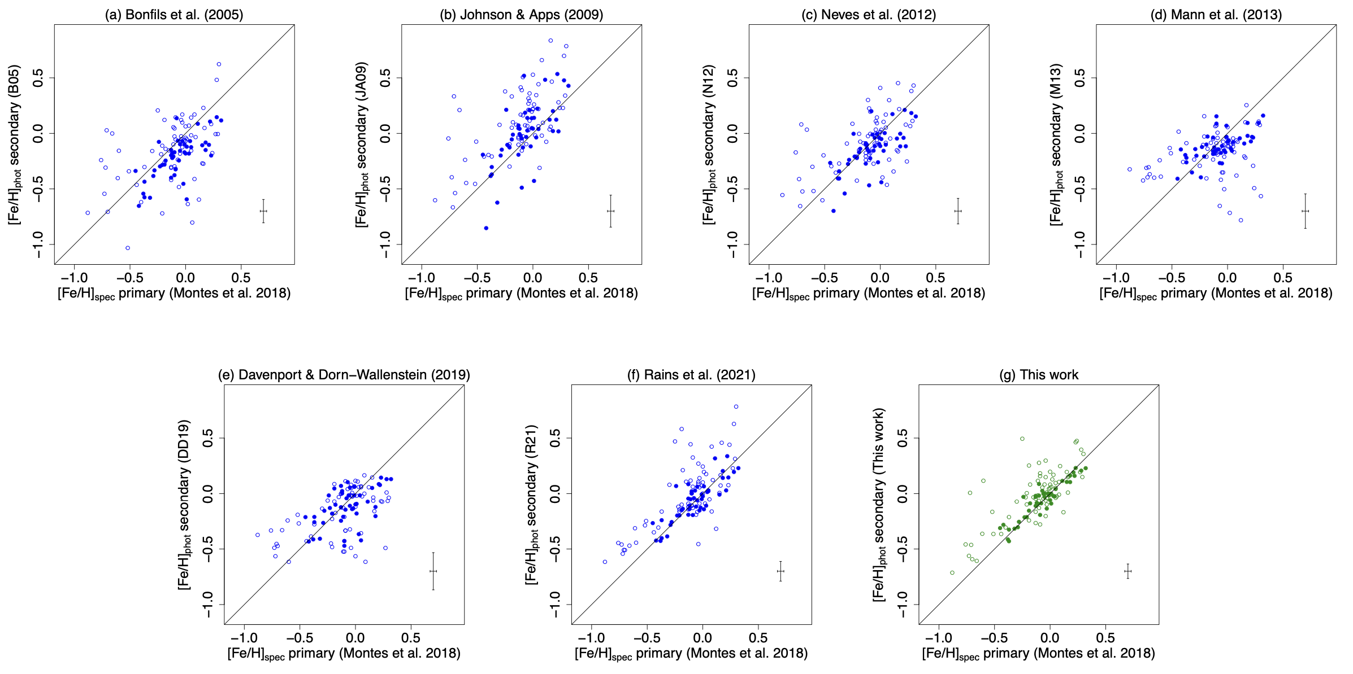
11:00
Comparisons with the literature
2024
2025
2026
202X
Top instrument
Top abundances
Top surveys
Top methodologies
Top instrument
Top R packages
Top instrument
Top proposals
HERMES
@Mercator
Carbon
Oxygen
Scandium
Vanadium
Manganese
Cobalt
Gaia DR3
2MASS
CatWISE
Bayesian fits
Neural Networks
CAFOS
@ 2.2m CAHA
projpred
brms
loo
bayesplot
CARMENES
@ 3.5m CAHA
23A-3.5-010 (36h)
23B-3.5-009 (23h)
24A-3.5-007 (20h)
24B-3.5-008 (29h)
Stars analysed
Top Genre
Stars included
Top Genre
Stars analysed
Top Genre
New observations
Top Genre
179
High-res
+4900
Photometry
+770
Low-res
+200 spectra
44 stars
High-res
DUQUE-ARRIBAS ET AL. 2024
DUQUE-ARRIBAS ET AL. 2023, 2025
DUQUE-ARRIBAS ET AL. (IN PREP)
WORK IN PROGRESS
Christian Duque Arribas

Slide 14

12:00
ANN architecture
2024
2025
Input layer: eight features, each corresponding to an absolute magnitude
Two hidden layers of 64 neurons fully connected
Output layer: a single neuron for regression
2026
202X
Top instrument
Top abundances
Top surveys
Top methodologies
Top instrument
Top R packages
Top instrument
Top proposals
HERMES
@Mercator
Carbon
Oxygen
Scandium
Vanadium
Manganese
Cobalt
Gaia DR3
2MASS
CatWISE
Bayesian fits
Neural Networks
Hyperparameter optimization with RandomizedSearchCV
Adam optimizer
Monte Carlo dropout: `posterior’ distribution instead of single estimates.
CAFOS
@ 2.2m CAHA
projpred
brms
loo
bayesplot
CARMENES
@ 3.5m CAHA
23A-3.5-010 (36h)
23B-3.5-009 (23h)
24A-3.5-007 (20h)
24B-3.5-008 (29h)
Stars analysed
Top Genre
Stars included
Top Genre
Stars analysed
Top Genre
New observations
Top Genre
179
High-res
+4900
Photometry
+770
Low-res
+200 spectra
44 stars
High-res
DUQUE-ARRIBAS ET AL. 2024
DUQUE-ARRIBAS ET AL. 2023, 2025
DUQUE-ARRIBAS ET AL. (IN PREP)
WORK IN PROGRESS
Christian Duque Arribas

Slide 15
13:00
Results for the test sample
Comparison with the binaries
2024
2025
2026
202X
Good-quality data
Not good-quality data
Top instrument
Top abundances
Top surveys
Top methodologies
Top instrument
Top R packages
Top instrument
Top proposals
HERMES
@Mercator
Carbon
Oxygen
Scandium
Vanadium
Manganese
Cobalt
Gaia DR3
2MASS
CatWISE
Bayesian fits
Neural Networks
CAFOS
@ 2.2m CAHA
projpred
brms
loo
bayesplot
CARMENES
@ 3.5m CAHA
23A-3.5-010 (36h)
23B-3.5-009 (23h)
24A-3.5-007 (20h)
24B-3.5-008 (29h)
Stars analysed
Top Genre
Stars included
Top Genre
Stars analysed
Top Genre
New observations
Top Genre
179
High-res
+4900
Photometry
+770
Low-res
+200 spectra
44 stars
High-res
DUQUE-ARRIBAS ET AL. 2024
DUQUE-ARRIBAS ET AL. 2023, 2025
DUQUE-ARRIBAS ET AL. (IN PREP)
WORK IN PROGRESS
Christian Duque Arribas

Slide 16


14:00
2024
2025
METaMorPHosis
METaMorPHosis-NN
2026
202X
Code available in
Github and through an
interactive web app!
github.com/chrduque/metamorphosis
chrduque.shinyapps.io/metamorphosis/
Code available in
Github as a
Jupyter Notebook!
github.com/chrduque/metamorphosis-NN
Top instrument
Top abundances
Top surveys
Top methodologies
Top instrument
Top R packages
Top instrument
Top proposals
HERMES
@Mercator
Carbon
Oxygen
Scandium
Vanadium
Manganese
Cobalt
Gaia DR3
2MASS
CatWISE
Bayesian fits
Neural Networks
CAFOS
@ 2.2m CAHA
projpred
brms
loo
bayesplot
CARMENES
@ 3.5m CAHA
23A-3.5-010 (36h)
23B-3.5-009 (23h)
24A-3.5-007 (20h)
24B-3.5-008 (29h)
Stars analysed
Top Genre
Stars included
Top Genre
Stars analysed
Top Genre
New observations
Top Genre
179
High-res
+4900
Photometry
+770
Low-res
+200 spectra
44 stars
High-res
DUQUE-ARRIBAS ET AL. 2024
DUQUE-ARRIBAS ET AL. 2023, 2025
DUQUE-ARRIBAS ET AL. (IN PREP)
WORK IN PROGRESS
Christian Duque Arribas

Slide 17
15:00
Low-resolution spectra for +770 M dwarfs (including 162 secondaries) using the Calar Alto Faint Object Spectrograph (CAFOS), at the 2.2m telescope of CAHA.
Optical spectrograph: 4200 – 8300 A
Low-resolution: ~1500
2024
2025
2026
202X
Top instrument
Top abundances
Top surveys
Top methodologies
Top instrument
Top R packages
Top instrument
Top proposals
HERMES
@Mercator
Carbon
Oxygen
Scandium
Vanadium
Manganese
Cobalt
Gaia DR3
2MASS
CatWISE
Bayesian fits
Neural Networks
CAFOS
@ 2.2m CAHA
projpred
brms
loo
bayesplot
CARMENES
@ 3.5m CAHA
23A-3.5-010 (36h)
23B-3.5-009 (23h)
24A-3.5-007 (20h)
24B-3.5-008 (29h)
Binary systems
Stars analysed
Top Genre
Stars included
Top Genre
Stars analysed
Top Genre
New observations
Top Genre
179
High-res
+4900
Photometry
+770
Low-res
+200 spectra
44 stars
High-res
DUQUE-ARRIBAS ET AL. 2024
DUQUE-ARRIBAS ET AL. 2023, 2025
DUQUE-ARRIBAS ET AL. (IN PREP)
WORK IN PROGRESS
Christian Duque Arribas

Slide 18
16:00
Empirical calibrations
2024
2025
2026
We calibrated empirical relations between low-resolution spectral indices and M-dwarf abundances using the wide binary systems. For each abundance, we constructed three different models: one trained on the full sample, and two tailored to early- and late-type M dwarfs.
202X
Top instrument
Top abundances
Top surveys
Top methodologies
Top instrument
Top R packages
Top instrument
Top proposals
HERMES
@Mercator
Carbon
Oxygen
Scandium
Vanadium
Manganese
Cobalt
Gaia DR3
2MASS
CatWISE
Bayesian fits
Neural Networks
CAFOS
@ 2.2m CAHA
projpred
brms
loo
bayesplot
CARMENES
@ 3.5m CAHA
23A-3.5-010 (36h)
23B-3.5-009 (23h)
24A-3.5-007 (20h)
24B-3.5-008 (29h)
Stars analysed
Top Genre
Stars included
Top Genre
Stars analysed
Top Genre
New observations
Top Genre
179
High-res
+4900
Photometry
+770
Low-res
+200 spectra
44 stars
High-res
DUQUE-ARRIBAS ET AL. 2024
DUQUE-ARRIBAS ET AL. 2023, 2025
DUQUE-ARRIBAS ET AL. (IN PREP)
WORK IN PROGRESS
Christian Duque Arribas

Slide 19
17:00
2024
2025
2026
202X
Top instrument
Top abundances
Top surveys
Top methodologies
Top instrument
Top R packages
Top instrument
Top proposals
HERMES
@Mercator
Carbon
Oxygen
Scandium
Vanadium
Manganese
Cobalt
Gaia DR3
2MASS
CatWISE
Bayesian fits
Neural Networks
CAFOS
@ 2.2m CAHA
projpred
brms
loo
bayesplot
CARMENES
@ 3.5m CAHA
23A-3.5-010 (36h)
23B-3.5-009 (23h)
24A-3.5-007 (20h)
24B-3.5-008 (29h)
Stars analysed
Top Genre
Stars included
Top Genre
Stars analysed
Top Genre
New observations
Top Genre
179
High-res
+4900
Photometry
+770
Low-res
+200 spectra
44 stars
High-res
DUQUE-ARRIBAS ET AL. 2024
DUQUE-ARRIBAS ET AL. 2023, 2025
DUQUE-ARRIBAS ET AL. (IN PREP)
WORK IN PROGRESS
Christian Duque Arribas

Slide 20
To test the reliability of our calibrations, we check with the full CAFOS sample (+770 stars):
1. Comparison with photometric [Fe/H]
2. Expected trends of [X/Fe] vs. [Fe/H]
18:00
Checking with the full CAFOS sample (+770 stars)
2024
2025
2026
202X
1. Comparison with photometric [Fe/H]
2. Expected trends of [X/Fe] vs. [Fe/H]
Top instrument
Top abundances
Top surveys
Top methodologies
Top instrument
Top R packages
Top instrument
Top proposals
HERMES
@Mercator
Carbon
Oxygen
Scandium
Vanadium
Manganese
Cobalt
Gaia DR3
2MASS
CatWISE
Bayesian fits
Neural Networks
CAFOS
@ 2.2m CAHA
projpred
brms
loo
bayesplot
CARMENES
@ 3.5m CAHA
23A-3.5-010 (36h)
23B-3.5-009 (23h)
24A-3.5-007 (20h)
24B-3.5-008 (29h)
Stars analysed
Top Genre
Stars included
Top Genre
Stars analysed
Top Genre
New observations
Top Genre
179
High-res
+4900
Photometry
+770
Low-res
+200 spectra
44 stars
High-res
DUQUE-ARRIBAS ET AL. 2024
DUQUE-ARRIBAS ET AL. 2023, 2025
DUQUE-ARRIBAS ET AL. (IN PREP)
WORK IN PROGRESS
Christian Duque Arribas

Slide 21
To test the reliability of our calibrations, we check with the full CAFOS sample (+770 stars):
1. Comparison with photometric [Fe/H]
2. Expected trends of [X/Fe] vs. [Fe/H]
19:00
Checking with the full CAFOS sample (+770 stars)
2024
2025
2026
3. Comparison with high-resolution studies from the literature
202X
Top instrument
Top abundances
Top surveys
Top methodologies
Top instrument
Top R packages
Top instrument
Top proposals
HERMES
@Mercator
Carbon
Oxygen
Scandium
Vanadium
Manganese
Cobalt
Gaia DR3
2MASS
CatWISE
Bayesian fits
Neural Networks
CAFOS
@ 2.2m CAHA
projpred
brms
loo
bayesplot
CARMENES
@ 3.5m CAHA
23A-3.5-010 (36h)
23B-3.5-009 (23h)
24A-3.5-007 (20h)
24B-3.5-008 (29h)
Stars analysed
Top Genre
Stars included
Top Genre
Stars analysed
Top Genre
New observations
Top Genre
179
High-res
+4900
Photometry
+770
Low-res
+200 spectra
44 stars
High-res
DUQUE-ARRIBAS ET AL. 2024
DUQUE-ARRIBAS ET AL. 2023, 2025
DUQUE-ARRIBAS ET AL. (IN PREP)
WORK IN PROGRESS
Christian Duque Arribas

Slide 22

20:00
CARMENES
Calar Alto high-Resolution search for M dwarfs with Exoearths
with Near-infrared and optical Echelle Spectrographs
2024
2025
2026
202X
Installed at the 3.5m telescope at the Calar Alto Observatory
VIS (5200 – 9600 A) and NIR (9600 – 17100 A) channels
Resolutions of 94 600 (VIS) and 80 400 (NIR)
Top instrument
Top abundances
Top surveys
Top methodologies
Top instrument
Top R packages
Top instrument
Top proposals
HERMES
@Mercator
Carbon
Oxygen
Scandium
Vanadium
Manganese
Cobalt
Gaia DR3
2MASS
CatWISE
Bayesian fits
Neural Networks
CAFOS
@ 2.2m CAHA
projpred
brms
loo
bayesplot
CARMENES
@ 3.5m CAHA
23A-3.5-010 (36h)
23B-3.5-009 (23h)
24A-3.5-007 (20h)
24B-3.5-008 (29h)
CARMENES GTO sample:
19 633 spectra of 362 stars (Ribas et al. 2023)
Only 7 M dwarfs in wide binaries with FGK stars!
Stars analysed
Top Genre
Stars included
Top Genre
Stars analysed
Top Genre
New observations
Top Genre
179
High-res
+4900
Photometry
+770
Low-res
+200 spectra
44 stars
High-res
DUQUE-ARRIBAS ET AL. 2024
DUQUE-ARRIBAS ET AL. 2023, 2025
DUQUE-ARRIBAS ET AL. (IN PREP)
WORK IN PROGRESS
Christian Duque Arribas

Slide 23
21:00
CARMENES
Calar Alto high-Resolution search for M dwarfs with Exoearths
with Near-infrared and optical Echelle Spectrographs
2024
2025
2026
202X
Top instrument
Top abundances
Top surveys
Top methodologies
Top instrument
Top R packages
Top instrument
Top proposals
HERMES
@Mercator
Carbon
Oxygen
Scandium
Vanadium
Manganese
Cobalt
Gaia DR3
2MASS
CatWISE
Bayesian fits
Neural Networks
CAFOS
@ 2.2m CAHA
projpred
brms
loo
bayesplot
CARMENES
@ 3.5m CAHA
23A-3.5-010 (36h)
23B-3.5-009 (23h)
24A-3.5-007 (20h)
24B-3.5-008 (29h)
Stars analysed
Top Genre
Stars included
Top Genre
Stars analysed
Top Genre
New observations
Top Genre
179
High-res
+4900
Photometry
+770
Low-res
+200 spectra
44 stars
High-res
DUQUE-ARRIBAS ET AL. 2024
DUQUE-ARRIBAS ET AL. 2023, 2025
DUQUE-ARRIBAS ET AL. (IN PREP)
WORK IN PROGRESS
Christian Duque Arribas

Slide 24
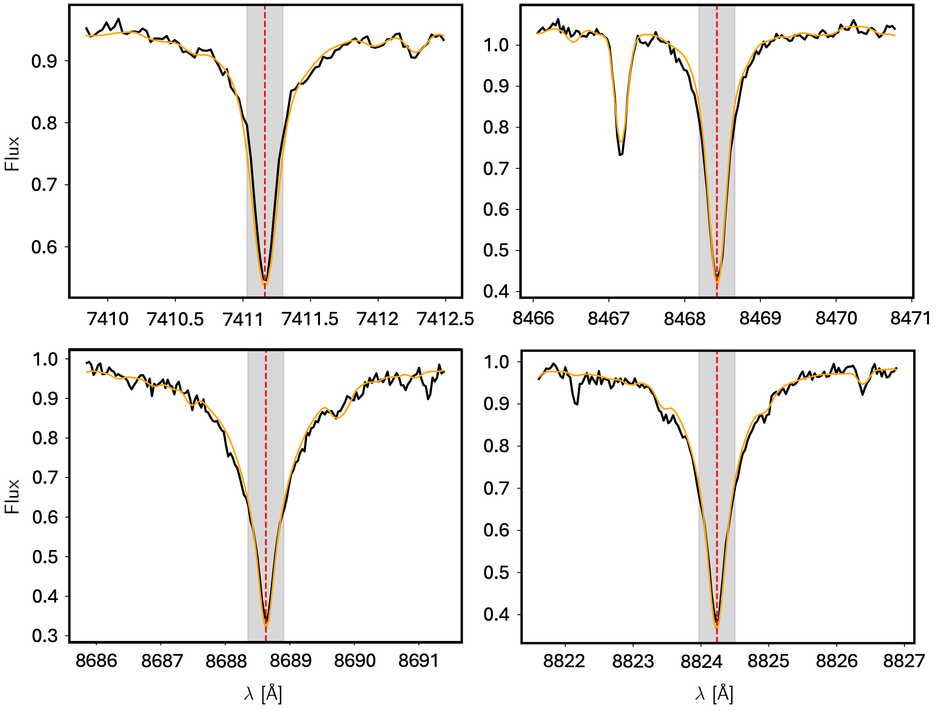
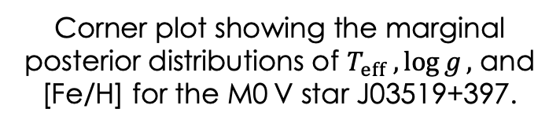
To test the reliability of our calibrations, we check with the full CAFOS sample (+770 stars):
1. Comparison with photometric [Fe/H]
2. Expected trends of [X/Fe] vs. [Fe/H]
Stellar parameters ($T_{eff} ,\log{g},$ and [Fe/H]) were determined using STEPARSYN (Tabernero et al. 2022), a Bayesian implementation of the spectral synthesis method.
22:00
Stellar parameters
2024
2025
2026
202X
Using STEPARSYN (Tabernero et al. 2022), a Bayesian implementation of the spectral synthesis method
Top instrument
Top abundances
Top surveys
Top methodologies
Top instrument
Top R packages
Top instrument
Top proposals
HERMES
@Mercator
Carbon
Oxygen
Scandium
Vanadium
Manganese
Cobalt
Gaia DR3
2MASS
CatWISE
Bayesian fits
Neural Networks
CAFOS
@ 2.2m CAHA
projpred
brms
loo
bayesplot
CARMENES
@ 3.5m CAHA
23A-3.5-010 (36h)
23B-3.5-009 (23h)
24A-3.5-007 (20h)
24B-3.5-008 (29h)
Stars analysed
Top Genre
Stars included
Top Genre
Stars analysed
Top Genre
New observations
Top Genre
179
High-res
+4900
Photometry
+770
Low-res
+200 spectra
44 stars
High-res
DUQUE-ARRIBAS ET AL. 2024
DUQUE-ARRIBAS ET AL. 2023, 2025
DUQUE-ARRIBAS ET AL. (IN PREP)
WORK IN PROGRESS
Christian Duque Arribas
Corner plot showing the marginal posterior distributions of $T_{eff} ,\log{g},$ and [Fe/H] for the M0 V star J03519+397.
Examples of selected lines for the same star, showing the observed spectrum (black) and the best synthetic fit (orange).

Slide 25
To test the reliability of our calibrations, we check with the full CAFOS sample (+770 stars):
1. Comparison with photometric [Fe/H]
2. Expected trends of [X/Fe] vs. [Fe/H]
23:00
Stellar parameters
2024
2025
2026
202X
Using STEPARSYN (Tabernero et al. 2022), a Bayesian implementation of the spectral synthesis method
Top instrument
Top abundances
Top surveys
Top methodologies
Top instrument
Top R packages
Top instrument
Top proposals
HERMES
@Mercator
Carbon
Oxygen
Scandium
Vanadium
Manganese
Cobalt
Gaia DR3
2MASS
CatWISE
Bayesian fits
Neural Networks
CAFOS
@ 2.2m CAHA
projpred
brms
loo
bayesplot
CARMENES
@ 3.5m CAHA
23A-3.5-010 (36h)
23B-3.5-009 (23h)
24A-3.5-007 (20h)
24B-3.5-008 (29h)
GTO stars
New observations.
Stars analysed
Top Genre
Stars included
Top Genre
Stars analysed
Top Genre
New observations
Top Genre
179
High-res
+4900
Photometry
+770
Low-res
+200 spectra
44 stars
High-res
DUQUE-ARRIBAS ET AL. 2024
DUQUE-ARRIBAS ET AL. 2023, 2025
DUQUE-ARRIBAS ET AL. (IN PREP)
WORK IN PROGRESS
Christian Duque Arribas
Corner plot showing the marginal posterior distributions of $T_{eff} ,\log{g},$ and [Fe/H] for the M0 V star J03519+397.
Examples of selected lines for the same star, showing the observed spectrum (black) and the best synthetic fit (orange).

Slide 26
To test the reliability of our calibrations, we check with the full CAFOS sample (+770 stars):
1. Comparison with photometric [Fe/H]
2. Expected trends of [X/Fe] vs. [Fe/H]
00:00
2024
2025
2026
202X
Top instrument
Top abundances
Top surveys
Top methodologies
Top instrument
Top R packages
Top instrument
Top proposals
HERMES
@Mercator
Carbon
Oxygen
Scandium
Vanadium
Manganese
Cobalt
Gaia DR3
2MASS
CatWISE
Bayesian fits
Neural Networks
CAFOS
@ 2.2m CAHA
projpred
brms
loo
bayesplot
CARMENES
@ 3.5m CAHA
23A-3.5-010 (36h)
23B-3.5-009 (23h)
24A-3.5-007 (20h)
24B-3.5-008 (29h)
Stars analysed
Top Genre
Stars included
Top Genre
Stars analysed
Top Genre
New observations
Top Genre
179
High-res
+4900
Photometry
+770
Low-res
+200 spectra
44 stars
High-res
DUQUE-ARRIBAS ET AL. 2024
DUQUE-ARRIBAS ET AL. 2023, 2025
DUQUE-ARRIBAS ET AL. (IN PREP)
WORK IN PROGRESS
Christian Duque Arribas
Corner plot showing the marginal posterior distributions of $T_{eff} ,\log{g},$ and [Fe/H] for the M0 V star J03519+397.
Examples of selected lines for the same star, showing the observed spectrum (black) and the best synthetic fit (orange).

Slide 27
To test the reliability of our calibrations, we check with the full CAFOS sample (+770 stars):
1. Comparison with photometric [Fe/H]
2. Expected trends of [X/Fe] vs. [Fe/H]
00:00
2024
2025
2026
202X
DUQUE-ARRIBAS ET AL. 2024
DUQUE-ARRIBAS ET AL. 2023, 2025
DUQUE-ARRIBAS ET AL. (IN PREP)
WORK IN PROGRESS
Chemical
chrduque@ucm.es
Directores: H. Tabernero & D. Montes
characterization
of M dwarfs
See the PhD thesis
Christian Duque Arribas
Corner plot showing the marginal posterior distributions of $T_{eff} ,\log{g},$ and [Fe/H] for the M0 V star J03519+397.
Examples of selected lines for the same star, showing the observed spectrum (black) and the best synthetic fit (orange).

Slide 28
T
H
A
N
K
S

Slide 29
2
0
2
5
Wrapped
T h e s i s e d i t i o n

Slide 30

Your Top Genres
1
K-Pop
2
0
2
5
78,432
R&B
2
3
Experimental
Hip Hop
You listened for 78,432 minutes.
Your top artist
That’s 86 days. Nice.
4
Techno
sombr
Share this story
5
Hyperpop
You spent 312 minutes with them,
which makes you a top 3% fan.
Share this story
Share this story

Slide 31
Your listening age
21
You were into music from the early 2020s.
Your taste is trending.
Share this story

Slide 32


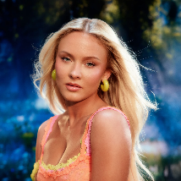

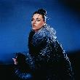
sombr is your top artist.
You spent 2,916 minutes with them, which
makes you a top 0.02% global fan.
Share this story

Slide 33





SoftHearts
Club
Full Charge
Crew
Club
Serotonin
Recruiter
Leader
Scout
Cosmic Stereo Club
Grit Collective
Cloud State Society
Collector
Curator
Leader

