Slide 1

Ghosts in Higher Derivative Quantum Field Theories
Based on arXiv:2511.03013
(Jose A. R. Cembranos, Eric G. Hemon, Juan J. Sanz-Cillero)
1

Slide 2
Ghosts in Higher Derivative Quantum Field Theories
Based on arXiv:2511.03013
(Jose A. R. Cembranos, Eric G. Hemon, Juan J. Sanz-Cillero)
Why Higher Derivative Theories?
Higher Derivative Classical Mechanics Oscillator
Higher Derivative Quantum Field Theory
Renormalizability of Higher Derivative QFT
Conclusions
2

Slide 3

1. Why Higher Derivative Theories?
• Motivation
Renormalizability of General Relativity as a QFT
$$S_{HE}=\frac{1}{2κ}\int{d^{4}x\sqrt{−g} R}$$
Non-renormalizable!
3

Slide 4
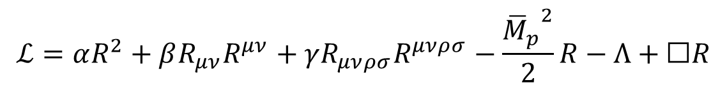
1. Why Higher Derivative Theories?
• Motivation
Renormalizability of General Relativity as a QFT
$$S_{HE}=\frac{1}{2κ}\int{d^{4}x\sqrt{−g} R}$$
Non-renormalizable!
• Renormalizable generalizations of the HE-action may be considered
$$ℒ=αR^{2}+βR_{μν}R^{μν}+γR_{μνρσ}R^{μνρσ}−\frac{{{\overline{M}}_{p}}^{2}}{2}R−Λ+☐R$$
Quadratic Gravity:
3

Slide 5
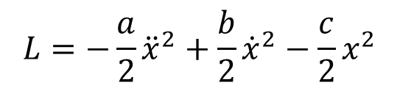
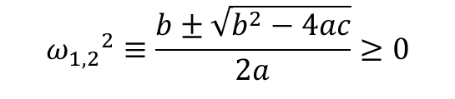

2. Higher Derivative Classical Mechanics Oscillator
• Quadratic Gravity inserts higher derivative terms
Ghost modes appear
$$L=−\frac{a}{2}{\ddot{x}}^{2}+\frac{b}{2}{\dot{x}}^{2}−\frac{c}{2}x^{2}$$
• Classical Mechanics Toy Model:
Harmonic oscillator
Pais-Uhlenbeck oscillator
EOM
$${ω_{1,2}}^{2}≡\frac{b±\sqrt{b^{2}−4ac}}{2a}≥0$$
$x\left(t\right)=A_{1}\cos\left(ω_{1}t+δ_{1}\right)+A_{2}\cos\left(ω_{2}t{+δ}_{2}\right)$ ;
4

Slide 6
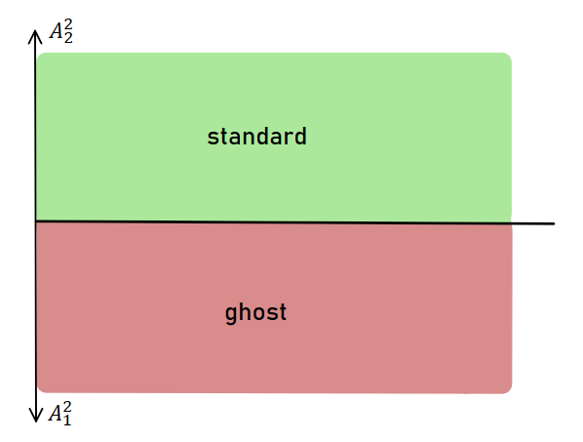

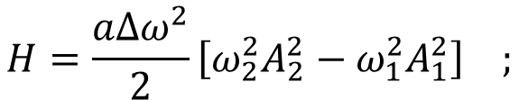
2. Higher Derivative Classical Mechanics Oscillator
Legendre
$$H=\frac{aΔω^{2}}{2}\left[ω_{2}^{2}A_{2}^{2}−ω_{1}^{2}A_{1}^{2}\right] ;$$
$$Δω^{2}≡ω_{1}^{2}−ω_{2}^{2}$$
Unbounded!
Ostrogradsky inestability
5

Slide 7

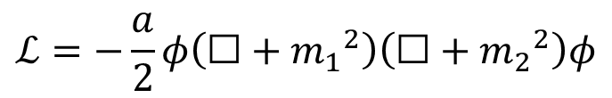
3. Higher Derivative Quantum Field Theory
$$ℒ=−\frac{a}{2}φ\left(☐+{m_{1}}^{2}\right)\left(☐+{m_{2}}^{2}\right)φ$$
!!!
• Lagrangian density:
Better UV convergence!!
• Propagator: $\tilde{G}\left(p\right)=\frac{−i/a}{\left(p^{2}−{m_{1}}^{2}\right)\left(p^{2}−{m_{2}}^{2}\right)}=\frac{1}{aΔm^{2}}\left(\frac{i}{p^{2}−{m_{2}}^{2}}+\frac{−i}{p^{2}−{m_{1}}^{2}}\right)$
6

Slide 8
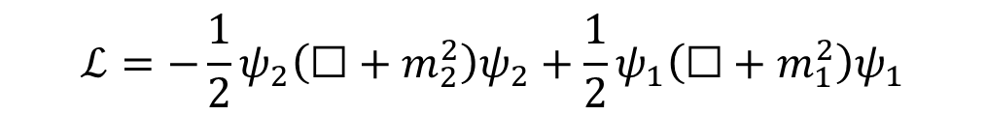
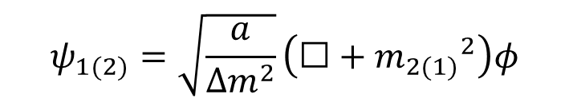
3. Higher Derivative Quantum Field Theory
$$ℒ=−\frac{a}{2}φ\left(☐+{m_{1}}^{2}\right)\left(☐+{m_{2}}^{2}\right)φ$$
!!!
• Lagrangian density:
Better UV convergence!!
• Propagator: $\tilde{G}\left(p\right)=\frac{−i/a}{\left(p^{2}−{m_{1}}^{2}\right)\left(p^{2}−{m_{2}}^{2}\right)}=\frac{1}{aΔm^{2}}\left(\frac{i}{p^{2}−{m_{2}}^{2}}+\frac{−i}{p^{2}−{m_{1}}^{2}}\right)$
!!!
• Hawking-Hertog canonical coordinates:
$$ψ_{1(2)}=\sqrt{\frac{a}{Δm^{2}}}\left(☐+{m_{2(1)}}^{2}\right)φ$$
$$ℒ=−\frac{1}{2}ψ_{2}\left(☐+m_{2}^{2}\right)ψ_{2}+\frac{1}{2}ψ_{1}\left(☐+m_{1}^{2}\right)ψ_{1}$$
6

Slide 9
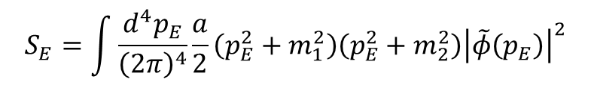

3. Higher Derivative Quantum Field Theory
• Path integral analysis: Canonical Coordinate Insertion
Bounded
$$ℒ=−\frac{a}{2}φ\left(☐+{m_{1}}^{2}\right)\left(☐+{m_{2}}^{2}\right)φ$$
$$S_{E}=\int{\frac{d^{4}p_{E}}{{\left(2π\right)}^{4}}\frac{a}{2}\left(p_{E}^{2}+m_{1}^{2}\right)\left(p_{E}^{2}+m_{2}^{2}\right){\left|\tilde{φ}\left(p_{E}\right)\right|}^{2}}$$
7

Slide 10
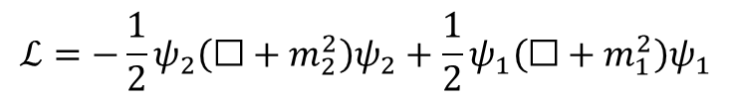
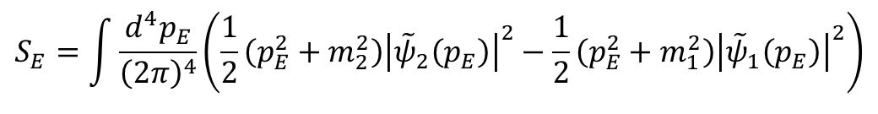
3. Higher Derivative Quantum Field Theory
• Path integral analysis: Canonical Coordinate Insertion
Bounded
$$ℒ=−\frac{a}{2}φ\left(☐+{m_{1}}^{2}\right)\left(☐+{m_{2}}^{2}\right)φ$$
$$S_{E}=\int{\frac{d^{4}p_{E}}{{\left(2π\right)}^{4}}\frac{a}{2}\left(p_{E}^{2}+m_{1}^{2}\right)\left(p_{E}^{2}+m_{2}^{2}\right){\left|\tilde{φ}\left(p_{E}\right)\right|}^{2}}$$
$$ℒ=−\frac{1}{2}ψ_{2}\left(☐+m_{2}^{2}\right)ψ_{2}+\frac{1}{2}ψ_{1}\left(☐+m_{1}^{2}\right)ψ_{1}$$
$$S_{E}=\int{\frac{d^{4}p_{E}}{{\left(2π\right)}^{4}}\left(\frac{1}{2}\left(p_{E}^{2}+m_{2}^{2}\right){\left|{\tilde{ψ}}_{2}\left(p_{E}\right)\right|}^{2}−\frac{1}{2}\left(p_{E}^{2}+m_{1}^{2}\right){\left|{\tilde{ψ}}_{1}\left(p_{E}\right)\right|}^{2}\right)}$$
Unbounded
What is happening? We focus on the path integral of the theory
7

Slide 11
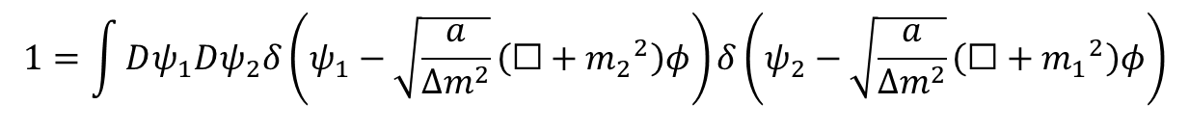
3. Higher Derivative Quantum Field Theory
• Path integral analysis: Canonical Coordinate Insertion
$$W\left[J\right]=\int{Dφe^{i\int{d^{4}x\frac{−a}{2}φ\left(☐+{m_{1}}^{2}\right)\left(☐+{m_{2}}^{2}\right)φ+i\int{d^{4}x Jφ}}}}$$
$$1=\int{Dψ_{1}Dψ_{2}δ\left(ψ_{1}−\sqrt{\frac{a}{Δm^{2}}}\left(☐+{m_{2}}^{2}\right)φ\right)δ\left(ψ_{2}−\sqrt{\frac{a}{Δm^{2}}}\left(☐+{m_{1}}^{2}\right)φ\right)}$$
$$W\left[J\right]=\int{Dψ_{1}Dψ_{2}Dλe^{i\int{d^{4}x\left(−\frac{1}{2}ψ_{2}\left(☐+m_{2}^{2}\right)ψ_{2}+\frac{1}{2}ψ_{1}\left(☐+m_{1}^{2}\right)ψ_{1}+λ\left(\left(☐+m_{2}^{2}\right)ψ_{2}−\left(☐+m_{1}^{2}\right)ψ_{1}\right)\right)+i\int{d^{4}x J \frac{ψ_{2}−ψ_{1}}{\sqrt{aΔm^{2}}}}}}}$$
Also unbounded
Lagrange multiplier
8

Slide 12
3. Higher Derivative Quantum Field Theory
• Path integral analysis: Canonical Coordinate Insertion
$$W\left[J\right]=\int{Dψ_{1}Dψ_{2}Dλe^{i\int{d^{4}x\left(−\frac{1}{2}ψ_{2}\left(☐+m_{2}^{2}\right)ψ_{2}+\frac{1}{2}ψ_{1}\left(☐+m_{1}^{2}\right)ψ_{1}+λ\left(\left(☐+m_{2}^{2}\right)ψ_{2}−\left(☐+m_{1}^{2}\right)ψ_{1}\right)\right)+i\int{d^{4}x J \frac{ψ_{2}−ψ_{1}}{\sqrt{aΔm^{2}}}}}}}$$
→ The fields $ψ_{2}+ψ_{1}$ and $λ$ can be integrated out by virtue of not being in the source terms, resulting in a bounded Euclidean action
→ We have explicitely shown that these two fields do not contribute in either canonical quantization and in the perturbative expansión of the Green functions
9

Slide 13
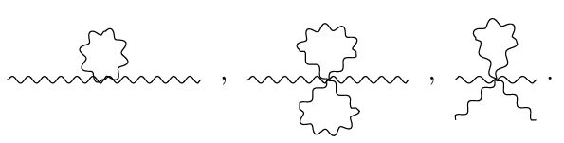

4. Renormalizability of Higher Derivative QFT
• Improved Ultraviolet Convergence of the Green Functions
→ We have proven the renormalizability of any $φ^{2n}$ self-interaction
→ Key point: only diagrams with one vertex are superficially divergent
Ej: $λ_{4}φ^{4}+λ_{6}φ^{6}$
10

Slide 14




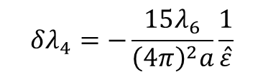
4. Renormalizability of Higher Derivative QFT
• $λ_{4}φ^{4}+λ_{6}φ^{6}$ all-order renormalization ($\overline{MS}$-scheme)
$$δZ_{φ}=0$$
Due to momentum independence of UV divergences
$$δm_{1}^{2}=−δm_{2}^{2}≡δM^{2}$$
$$δλ_{6}=0$$
$$δλ_{4}=−\frac{15λ_{6}}{{\left(4π\right)}^{2}a}\frac{1}{\hat{ε}}$$
Necesary to cancel out the 4-point Green function UV divergence
$${\left(δM^{2}\right)}^{2}+Δm^{2}δM^{2}=\frac{3λ_{4}}{4π^{2}a^{2}}\frac{1}{\hat{ε}}−\frac{90λ_{6}}{{\left(4π\right)}^{4}a^{3}}\frac{1}{{\hat{ε}}^{2}}$$
11

Slide 15
5. Conclusion
• Rigorous canonical quantization of the theory. Path integral consistency of the interacting theory.
• Proof of the renormalizability of a general set of interactions for higher derivative theories. Several explicit examples of renormalized theories are provided.
• Open problems: Dealing with negative energy/squared norm states, cosmological applications, etc.
12

Slide 16

Ghosts in Higher Derivative Quantum Field Theories
Based on arXiv:2511.03013
(Jose A. R. Cembranos, Eric G. Hemon, Juan J. Sanz-Cillero)
13

