Slide 1




Collins effect for pion-in-jet production IN hadron-hadron and lepton-hadron collisions
Umberto D’Alesio
C. Flore & M. Zaccheddu,
PLB 2025 &
arXiv:2605.02890 [hep-ph]
to appear in PLB

Slide 2
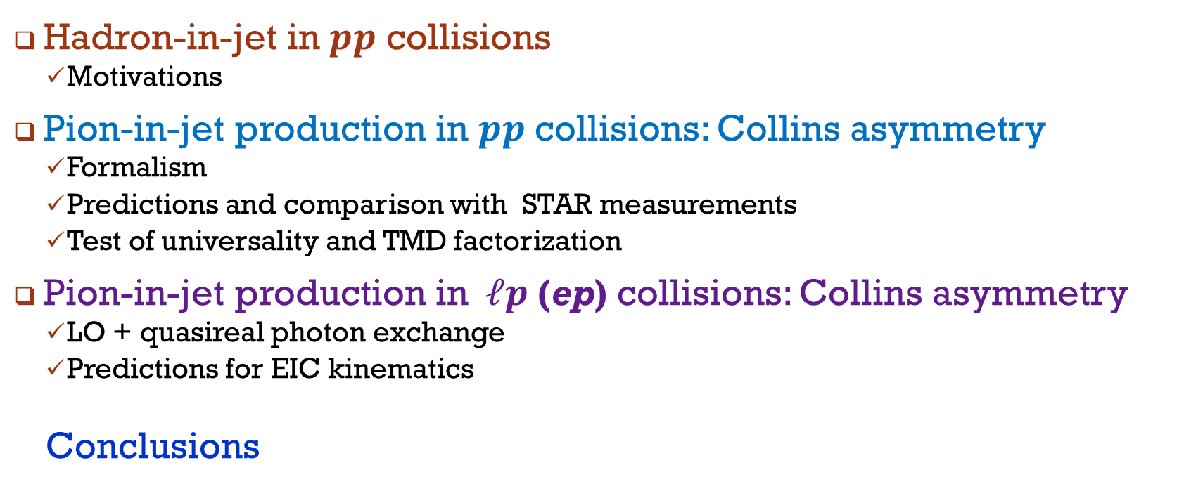
Outline
Hadron-in-jet in $pp$ collisions
  Motivations
Pion-in-jet production in $pp$ collisions: Collins asymmetry
  Formalism
  Predictions and comparison with STAR measurements
  Test of universality and TMD factorization
Pion-in-jet production in$ℓp$(ep) collisions: Collins asymmetry
  LO + quasireal photon exchange
  Predictions for EIC kinematics
  Conclusions

Slide 3
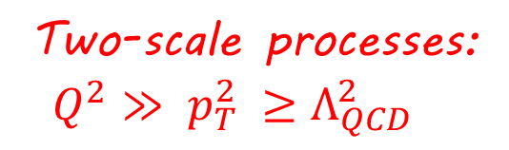
“Standard” TMD processes
Two-scale processes:
$Q^{2}≫$ $p_{T}^{2}$ $≥Λ_{QCD}^{2}$

Slide 4

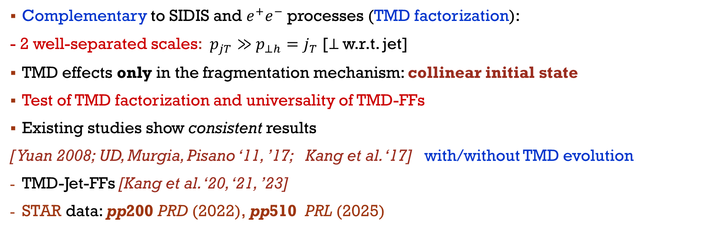
Motivations
Complementary to SIDIS and $e^{+}e^{−}$ processes (TMD factorization):
- 2 well-separated scales: $p_{jT}≫$ $p_{⊥h}=j_{T}$ [⊥ w.r.t. jet]
TMD effects only in the fragmentation mechanism: collinear initial state
Test of TMD factorization and universality of TMD-FFs
Existing studies show consistent results
[ Yuan 2008; UD, Murgia, Pisano ‘11, ’17; Kang et al. ‘17] with/without TMD evolution
TMD-Jet-FFs [Kang et al. ‘20, ‘21, ’23]
STAR data: pp200 PRD (2022), pp510 PRL (2025)

Slide 5
Hadron-in-jet Physics: Modern Landscape
Selected/illustrative works
QCD Framework (SCET / FJF)
  Kaufmann et al., JHEP 02 (2020)
  Kang, Lee, Zhao, PLB 809 (2020)
  Wang et al., PRD 103 (2021)
  Kang et al., JHEP 03 (2024)
Global Analyses & Universality & Bridges
  Gao et al., PRD 110 (2024) global FF fit incl. LHC jet data
  Bacchetta et al., PRD 108 (2023) analogies h-jet and DiFFs
  D’Alesio et al., global phenomenology (pp ↔ ep)
  D’Alesio et al., EIC projections (2026)
Experiment (RHIC & LHC)
  [polarized] STAR, PLB 780 (2018)
  [polarized] STAR, PRD 106 (2022)
  [polarized] STAR, PRL 135 (2025)
  [unpolarized] LHCb, PRL 123 (2019)
  [unpolarized] LHCb, PRD 108 (2023)
  [unpolarized] ALICE/ATLAS, jet fragmentation (2019–2021)
Spin & TMD Observables
  Arratia et al., PRD 102 (2020)
  Kang et al., PLB 774 (2017)
  D’Alesio et al., PLB 773 (2017)
  Gutierrez-Reyes et al., PRL 121 (2018)
Very active field

Slide 6
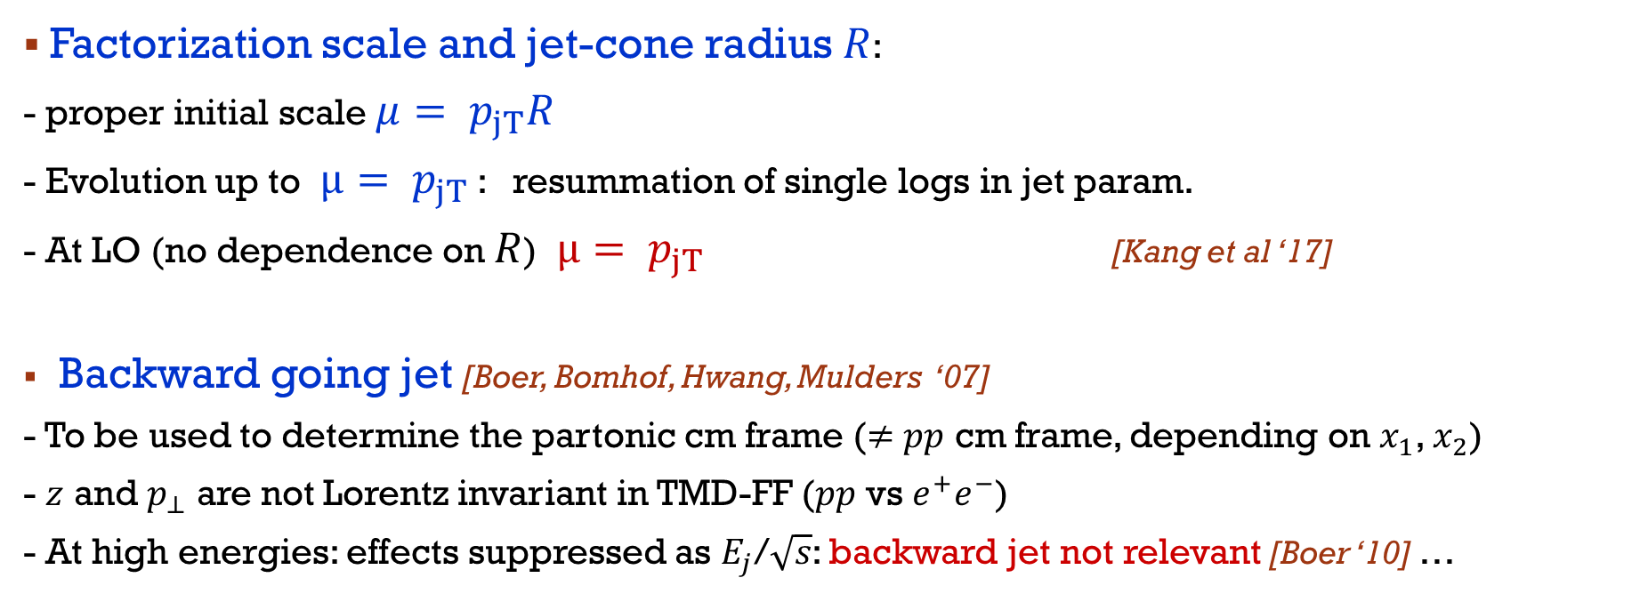
Factorization scale and jet-cone radius $R$:
- proper initial scale $μ= p_{jT}R$
- Evolution up to $μ= p_{jT}$ : resummation of single logs in jet param.
- At LO (no dependence on $R$) $μ= p_{jT}$ [Kang et al ‘17]
Backward going jet [Boer, Bomhof, Hwang, Mulders ‘07]
- To be used to determine the partonic cm frame ($≠$ $pp$ cm frame, depending on $x_{1}$, $x_{2}$)
- $z$ and $p_{⊥}$ are not Lorentz invariant in TMD-FF ($pp$ vs $e^{+}e^{−}$)
- At high energies: effects suppressed as $E_{j}$/$\sqrt{s}$: backward jet not relevant [Boer ‘10] …

Slide 7
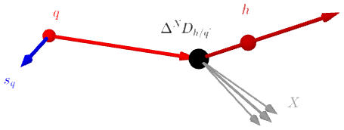
TMD-Ffs for spin ½ hadrons
Collins FF
T-odd, chiral-odd

Slide 8


Kinematic configuration
ab collinear
Figure from Kang, Lee, Zhao 2020

Slide 9
Azimuthal structure
UD, Murgia, Pisano 2011
Collins effect

Slide 10
Collins asymmetry
Collinear initial state

Slide 11


parametrizations
FIT to SIDIS and $e^{+}e^{−}$ data
Boglione, UD, Flore, Gonzalez-Hernandez, Murgia, Prokudin, PLB2024
only valence - Soffer bound a posteriori

Slide 12
Results predictions
UD, C. Flore, M. Zaccheddu, PLB 2025

Slide 13
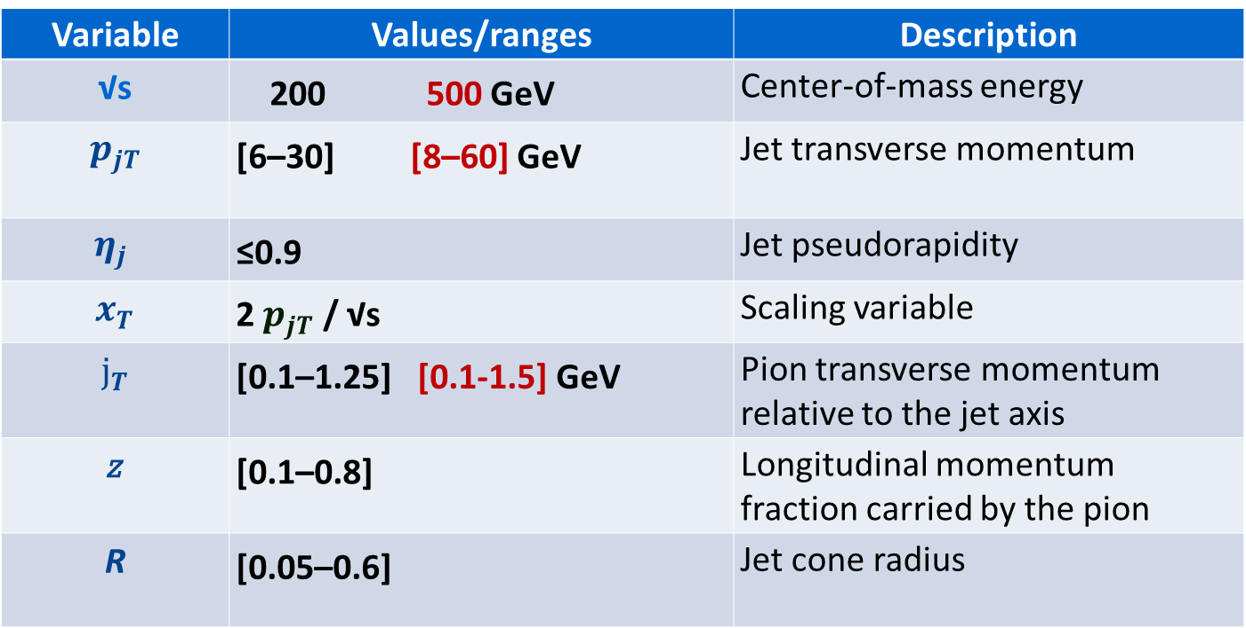
STAR kinematics
Variable​ | Values​/ranges | Description​
√s​ | 200 500 ​GeV | Center-of-mass energy​
$$p_{jT}$$ | [6–30] [8–60] ​GeV | Jet transverse momentum​
$$η_{j}$$ | ≤0.9 ​ | Jet pseudorapidity​
$$x_{T}$$ | 2 $p_{jT}$ / √s​ | Scaling variable​
$$j_{T}$$ | [0.1–1.25] [0.1-1.5] GeV​ | Pion transverse momentum relative to the jet axis​
z | [0.1–0.8]​ | Longitudinal momentum fraction carried by the pion​
R | [0.05–0.6]​ | Jet cone radius

Slide 14

AsYmmetries vs$z$ predictions/data
STAR 200 GeV STAR 510 GeV
Central value: median of the compressed ${10}^{6}$ MC sets; uncertainties at 2𝜎 (CL).

Slide 15

ASYMMETRIEs vs $x_{T}$ predictions/data
200 GeV 510 GeV

Slide 16

ASYMMETRIEs vs$z$ binned in $p_{jT}$ predictions/data
STAR
510 GeV

Slide 17
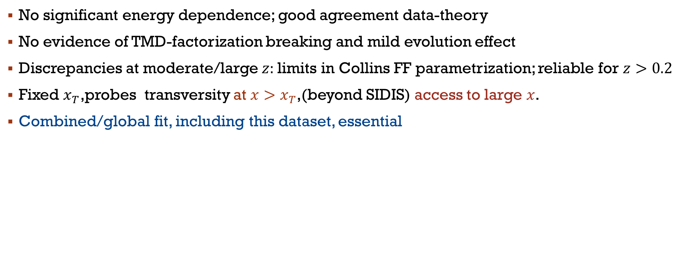
Remarks I
No significant energy dependence; good agreement data-theory
No evidence of TMD-factorization breaking and mild evolution effect
Discrepancies at moderate/large $z:$limits in Collins FF parametrization; reliable for $z>0.2$
Fixed $x_{T}$,probes transversity at $x>x_{T}$,(beyond SIDIS) access to large $x$.
Combined/global fit, including this dataset, essential

Slide 18

Asymmetries vs $j_{T}$ binned in${ p}_{jT}$ predictions/data
STAR
510 GeV

Slide 19

asymmetries vs $j_{T}$ binned in$z$ predictions/data
STAR
200 GeV
STAR
510 GeV

Slide 20
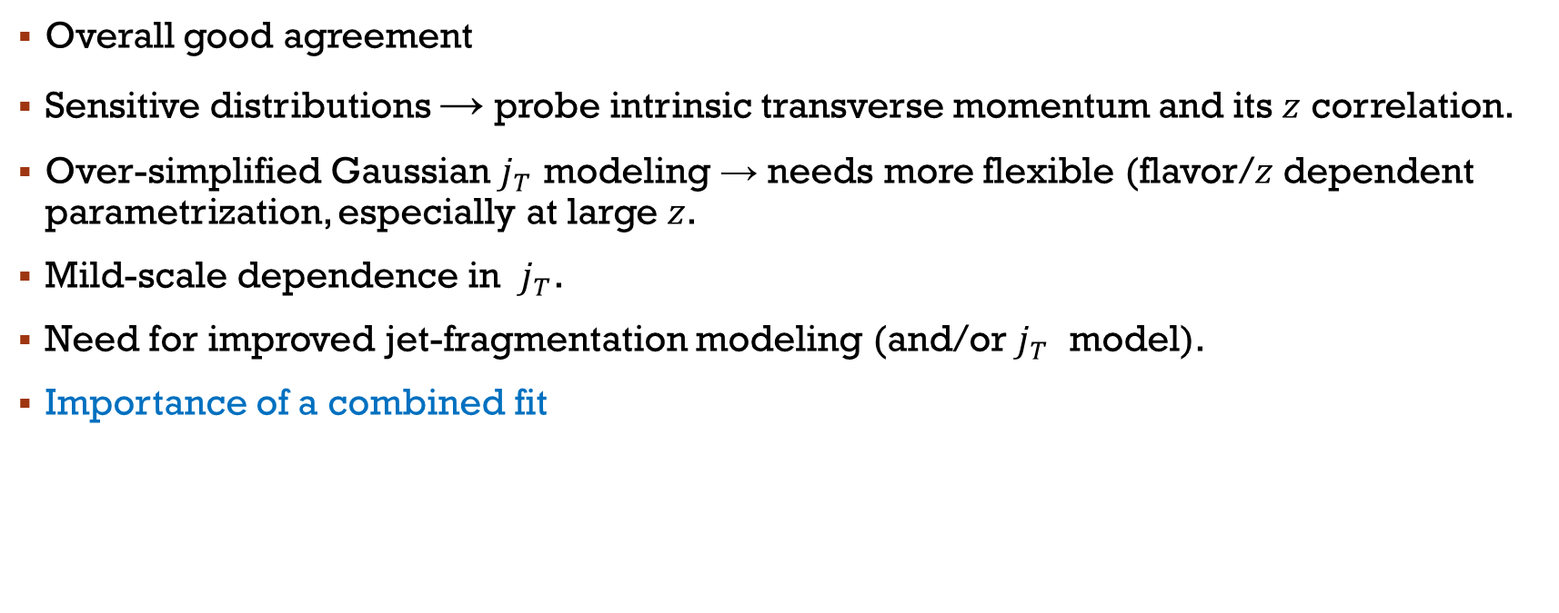
Remarks II
Overall good agreement
Sensitive distributions → probe intrinsic transverse momentum and its $z$ correlation.
Over-simplified Gaussian $j_{T}$ modeling → needs more flexible (flavor/$z$ dependent parametrization, especially at large $z$.
Mild-scale dependence in $j_{T}$.
Need for improved jet-fragmentation modeling (and/or $j_{T}$ model).
Importance of a combined fit

Slide 21
UD, C. Flore & M. Zaccheddu, arXiv:2605.02890 [hep-ph] to appear in PLB

Slide 22
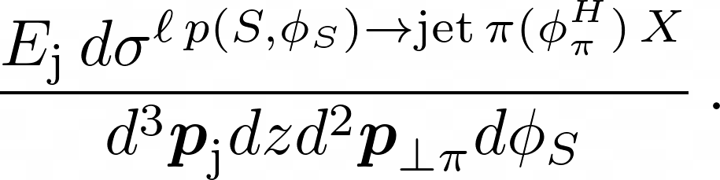
Collins asymmetry
Formally identical, but less channels involved w.r.t the pp case

Slide 23

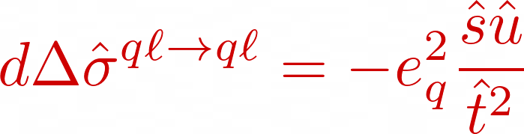
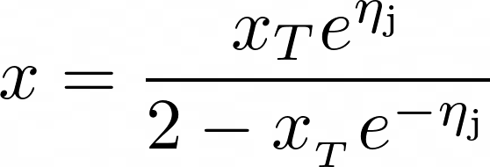

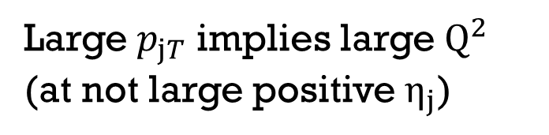
LO
Large $p_{jT}$ implies large $Q^{2}$
(at not large positive $η_{j}$)

Slide 24


Final lepton is not observed also collinear…
quasireal photon exchange [WW approximation]
B. A. Kniehl, G. Kramer, M. Spira, Z. Phys. C 1997

Slide 25


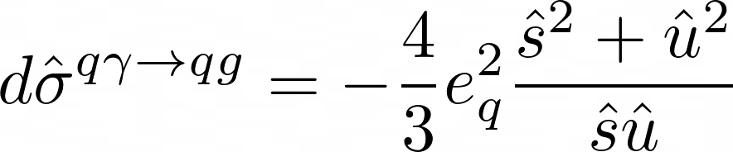
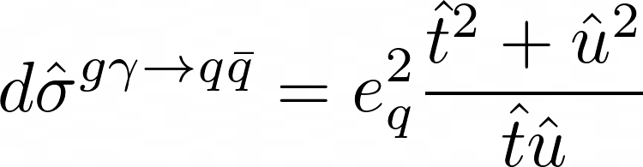
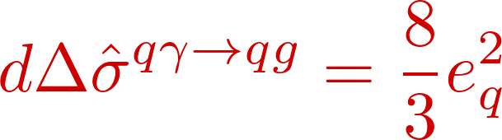
Channels
Numerator: only one channel

Slide 26
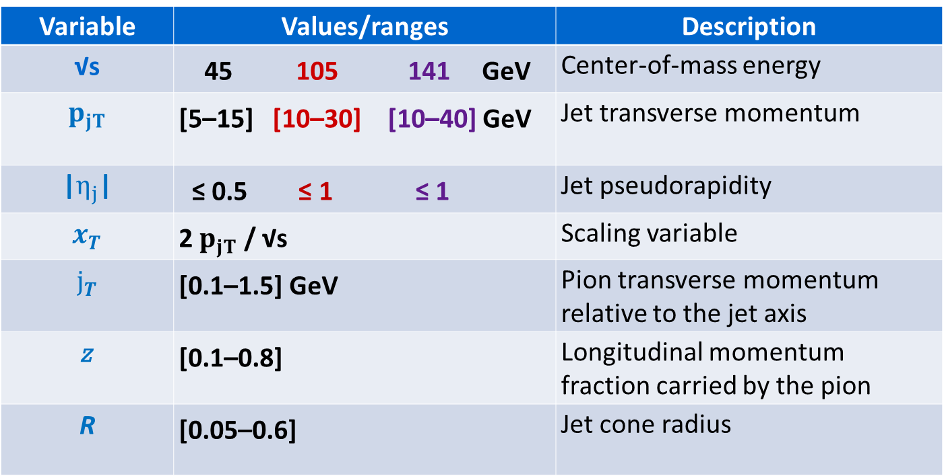
EIC kinematics
Variable​ | Values​/ranges | Description​
√s​ | 45 105 141 GeV​ | Center-of-mass energy​
$$p_{jT}$$ | [5–15] [10–30] [10–40] GeV​ | Jet transverse momentum​
|$η_{j}$|​ | ≤ 0.5 ≤ 1 ≤ 1 ​ | Jet pseudorapidity​
$$x_{T}$$ | 2 $p_{jT}$ / √s​ | Scaling variable​
$$j_{T}$$ | [0.1–1.5] GeV​ | Pion transverse momentum relative to the jet axis​
z | [0.1–0.8]​ | Longitudinal momentum fraction carried by the pion​
R | [0.05–0.6]​ | Jet cone radius

Slide 27

Unpolarized cross sections vs $η_{j}$
45 GeV
105 GeV
141 GeV
Sizeable WW contr.
(LO+WW)/LO
around 2-1.5
Quark dominance!!!
backward region: gluon-initiated channels, entering only via the WW term, play some role

Slide 28

Azimuthal asymmetries vs $η_{j}$
45 GeV
105 GeV
141 GeV

Slide 29
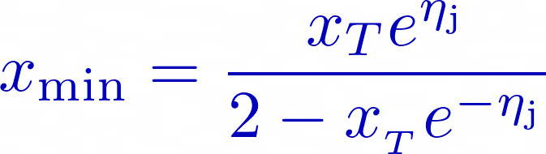

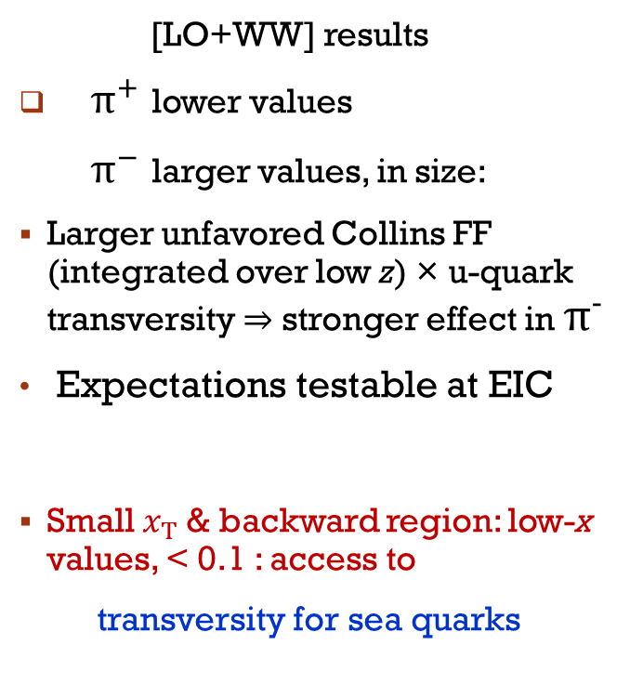
Azimuthal asymmetries vs $x_{T}$
45 GeV
105 GeV
141 GeV
[LO+WW] results
$π^{+}$ lower values
${ π}^{−}$ larger values, in size:
Larger unfavored Collins FF (integrated over low z) × u-quark transversity ⇒ stronger effect in $π^{−}$
Expectations testable at EIC
Small $x_{T}$& backward region: low-x values, < 0.1 : access to
transversity for sea quarks

Slide 30
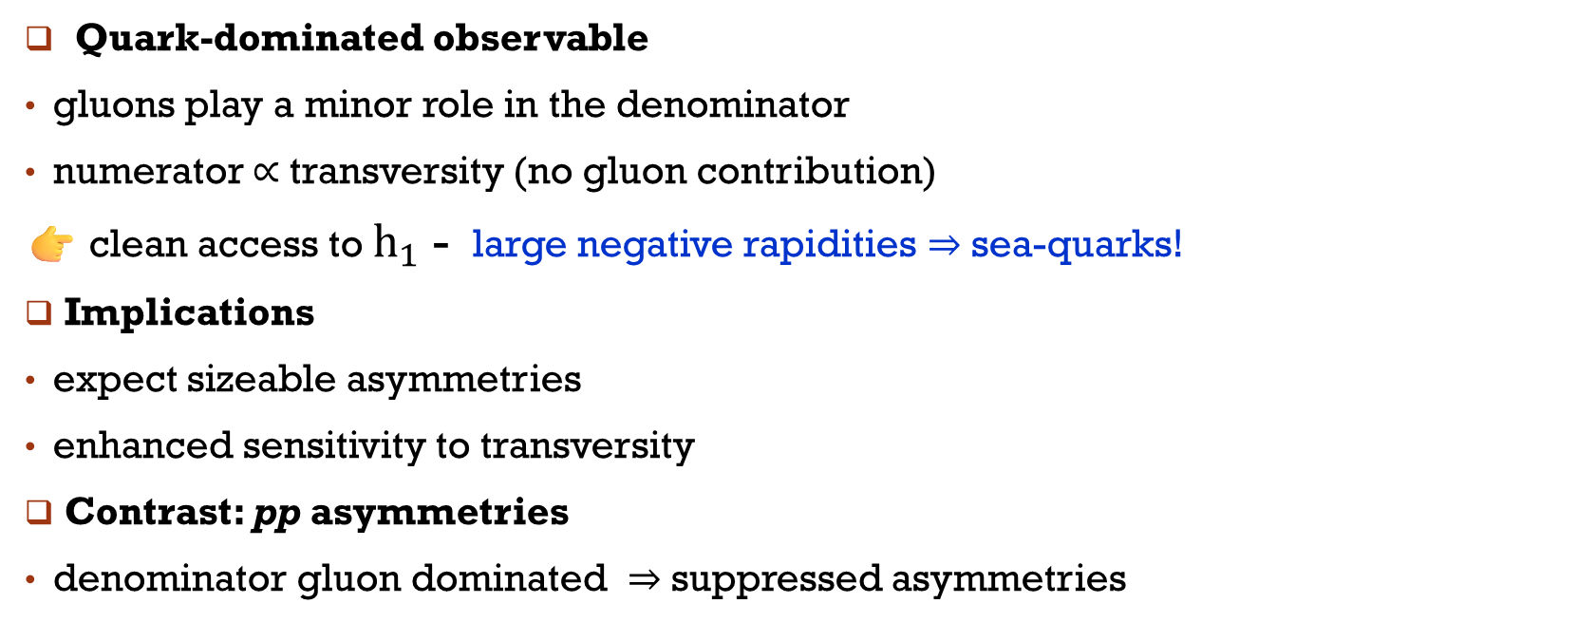
REMARKS
Quark-dominated observable
gluons play a minor role in the denominator
numerator ∝ transversity (no gluon contribution)
👉 clean access to $h_{1}$ - large negative rapidities ⇒ sea-quarks!
Implications
expect sizeable asymmetries
enhanced sensitivity to transversity
Contrast: pp asymmetries
denominator gluon dominated ⇒ suppressed asymmetries

Slide 31

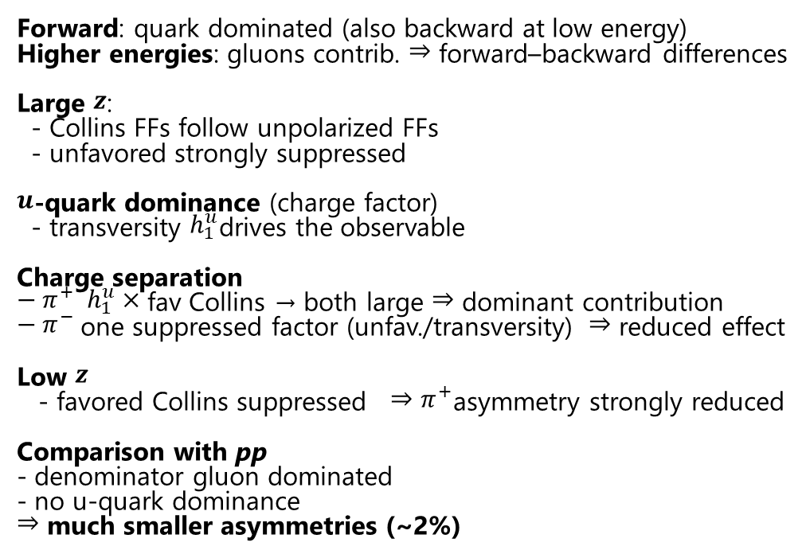
Azimuthal asymmetries vs $z$
45 GeV
105 GeV
141 GeV
Forward: quark dominated (also backward at low energy)
Higher energies: gluons contrib. ⇒ forward–backward differences
Large $z$:
- Collins FFs follow unpolarized FFs
- unfavored strongly suppressed
$u$-quark dominance (charge factor)
- transversity $h_{1}^{u}$drives the observable
Charge separation
${− π}^{+} h_{1}^{u}×$ fav Collins → both large ⇒ dominant contribution
$− π^{−}$one suppressed factor (unfav./transversity) ⇒ reduced effect
Low $z$
- favored Collins suppressed ⇒ $π^{+}$asymmetry strongly reduced
Comparison with pp
- denominator gluon dominated
- no u-quark dominance
⇒ much smaller asymmetries (~2%)
Forward
Backward
Expectations testable at the EIC

Slide 32
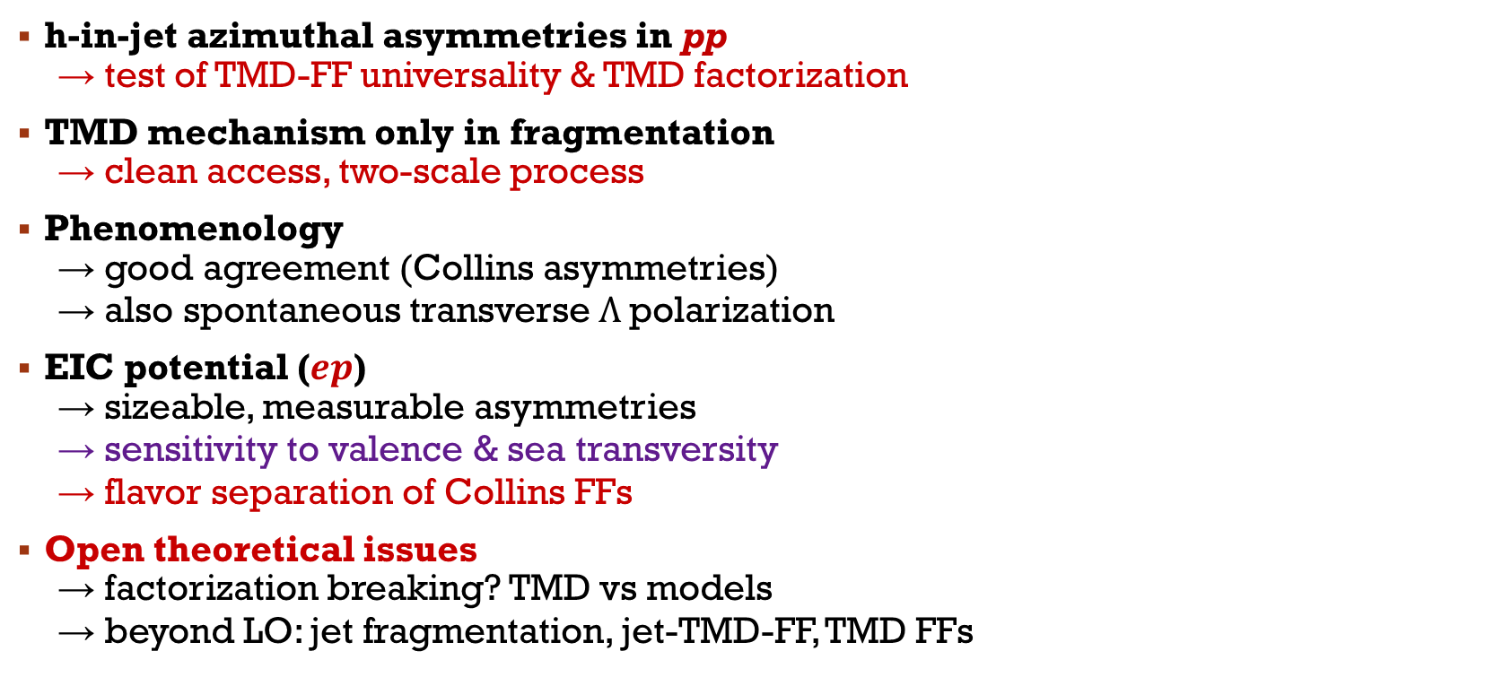
Conclusions
h-in-jet azimuthal asymmetries in pp
  → test of TMD-FF universality & TMD factorization
TMD mechanism only in fragmentation
  → clean access, two-scale process
Phenomenology
  → good agreement (Collins asymmetries)
  → also spontaneous transverse Λ polarization
EIC potential ($ep$)
  → sizeable, measurable asymmetries
  → sensitivity to valence & sea transversity
  → flavor separation of Collins FFs
Open theoretical issues
  → factorization breaking? TMD vs models
  → beyond LO: jet fragmentation, jet-TMD-FF, TMD FFs
THANKS for the ATTENTION

Slide 33
Back-up slides

Slide 34
The semi-inclusive TMD fragmenting jet function
TMD FF
TMD factorization
Kang, Liu, Ringer, Xing, JHEP 1711 (2017) 068

Slide 35
Uncertainty bands
Compression procedure
We adopt as an indicator the Welch’s 𝑡-statistic, defined as
which quantifies the difference of the arithmetical means of two samples with unequal variances and sizes. One has to verify that |𝑡| is such that the corresponding 𝑝-values are ≳ 0.1. Provided this condition holds, one can conclude that the sampled distribution and the original distribution are statistically equivalent. Notice that we sample directly in the parameter space.

Slide 36

predictions vs. $j_{T}$ binned in $p_{jT}$
STAR
200 GeV

Slide 37
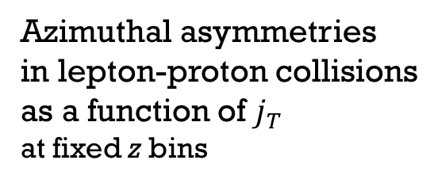
Azimuthal asymmetries
in lepton-proton collisions
as a function of $j_{T}$
at fixed z bins

Slide 38
Transversity and Collins FFs
fav
unfav
Proper use of the Soffer bound in a fit
PLB 2020 UD, Flore, Prokudin
PLB 2024 Boglione, UD, Flore, Gonzalez-Hernandez, Murgia, Prokudin

