Slide 1




Unpolarized Twist-Two GPDs
and the
Role of Different IR Regulators
Ignacio Castelli
QCD Evolution 2026
In collaboration with: A. C. Alvaro, C. Lorcé, A. Metz, B. Pasquini and S. Rodini, in press, DOI: 10.1016/j.physletb.2026.140501

Slide 2
Outline
Motivation: Previous Works and Factorization in DVCS
Connection of GPD with PDFs: Forward Limit Condition
Study of the Axial Current: Quark Mass as an IR Regulator
Study of the Vector Current: Dimensional Regularization (DR) as IR Regulator
Conclusions

Slide 3
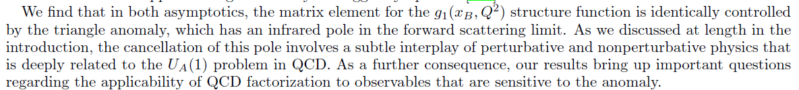
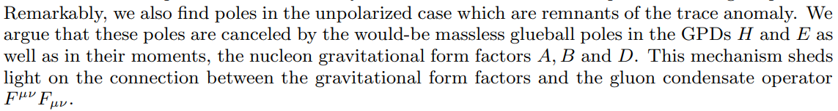
Motivation: Anomaly Poles in Feynman Diagrams?
Doubts in the theoretical framework to extract PDFs and GPDs from experimental data?
Tarasov-Venugopalan (TV) (2020, 2021, 2024) in DIS:
Bhattacharya, Hatta and Vogelsang (BHV) (2022, 2023) in DVCS:
Bhattacharya, Hatta and Schoenleber (BHS) (2025)

Slide 4
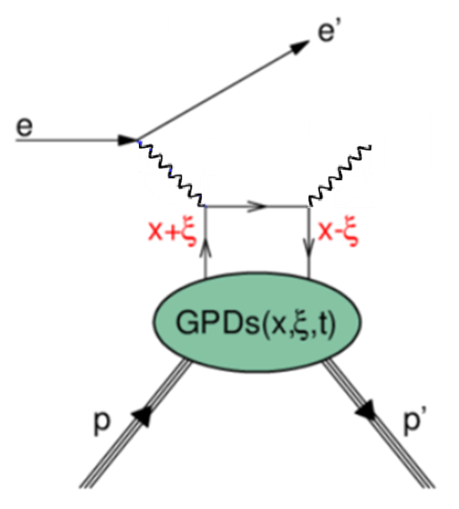
Recent Claims: Explanation for DVCS
Factorization theorems rely on the cancellation of IR divergences in the ‘hard part’ with the ones in the ‘soft part’ of the process .
Perturbative probe (high energy photon).
Non-perturbative (internal hadron dynamics).
Recent claim: original proof of factorization theorems did not consider the ‘anomaly pole’ effects, that can be captured only when using off-forward kinematics.
In DIS (defined in forward kinematics) the off-forward momentum serves as a possible IR regulator.
In DVCS (defined in off-forward kinematics) the off-forward momentum is also a possible IR regulator.

Slide 5
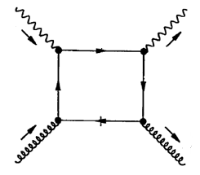
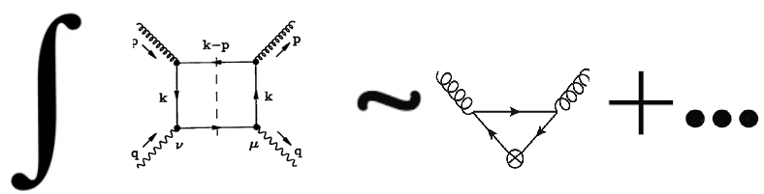
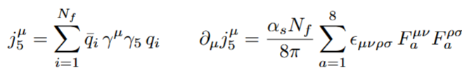
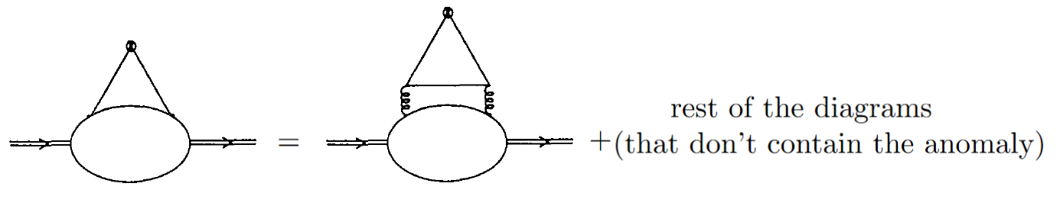
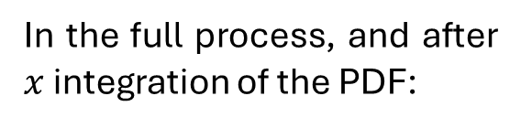
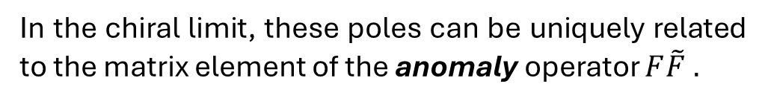
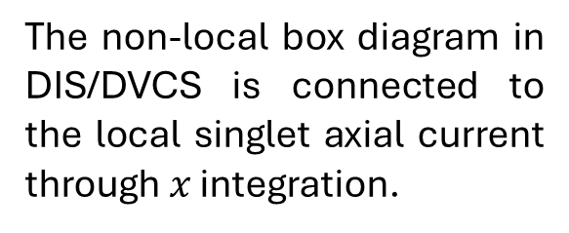
Motivation: Explanation
The non-local box diagram in DIS/DVCS is connected to the local singlet axial current through $x$ integration.
Claim: when using off-forward kinematics as IR regulator of the ‘hard’ box diagram (perturbative part) one finds (new) apparent collinear poles.
In the chiral limit, these poles can be uniquely related to the matrix element of the anomaly operator $F\tilde{F} .$
In the full process, and after $x$ integration of the PDF:
Has poles in the collinear limit?

Slide 6

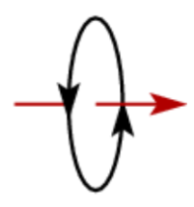
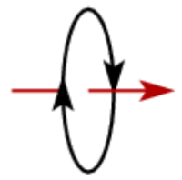
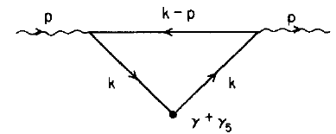
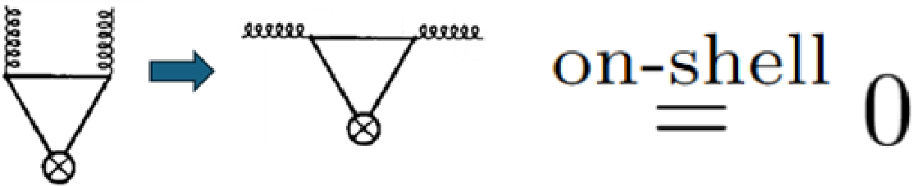
Motivation: Previous Work- Local Case
2) We performed a first order calculation by including the quark mass ($m$) as IR regulator, and the form factor $G_{2}\left(\frac{Δ^{2}}{m^{2}}→0\right)→0.$
The logic for introducing an extra IR regulator ($m$) is to keep an IR regulator even in the limit $Δ^{2}→0$ .
3) The form factor $G_{2}$ describes a helicity-flip, so it should vanish in the collinear limit $Δ^{2}→0$ due to conservation of angular momentum.
Based on: 2408.00554

Slide 7
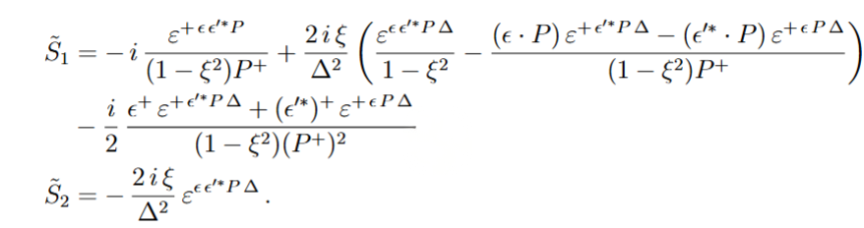
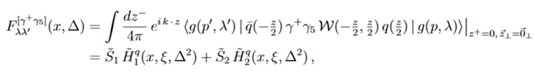

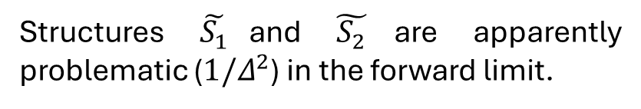
Motivation: Summary
We also studied the non-local axial current for on-shell gluons, and found that the PDF limit is safe when considering a quark mass.
Structures $\tilde{S_{1}}$and $\tilde{S_{2}}$are apparently problematic ($1/Δ^{2}$) in the forward limit.
After contraction with physical polarization vectors the apparent divergence disappears:
Will the conclusions hold (safe collinear (PDF) limit?) in the same way for other IR regulators? Standard perturbative calculations are made in DR.
Will the conclusions hold for the vector current? (Related to the trace anomaly).

Slide 8
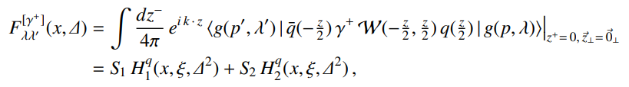
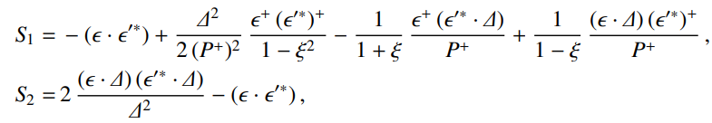

Consistency Conditions for the PDF Limit: Vector Current
PDF decomposition for external on-shell gluons:
GPD decomposition for external on-shell gluons:
Conditions on the GPDs for a well-defined collinear limit.

Slide 9

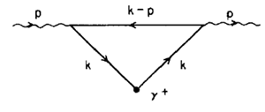
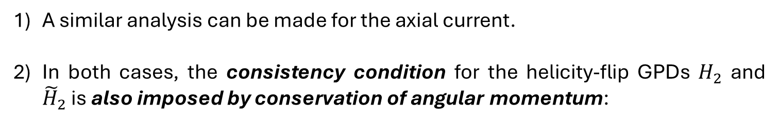
Consistency Conditions for the PDF Limit: Vector Current (Some Remarks)
A similar analysis can be made for the axial current.
In both cases, the consistency condition for the helicity-flip GPDs $H_{2}$ and ${\tilde{H}}_{2}$is also imposed by conservation of angular momentum:
Non-local vector current.
Non-local axial current.

Slide 10
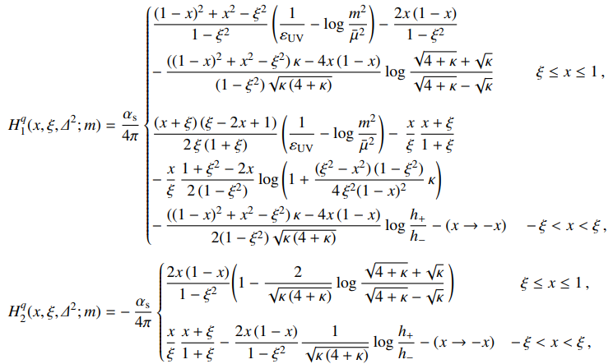


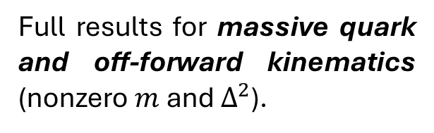
GPD Results at One-Loop Massive Quarks
Full results for massive quark and off-forward kinematics (nonzero $m$ and $Δ^{2}$).

Slide 11
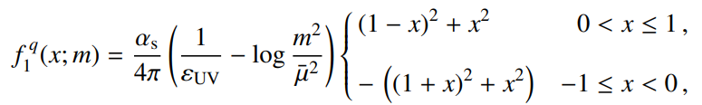
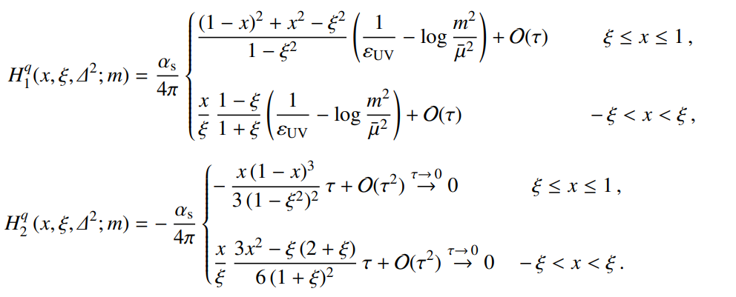
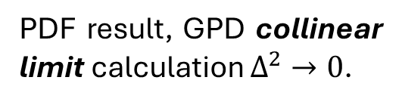
GPD Collinear Limit Results at One-Loop Massive Quarks
PDF result, direct calculation.
PDF result, GPD collinear limit calculation $Δ^{2}→0$.
The helicity-flip GPD vanishes in the collinear limit.
We argue that to take the limit $Δ^{2}→0$ another mass scale (IR regulator) should be kept.
Here we use a nonzero mass of the quark $m$.

Slide 12

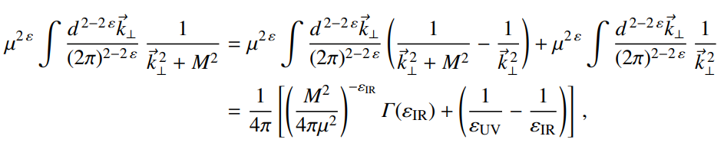
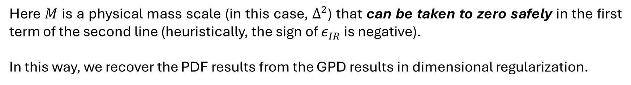
GPD Results at One-Loop Dimensional Regularization for IR Divergences
Dimensionless integral of this kind appear in the PDF calculations:
That separates UV and IR divergences.
Integral of the following kind appear in the GPD calculations:
Here $M$ is a physical mass scale (in this case, $Δ^{2}$) that can be taken to zero safely in the first term of the second line (heuristically, the sign of $ε_{IR}$ is negative).
In this way, we recover the PDF results from the GPD results in dimensional regularization.

Slide 13
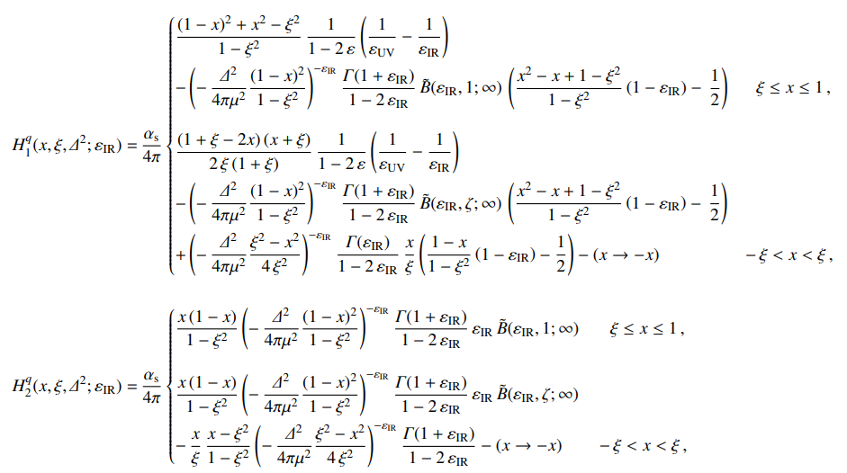

GPD Results at One-Loop Dimensional Regularization for IR Divergences

Slide 14

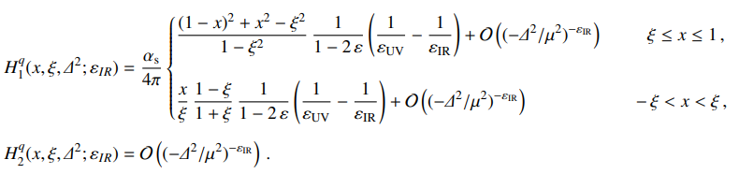
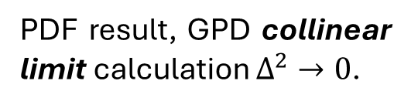
GPD Collinear Limit Results at One-Loop Dimensional Regularization for IR Divergences
PDF result, direct calculation.
PDF result, GPD collinear limit calculation $Δ^{2}→0$.
The helicity-flip GPD vanishes in the collinear limit.
We argue that to take the limit $Δ^{2}→0$ another mass scale (IR regulator) should be kept.
Here we use a nonzero mass scale $μ^{2}$.

Slide 15
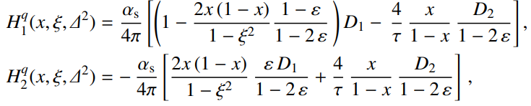
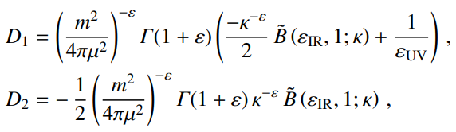
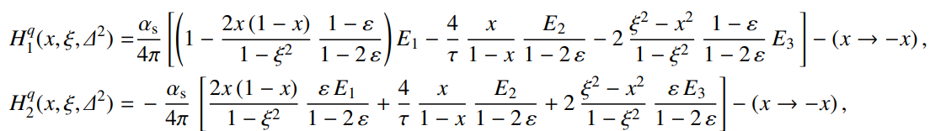
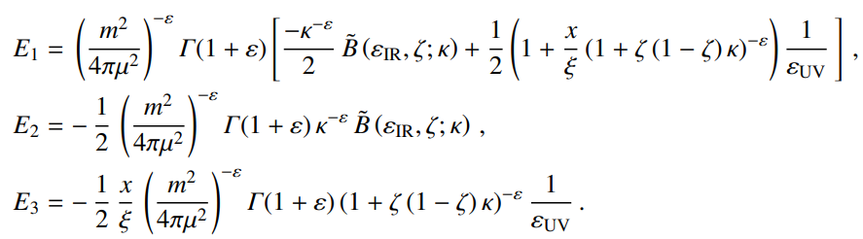
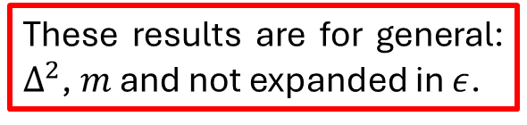

Side Remark: We Have Results not Expanded in the quark mass $m$ or in $ε$
For the DGLAP region results look:
with:
These results are for general: $Δ^{2}$, $m$ and not expanded in $ε$.
For the ERBL region results look:
We can get the results from the previous slides by expanding these integrals.
with:

Slide 16
Conclusions
We extended our previous work to the study of the nonlocal vector current.
We identified conditions under which the GPDs have a well-defined PDF limit.
Using dimensional regularization and a quark mass as an extra IR regulator in perturbation theory, these conditions are satisfied.
We find no poles in the collinear limit, indicating that the existing factorization framework of DVCS/DIS does not need to be modified.

