Slide 1
Introduction to Accelerator Physics for the EIC
Davide GAMBA
Slides and material adapted from F. Tecker, T. Pieloni, and more colleagues from CAS,
and from recent EIC reports by A. Seryi and S. Nagaitsev
2nd European School on the Physics of the EIC and Related Topics
June 2025

Slide 2
Disclaimer and Organisational matters
Not here to make you an EIC accelerator physics experts in 1.5 h !
  I am not an EIC design expert either !
  If you are (or will be, I hope!) passionate about accelerator physics:
  => consider enrolling to the next CAS – Introduction in Santa Susanna 21/09-04/10 !
My aim :
  Learn myself about the EIC design and its challenges
  Make you understand the future “EIC design update” talks that you will encounter…
Strategy :
  Profit of latest A. Seryi and S. Nagaitsev slides on EIC design to guide our exploration
  Touch base on relevant accelerator physics, at least qualitatively
  (Try to) answer your questions and curiosity about accelerator physics

Slide 3


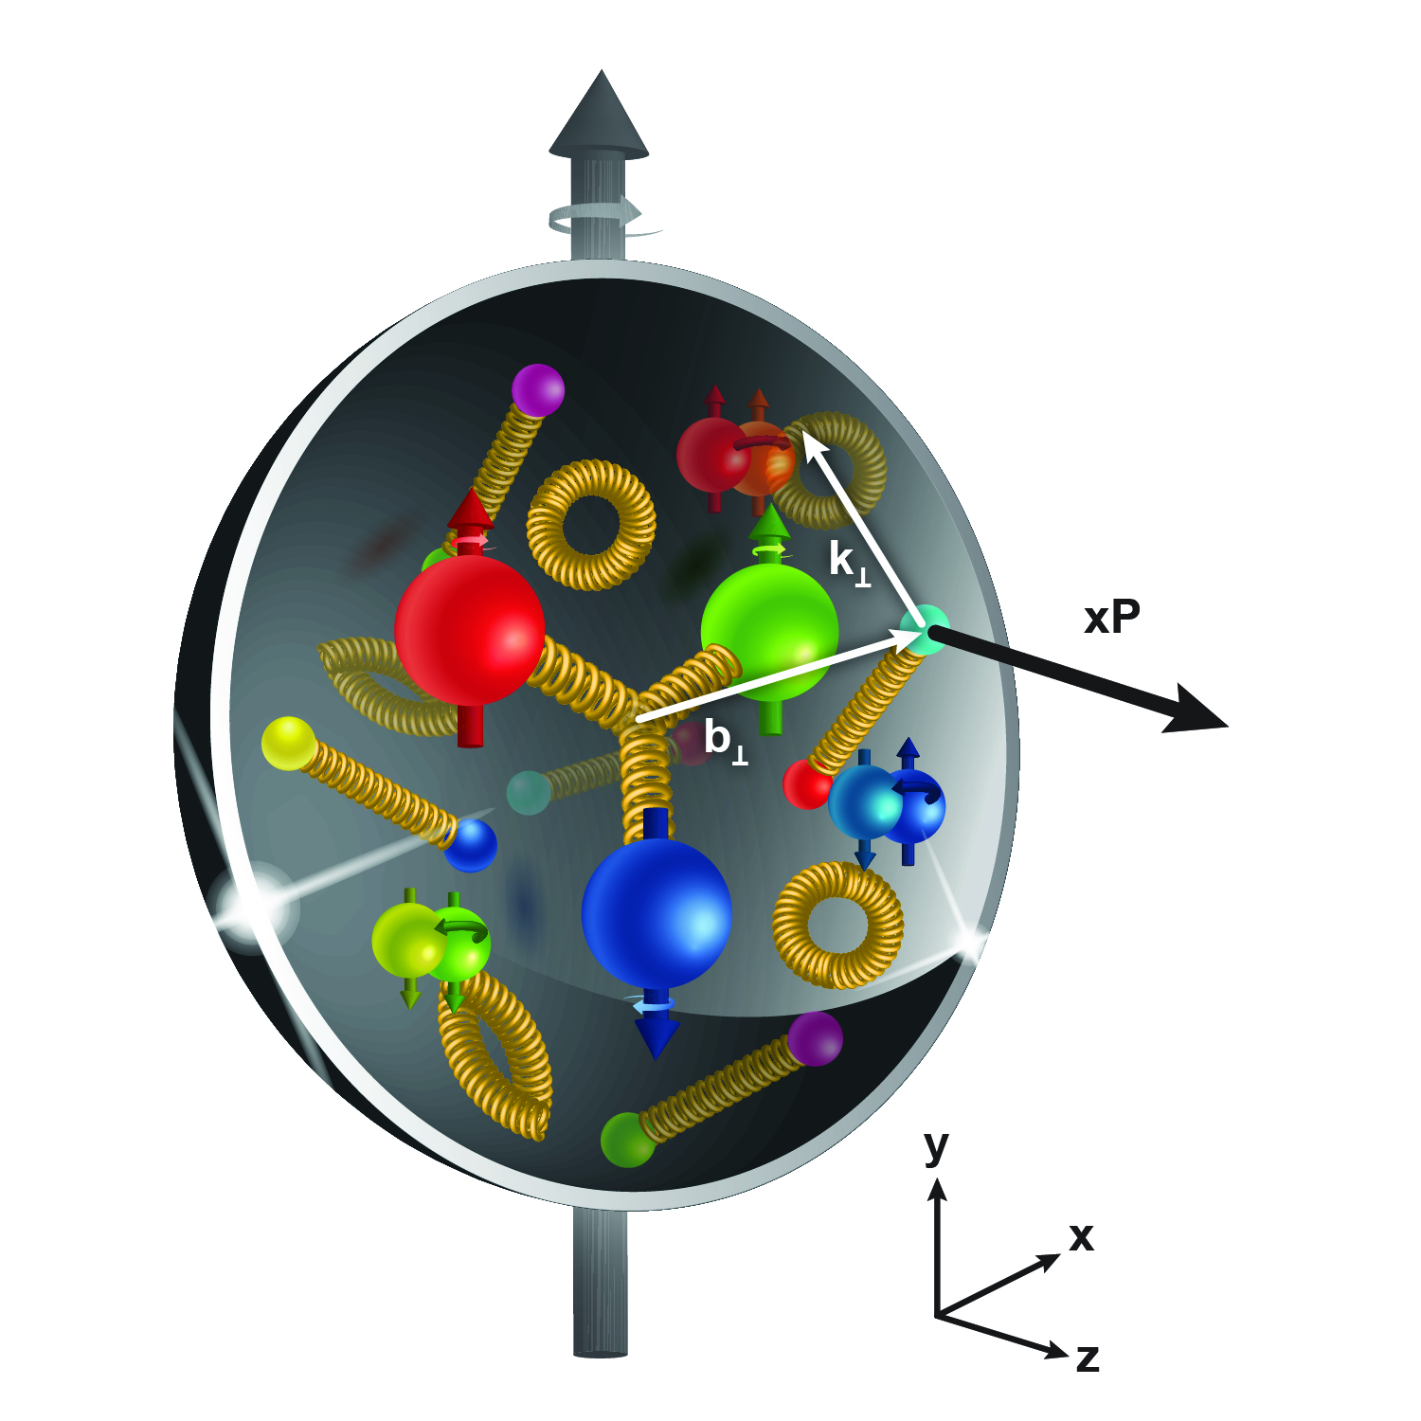
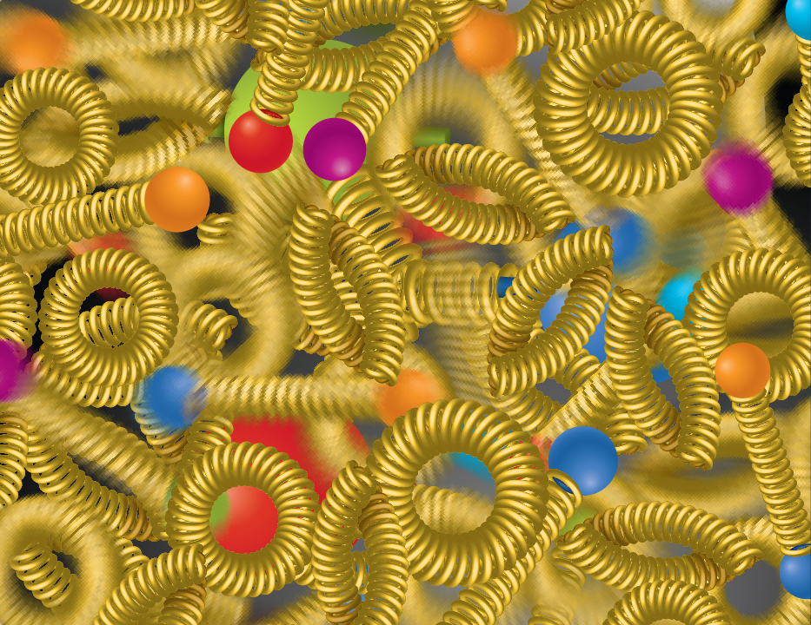
Compelling EIC Science (National Academy Report)
How do quarks, gluons, and orbital angular momentum contribute to proton spin?
Spin is a fundamental property of matter.
All elementary particles,
but the Higgs, carry spin.
Spin cannot be explained by a static picture, rather the interplay between the properties and interactions of quarks and gluons inside
the proton.
Does the mass of visible matter emerge from quark-gluon interactions?
Atom: Binding/Mass = 0.00000001
Nucleus: Binding/Mass = 0.01
Proton: Binding/Mass = 100
The EIC will determine an important term contributing to the proton mass, the so-called quantum chromodynamics (QCD) trace anomaly.
How can we understand QCD dynamics and the relation to confinement?
EIC will image quarks and gluons in 3D in space and momentum inside the nucleon and nuclei and uncover how the nucleon properties emerge from quarks and gluons and their interactions.
How do quark-gluon interactions create nuclear binding?
Is the structure of a free and bound nucleon the same?
How do quarks and gluons, interact with a nuclear medium?
How do the confined hadronic states emerge from these quarks and gluons?
Does gluon density in nuclei saturate at high energy?
How many gluons can fit in a proton?
How does a dense nuclear environment affect the quarks and gluons, their correlations and interactions?
=
gluon
splitting
?
gluon
recombination

Slide 4
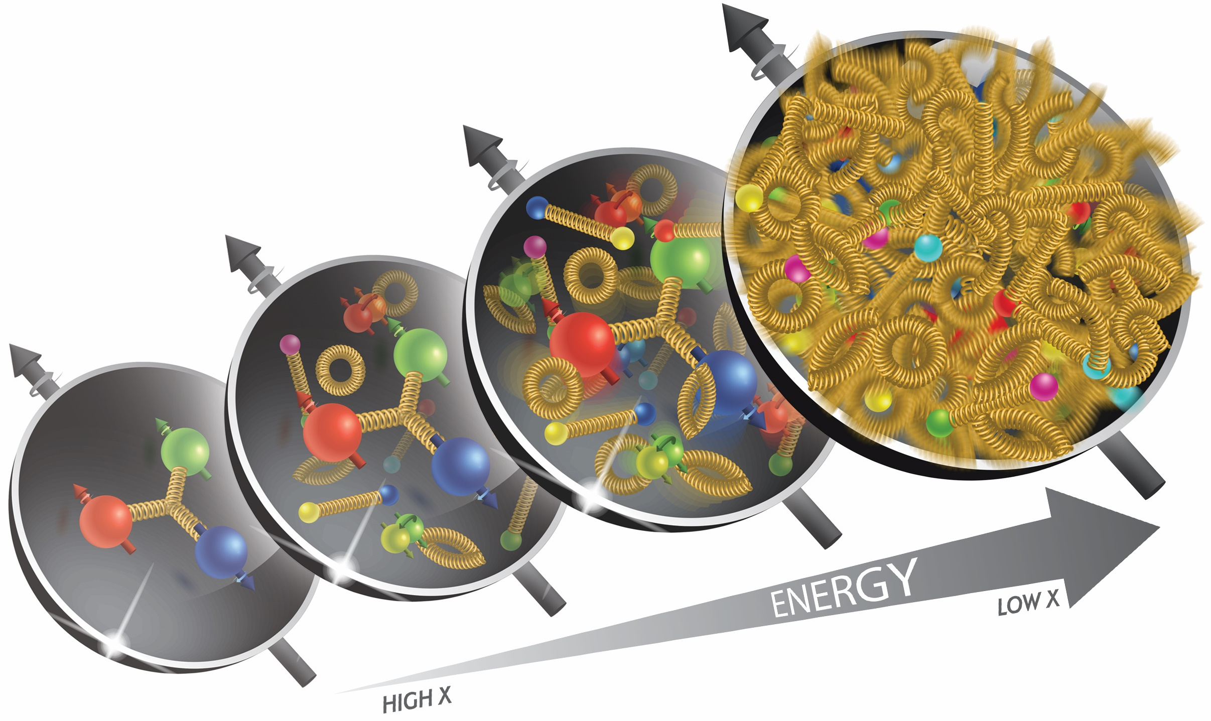
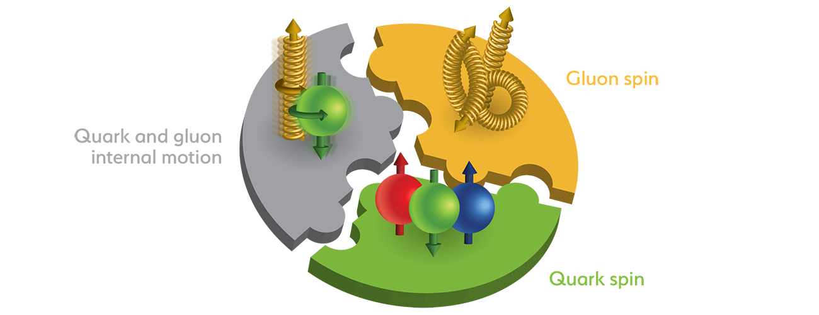
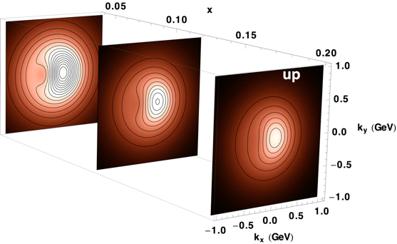
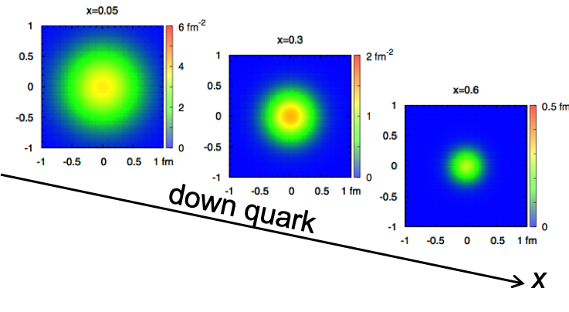
EIC Accelerator Performance Needs
wide center-of-mass energy √s: 20 – 140 GeV :
map the out nucleon and nuclei structure from high to low x
polarized electron and hadron (p, He-3) beams:
access to spin structure of nucleons and nuclei
Spin vehicle to access the spatial and momentum structure of the nucleon in 3d
Full specification of initial and final states to probe q-g structure of NN and NNN interaction in light nuclei
nuclear beams: d to Pb
accessing the highest gluon densities → saturation
quark and gluon interact with a nuclear medium
high luminosity 10³³-10³⁴ cm⁻²s⁻¹ :
mapping the spatial and momentum structure of nucleons and nuclei in 3d
access to rare probes, i.e. Ws
large acceptance (0.2 – 1.3 GeV) through forward focusing IR magnets
spatial imaging of nucleons and nuclei
gluon emission
gluon recombination
?
=

Slide 5
EIC Accelerator Performance Needs
wide center-of-mass energy √s: 20 – 140 GeV :
map the out nucleon and nuclei structure from high to low x
polarized electron and hadron (p, He-3) beams:
access to spin structure of nucleons and nuclei
Spin vehicle to access the spatial and momentum structure of the nucleon in 3d
Full specification of initial and final states to probe q-g structure of NN and NNN interaction in light nuclei
nuclear beams: d to Pb
accessing the highest gluon densities → saturation
quark and gluon interact with a nuclear medium
high luminosity 10³³-10³⁴ cm⁻²s⁻¹ :
mapping the spatial and momentum structure of nucleons and nuclei in 3d
access to rare probes, i.e. Ws
large acceptance (0.2 – 1.3 GeV) through forward focusing IR magnets
spatial imaging of nucleons and nuclei
gluon emission
gluon recombination
?
=

Slide 6
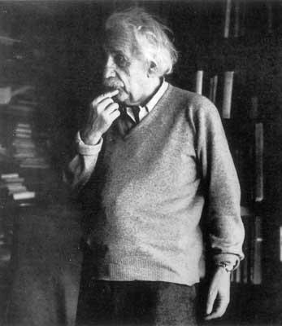
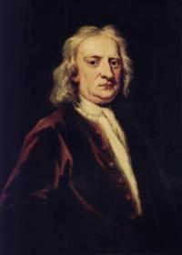
Accelerating particles →Towards Relativity
velocity
c
}
Einstein:
mass increases
not velocity
energy
Newton:

Slide 7
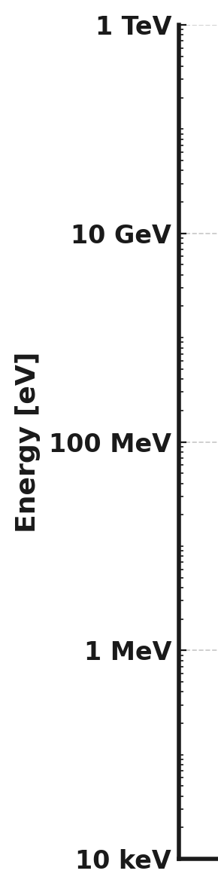
Particles to Accelerate
Ur²³⁸, 221 GeV
Pb²⁰⁸, 194 GeV
Wide range of rest masses from electron to heavy ions
Accelerator design largely depends on particle type and properties, including mass and energy, e.g.
particle speed in cavities
synchrotron radiation power
activation by losses
requirements for vacuum
Proton, 938MeV
Muon, 106MeV, τ=2.2µs
Electron, 511keV
Notes:
Rest mass of Pb (82p, 126n), 207.97 mass units, 931.5MeV per mass unit, results in 194GeV

Slide 8
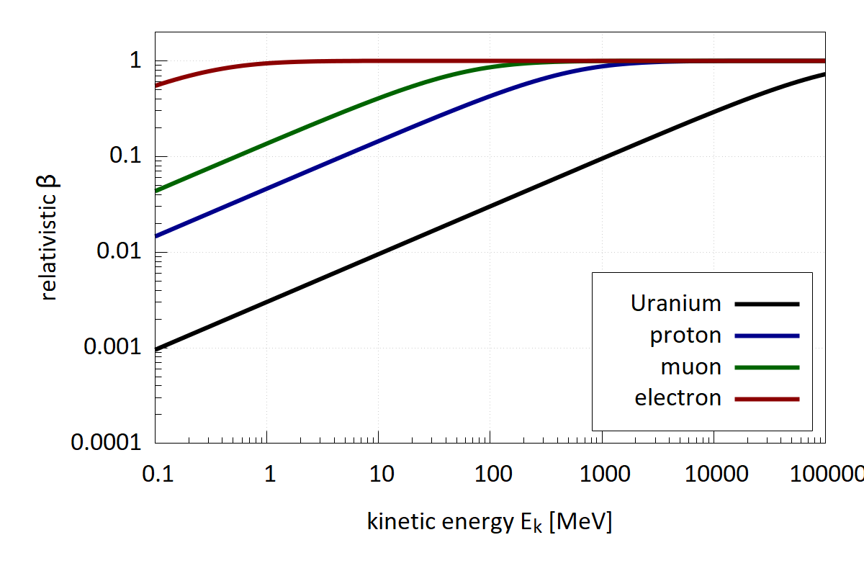
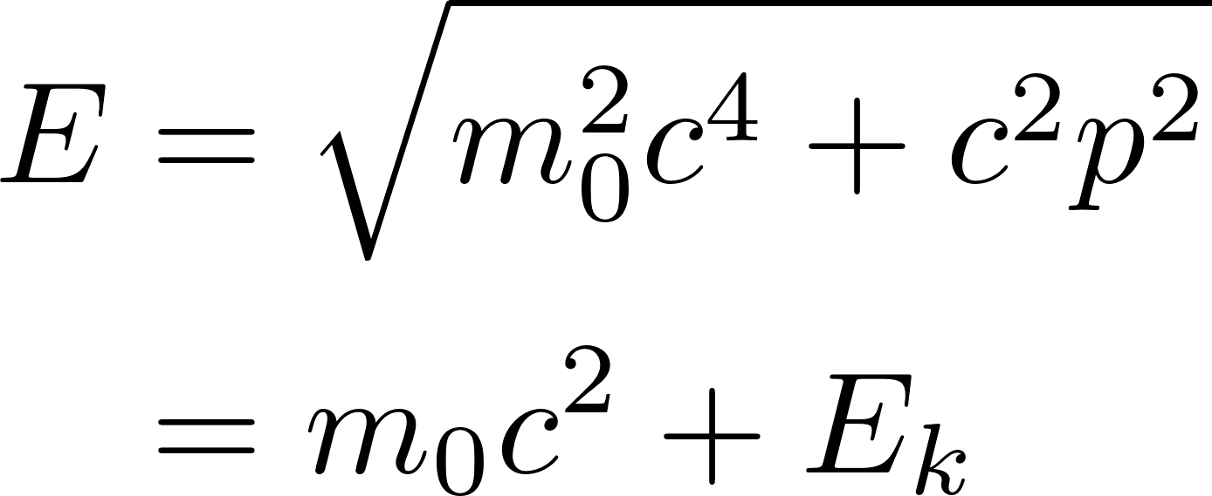
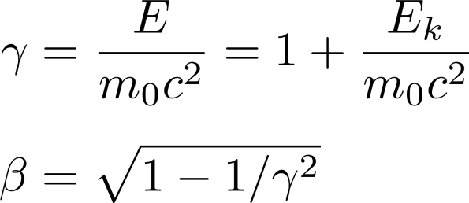
Speed of different particles vs energy
Relativistic energy-momentum relation:
Relativistic electrons at ~ MeV
Relativistic protons at ~ GeV

Slide 9
EIC Accelerator Performance Needs
wide center-of-mass energy √s: 20 – 140 GeV :
map the out nucleon and nuclei structure from high to low x
polarized electron and hadron (p, He-3) beams:
access to spin structure of nucleons and nuclei
Spin vehicle to access the spatial and momentum structure of the nucleon in 3d
Full specification of initial and final states to probe q-g structure of NN and NNN interaction in light nuclei
nuclear beams: d to Pb
accessing the highest gluon densities → saturation
quark and gluon interact with a nuclear medium
high luminosity 10³³-10³⁴ cm⁻²s⁻¹ :
mapping the spatial and momentum structure of nucleons and nuclei in 3d
access to rare probes, i.e. Ws
large acceptance (0.2 – 1.3 GeV) through forward focusing IR magnets
spatial imaging of nucleons and nuclei
gluon emission
gluon recombination
?
=

Slide 10
Centre of mass energy
In EIC one wants to collide (possibly head-on) e⁻ and ions
General definition of centre of mass energy:
Recalling definition of momentum:
  Assuming then hence:
Ideally, E_{h}=E_{e}, but different challenges for accelerating light e⁻ and heavy ions
Notes:
p &= \gamma_{rel} m_0 \beta_{rel} c = \sqrt{\gamma_{rel}^2 - 1} m_0 c = \frac{\sqrt{E^2 - E_0^2}}{c}\\
E \gg E_0
P \approx p/c
s &= m_T^2c^4 = E_T^2 - p_T^2c^2 = (E_h + E_e)^2 - (p_h - p_e)^2 c^2 \\
s \approx 2 \sqrt{E_1 E_2}

Slide 11
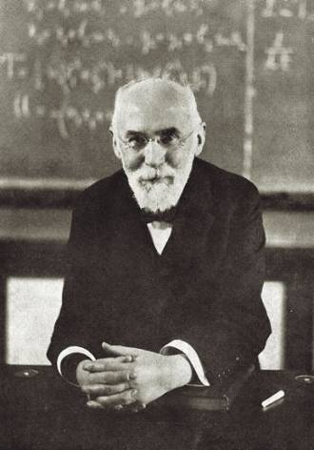
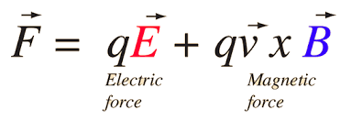
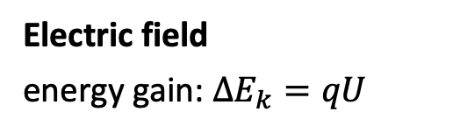
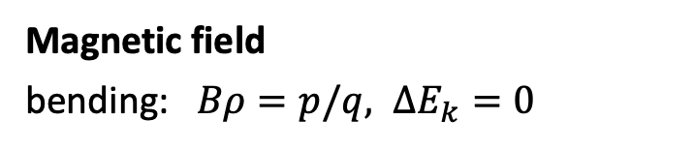
Accelerating charged particles: Lorentz Force
H.A.Lorentz
1853-1928
Electric field
energy gain: ${ΔE}_{k}=qU$
Magnetic field
bending: $Bρ=p/q, {ΔE}_{k}=0$
Always in the direction of E field
Perpendicular to the direction of motion.
N
-
+
Only option to increase momentum a beam of charged particles!
What about “steering” or bending them?
ρ
S

Slide 12
Transverse kick in a constant Electric field
Consider a charged particle entering a region with a constant electric field perpendicular to its motion…
The increase in transverse momentum is approximately
The angle is approximately (assuming small kicks)
Mind that there is a small boost in total p, here neglected.
Very large number for β ~ 1!

Slide 13
Transverse Kick in a constant Magnetic field
Consider a charged particle entering a region with a constant magnetic field perpendicular to its motion…
From geometric considerations:
Multiplying by the magnetic field B:
Assuming small angles:
Equating Lorentz force and centripetal force yields:
Putting everything together:
Local integrated magnetic field
“Constant” of the particle

Slide 14
Which field to guide ultra-relativistic particles?
E.g. Bending radius for protons in B and E for varying E_{k}:
  Comparison E and B field:
“Beam Rigidity” of the most useful relativist relation for the accelerator physicist:
where β_{r} is the relativistic factor, e is the elementary charge, and Z is the charge state (e.g. Z=1 for protons)
E_{k} | B = 1T | E = 10MV/m
60 keV | 35 mm | 12 mm
1 MeV | 140 mm | 200 mm
1 GeV | 5.6 m | 150 m
    Magnetic fields are used exclusively to bend and focus ultra-relativistic particles !
    => Normalisation factor for all “magnetic” effects

Slide 15
The path is long…
…let’s get some Energy !
Introduction of longitudinal beam dynamics

Slide 16
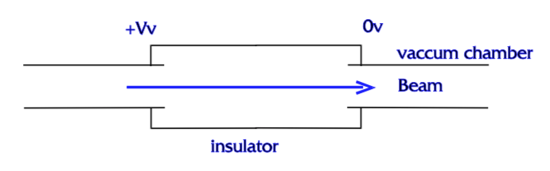
Electrostatic acceleration
Simplest way to generate an electric field in the motion direction: voltage difference
Gain on kinetic energy is proportional to V (the potential)
Remember: the energy unit (electron Volt): 1 eV is the energy that 1 elementary charge e gains when it is accelerated in a voltage of 1 Volt.
Electrostatic machines are still used at lower energy, as a 1st stage of acceleration, radiotherapy, particle source, etc.
Limitations:
Max. Voltage ~ 10MV due to insulation problems.
Cockcroft-Walton high voltage generator (600kV - 1964)

Slide 17
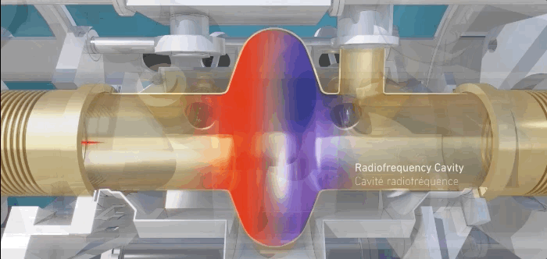
Radio-frequency acceleration
Apply an E-field which is reversed while the particle travels inside the tube
  it gets accelerated at each passage !
It can be used to accelerate beams in Linear and Circular machines
Only particles synchronized with RF will be accelerated → particles are bunched in “packages”

Slide 18
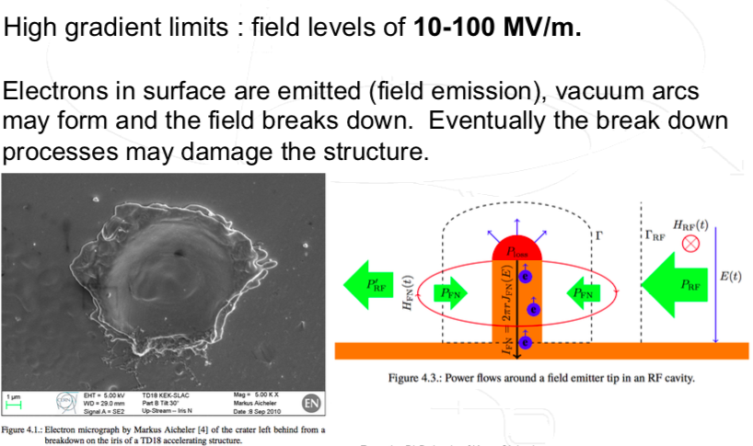
Limitation: RF field break down!

Slide 19
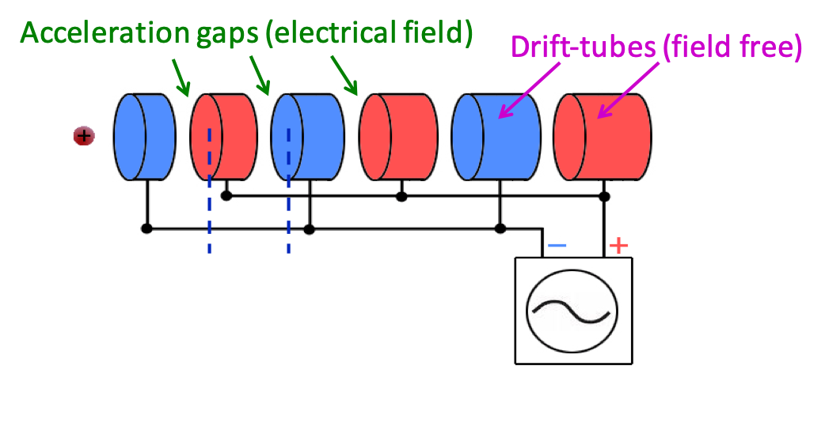


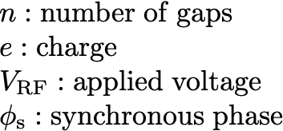

LINAC: linear accelerator
For non-relativistic particles:
→ Distance (L) between the acceleration gaps needs to fulfil the synchronism condition with T the period of the RF oscillator.
Energy gain:
Note: Bunched Beam!
If a particle arrives “off-phase” wrt to RF voltage, it gets decelerated!

Slide 20
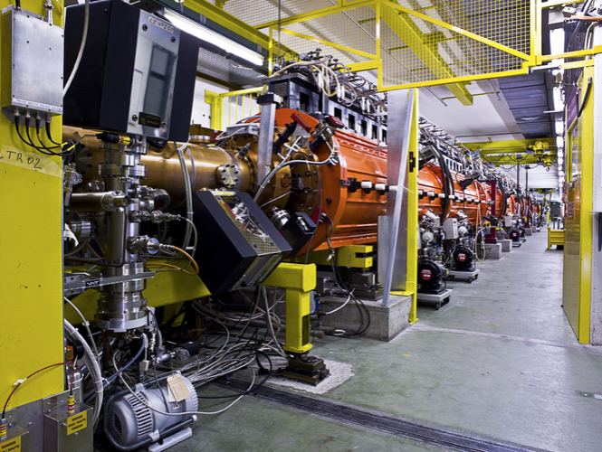
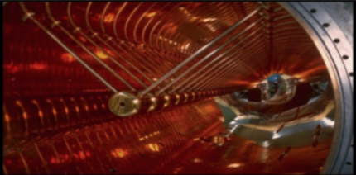
From LINAC to Circular Machines
LINACs are today the first stage in many accelerator complexes
Limited by the particle energy reach due to length and single pass
CERN LINAC2
Until 2018was the first accelerator in the proton acceleration chain for LHC. Replaced during LS2 by LINAC4
Unilac at GSI, Darmstadt
Circular Accelerators
Use of circular structures in order to apply over and over the accelerating fields.
Particles are bend onto circular trajectories → Many passages through RF structure

Slide 21

Circular accelerators: The Synchrotron
RF generator
Constant orbit during acceleration
To keep particles on the closed orbit, B should increase with time
ω_{s} and ω_{RF} increase with energy
B
RF cavity
E
Bending
magnet
R=C/2π
injection
extraction
RF frequency can be multiple of revolution frequency
$$ω_{RF}=hωs$$
ρ
bending
radius
h integer,
harmonic number:
number of RF cycles
per revolution
Synchronism condition
Note: h is also the maximum number of bunches in the synchrotron.
… but normally less bunches due to gaps for injection/ejection kickers, collision constraints,…

Slide 22
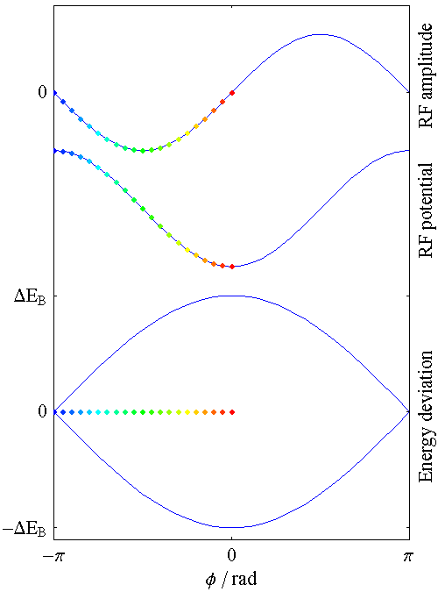
Synchrotron oscillations
A
V
time
B
1st revolution period
700th revolution period
800th revolution period
600th revolution period
300th revolution period
400th revolution period
500th revolution period
100th revolution period
200th revolution period
Particle B is performing Synchrotron Oscillations around synchronous particle A.
Oscillation amplitude and speed depends on the initial phase and energy
  For low amplitude ≈ harmonic oscillator
  But general: the restoring force is non-linear !

Slide 23
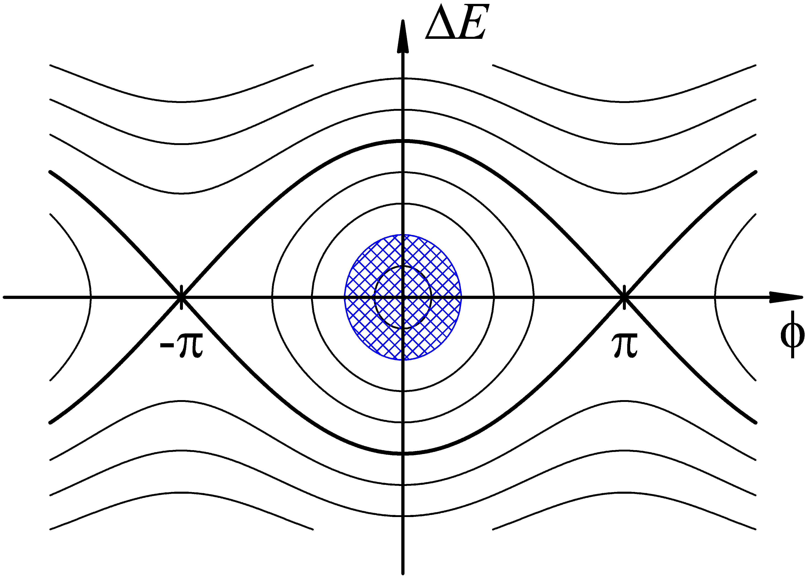
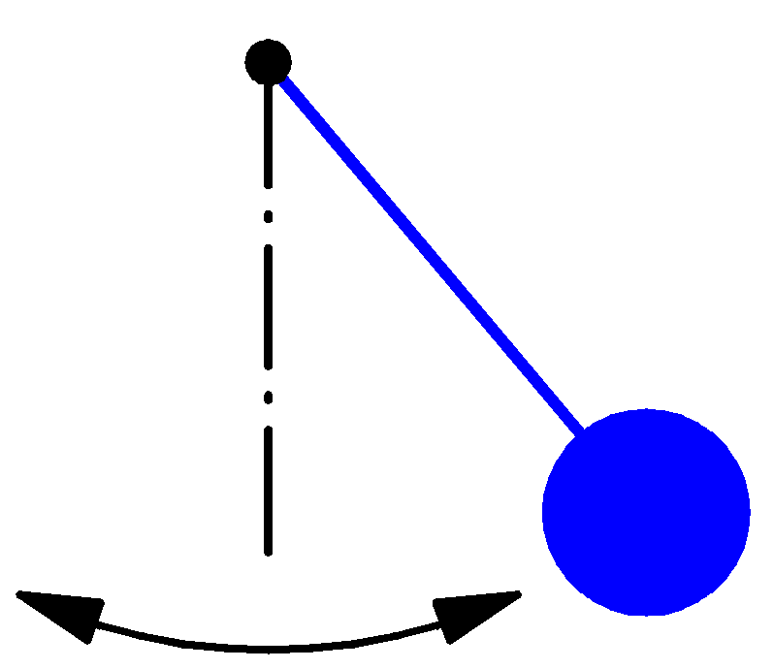

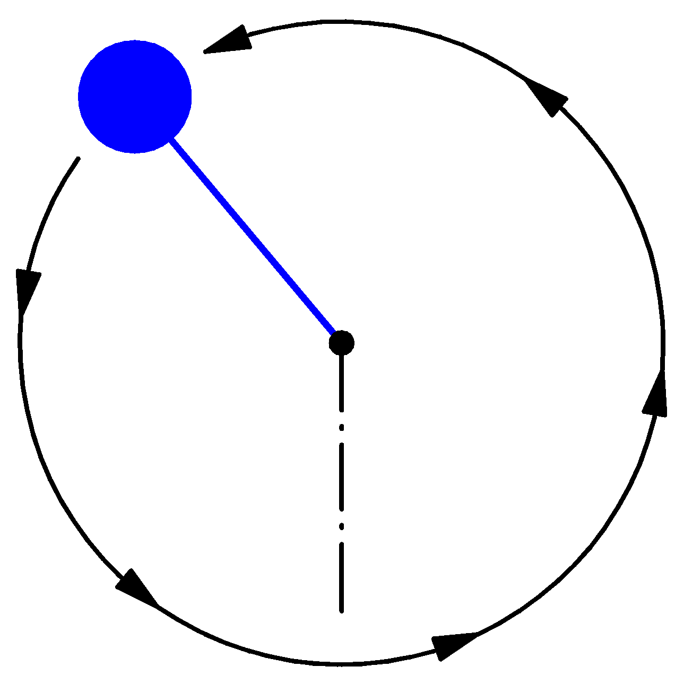
Synchrotron motion in phase space
ΔE-φ phase space of a stationary bucket
(when there is no acceleration)
Dynamics of a particle
Non-linear, conservative oscillator
→ e.g. pendulum
Particle inside the separatrix:
Particle at the
unstable fix-point
Particle outside the separatrix:
Bucket area: area enclosed by the separatrix
Longitudinal beam emittance: area covered by particles is phase space

Slide 24

Synchrotron oscillations (with acceleration)
Synchronous phase 𝜙_{s} : RF phase for which acceleration rate matches B field increase
1
Case with acceleration => B increasing
2
$$γ<γ_{t}$$
φ_{s}
π−φ_{s}
Phase space picture
Note: the symmetry of the case B = const. is lost
stable region
unstable region
separatrix

Slide 25
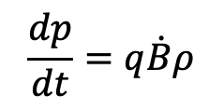


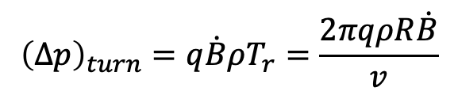
The Synchrotron – Energy ramping
Energy ramping by increasing the B field (frequency has to follow v):
$$\frac{dp}{dt}=q\dot{B}ρ$$
$${\left(∆p\right)}_{turn}=q\dot{B}ρT_{r}=\frac{2πqρR\dot{B}}{v}$$
$$p=qBρ$$
ρ const
With
$${\left(∆E\right)}_{turn}=2πqρR\dot{B}=q\hat{V}\sin{φ_{s}}$$
Synchronous phase φ_{s} changes during energy ramping:
The synchronous phase depends on
  the change of the magnetic field
  and the RF voltage
φ_{s}

Slide 26
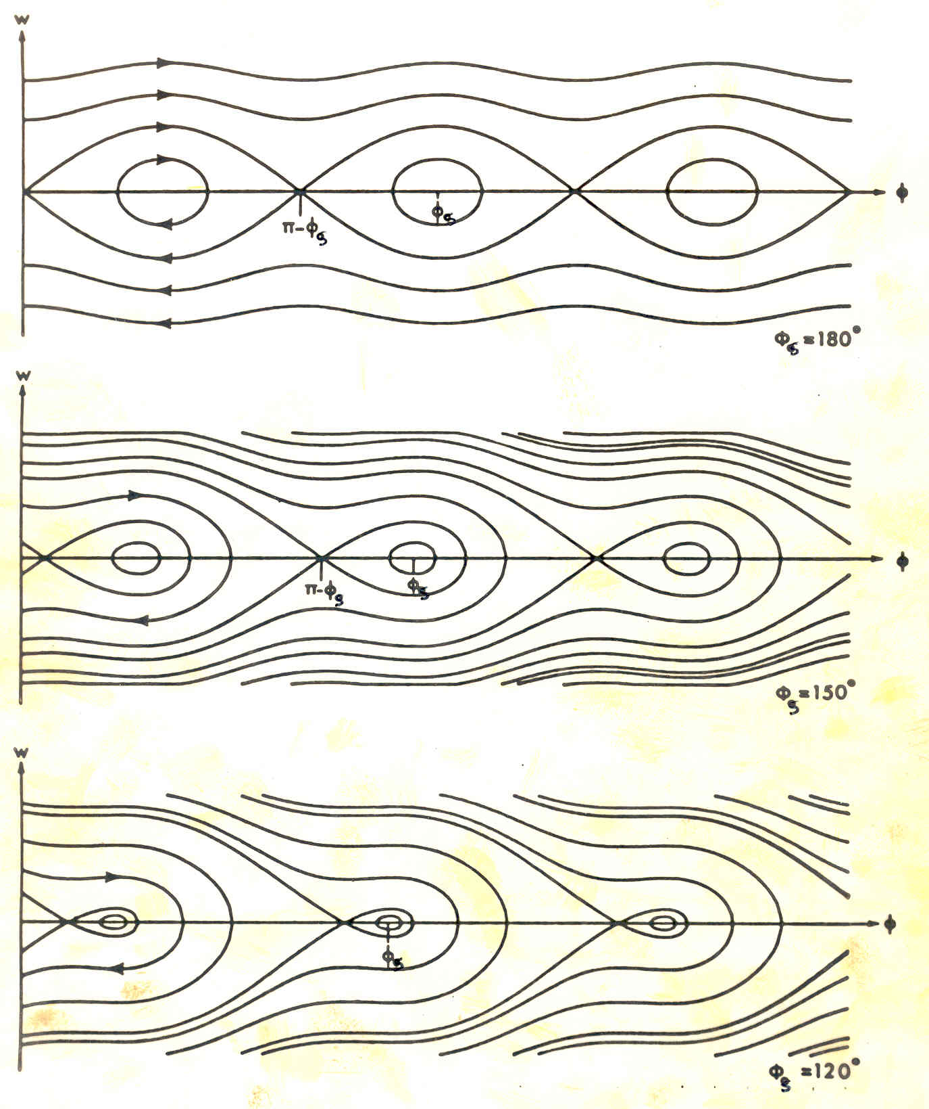
RF Acceptance versus Synchronous Phase
The areas of stable motion (closed trajectories) are called “BUCKET”. The number of circulating buckets is equal to “h”.
The phase extension of the bucket is maximum for φ_{s} =180º (or 0°) which means no acceleration.
During acceleration, the buckets get smaller, both in length and energy acceptance.
=> Depends on RF voltage and desired acceleration rate (i.e. B-field increase rate)

Slide 27
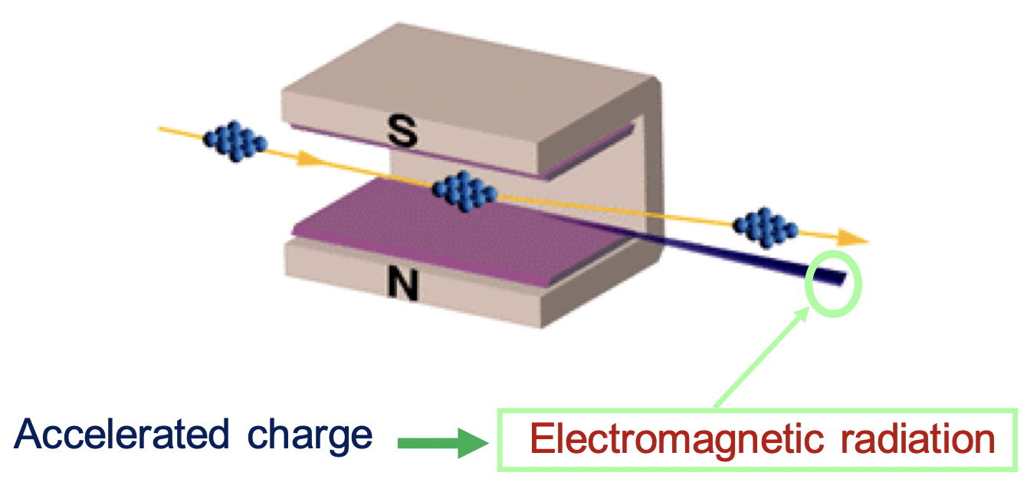
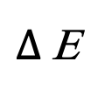
Limitation: Synchrotron Radiation
Bending charged particles results in the emission
of synchrotron radiation, i.e. particle losses energy!
Average energy-loss is
energy, bending-radius,
rest-mass dependant !
Typically limiting maximum energy of light particles (e.g. e⁻) in synchrotrons !
  Energy loss per turn larger than how much we can re-accelerate => many cavities for EIC e⁻!
It is helpful to damp synchrotron motion (and also transverse motion) !
  When the particle is in the upper half-plane,
  it loses more energy per turn, its energy gradually reduces
  When the particle is in the lower half-plane, it loses less
  energy per turn, but receives U₀ on the average, so its energy
  deviation gradually reduces (limited by quantum excitations)
  e⁻ beams “cool” themselves to low “emittances”!
4
r
E
4
U
=
π
e,p
(
)
0
3
m
c
2
3
ρ
0
$∆$Ε

Slide 28
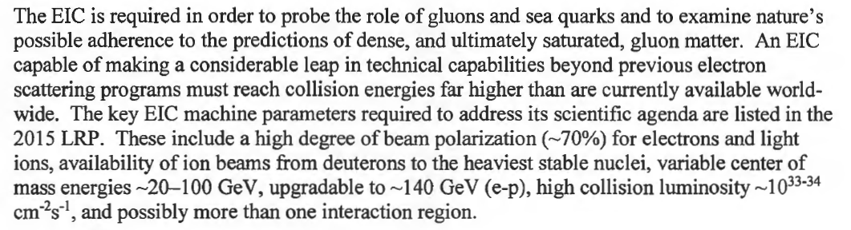
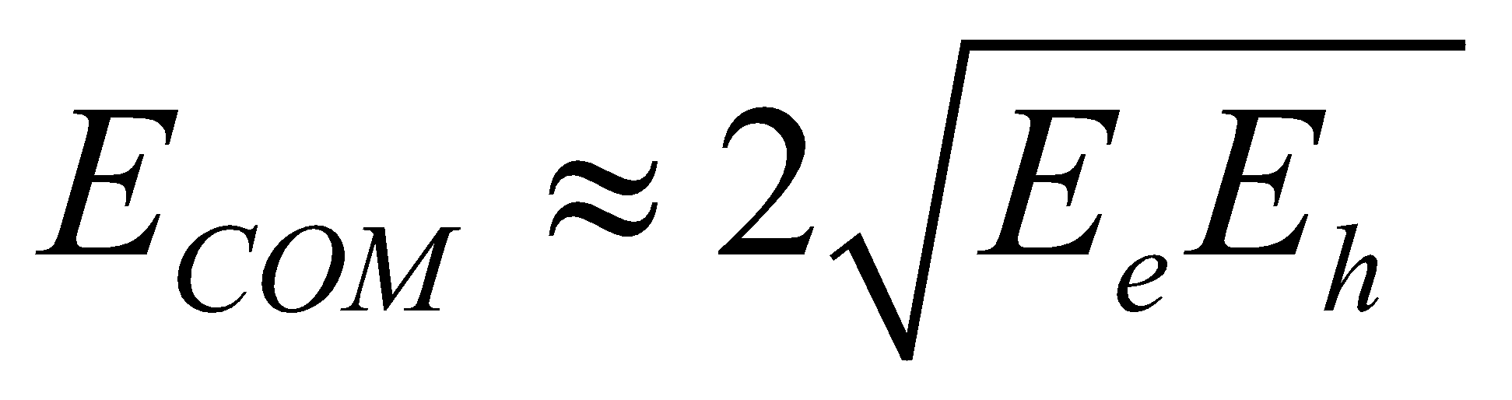
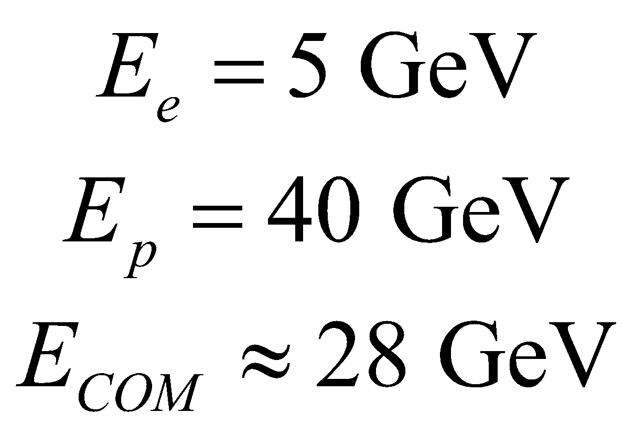
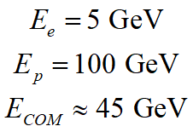
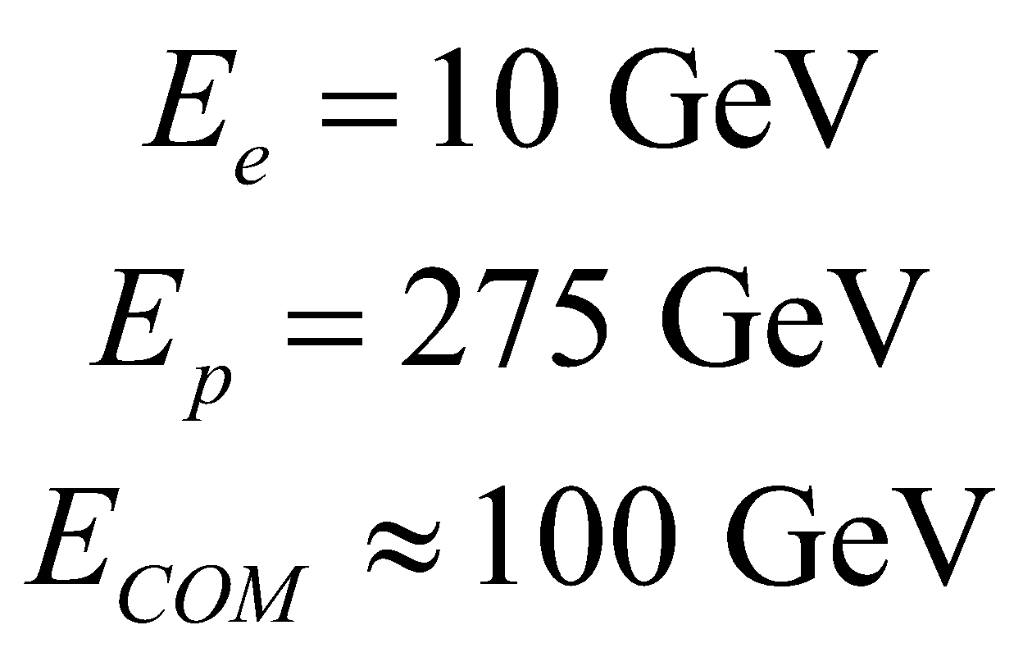
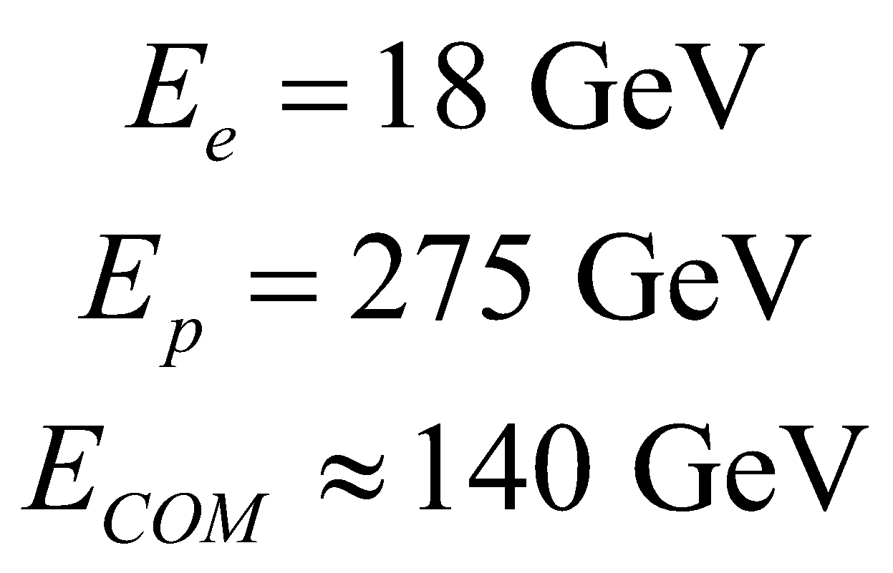
The DOE CD0 Mission-Need 2019
Much lower e⁻ energy than p/h

Slide 29
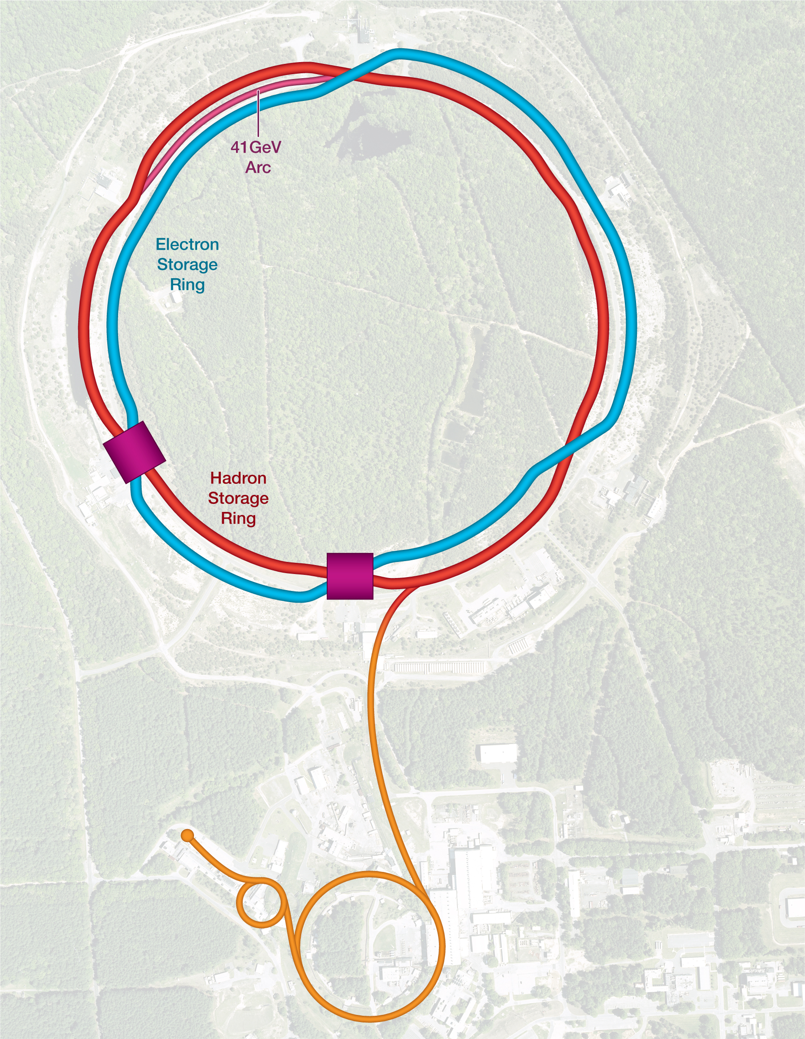
Collision Synchronization
HSR needs to operate over a wide energy range
Changing the beam energy in the HSR causes a significant velocity change
  To keep the two beams in collision, they have to be synchronized so bunches arrive at the detector(s) at the same time
Synchronization accomplished by path length change
  Between 100 and 275 GeV (protons), this can be done by a small radial shift – there is enough room in the beampipe
  For lower energies, use an inner instead of an outer arc as a shortcut. 90 cm path length difference corresponds to 41 GeV proton beam energy

Slide 30
EIC Accelerator Performance Needs
wide center-of-mass energy √s: 20 – 140 GeV :
map the out nucleon and nuclei structure from high to low x
polarized electron and hadron (p, He-3) beams:
access to spin structure of nucleons and nuclei
Spin vehicle to access the spatial and momentum structure of the nucleon in 3d
Full specification of initial and final states to probe q-g structure of NN and NNN interaction in light nuclei
nuclear beams: d to Pb
accessing the highest gluon densities → saturation
quark and gluon interact with a nuclear medium
high luminosity 10³³-10³⁴ cm⁻²s⁻¹ :
mapping the spatial and momentum structure of nucleons and nuclei in 3d
access to rare probes, i.e. Ws
large acceptance (0.2 – 1.3 GeV) through forward focusing IR magnets
spatial imaging of nucleons and nuclei
gluon emission
gluon recombination
?
=

Slide 31
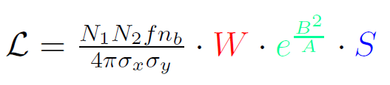
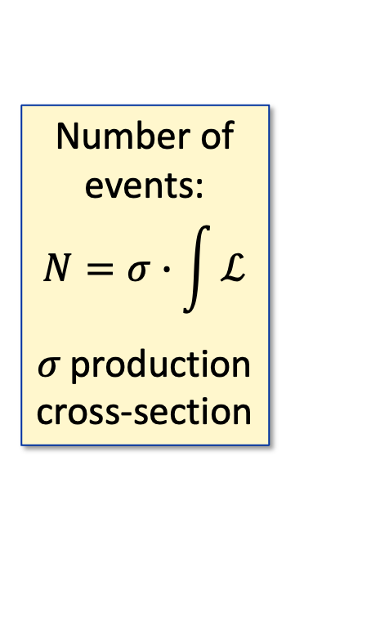
Luminosity: the main figure of merit for colliders
Revolution frequency
Number of bunches
Number of events:
$$N=σ∙\int{ℒ}$$
𝜎 production cross-section
Intensity per bunch
Beam transverse dimensions
Geometric correction factors
The instantaneous luminosity is the amount of events per unit of surface per second [cm⁻²s⁻¹]
Integrating this over time results in the integrated luminosity
  Note: Cross section is expressed in units of barns (1 barn = 10⁻²⁸m²)

Slide 32
Beam size matters…
…let’s Focus!
Introduction of transverse beam dynamics

Slide 33
Charged particles in homogeneous B field
Two charged Particles in a homogeneous magnetic field
Horizontal motion along
a reference particle/orbit
Representation in
phase-space
x'
Horizontal
displacement
μ
x
0
Machine circumference
L
Different particles with different initial conditions in a homogeneous magnetic field will cause oscillatory motion in the horizontal plane
=> Betatron Oscillations
Visualisation of the
phase-advance concept !
Note: for one full turn in the machine circumference => Tune (Q) (here=1)
Particle A (reference)
Particle B

Slide 34
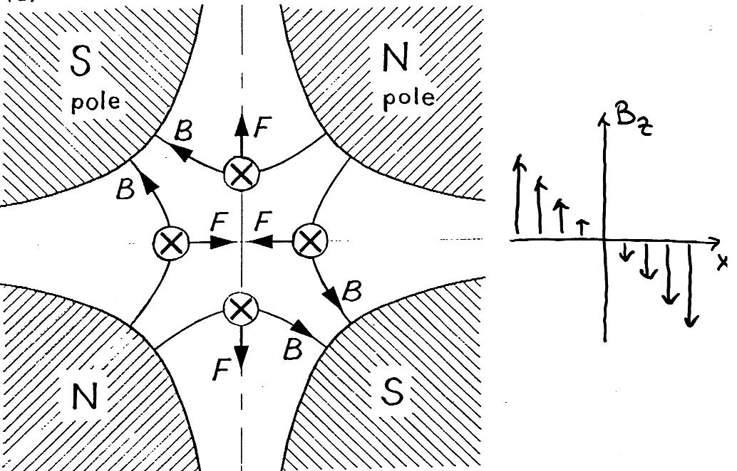
Oscillatory Motion of Particles
Transverse field linear with displacement from centre!
The horizontal motion seems to be “stable”…
…what about the vertical plane ?
Many particles …
… many initial conditions
Transverse focusing
needed !
=> make use of quadrupoles !
Vertical
displacement
→ s
Many different angles
Beam gets dispersed
But: focusing in one plane, defocusing in the other plane !

Slide 35
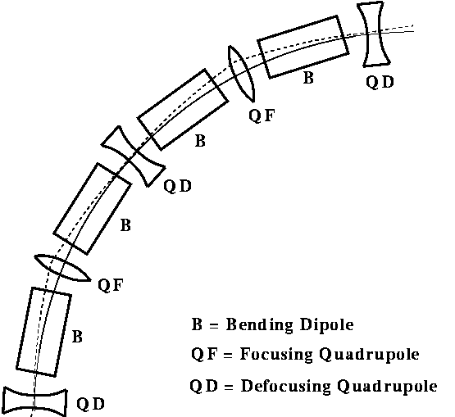
Alternating gradient lattice
An illustrative scheme
(LHC: 2x3 dipoles per cell)
One can find an arrangement of quadrupole magnets that provides net focusing in both planes (“strong focusing”)
Quadrupoles are interleaved with dipole magnets keep the particles on the circular orbit.
s
x
y
Coordinate system
Notes:
This is how it looks in practice
One can find an arrangement of quadrupole magnets that provides net focusing in both planes (“strong focusing”).
Dipole magnets keep the particles on the circular orbit.
Quadrupole magnets focus alternatively in both planes.

Slide 36
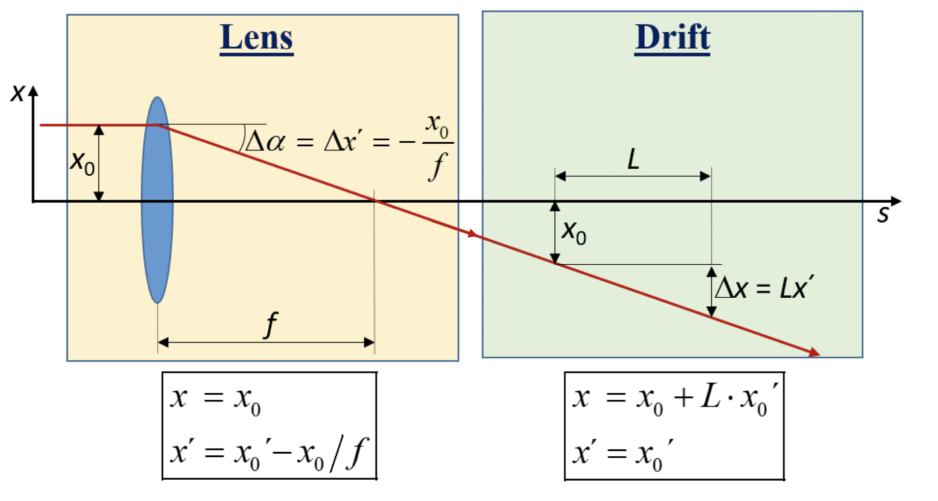
More in details: Optics
Change of particle displacements in horizontal / vertical plane:
They are linear transformations! => they can be described by matrices!
What is f ?!
Recall kicks in B-field:
In quadrupoles B_{y} = G x
Where G and l are the quadrupole gradient and length, respectively
Notes:
f &\approx \frac{p/q}{G l}

Slide 37
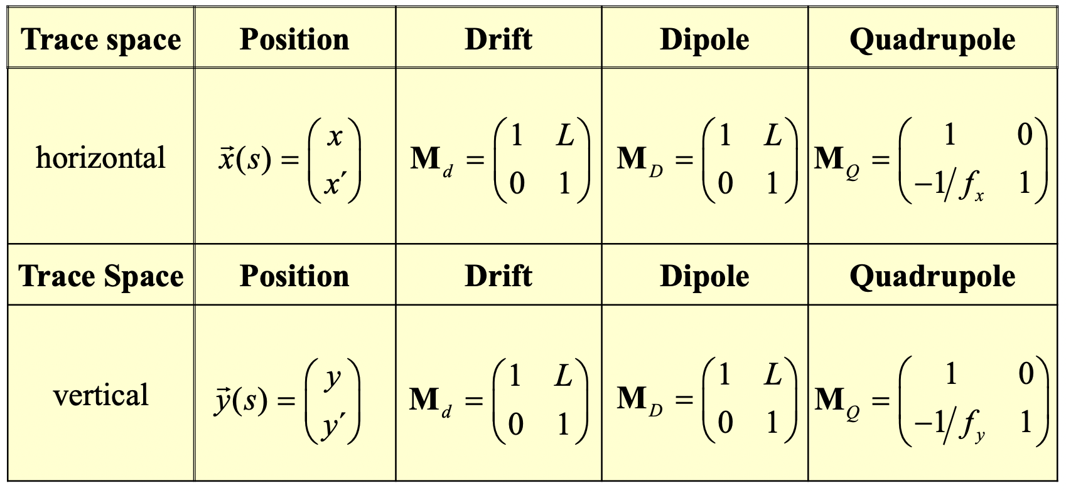
Synchrotron main building blocks
Planes (x, x´) and (y, y´) are called transverse trace spaces:
Note: A single quadrupole must have f_{x} = −f_{y} , Convention: f > 0 → focusing

Slide 38
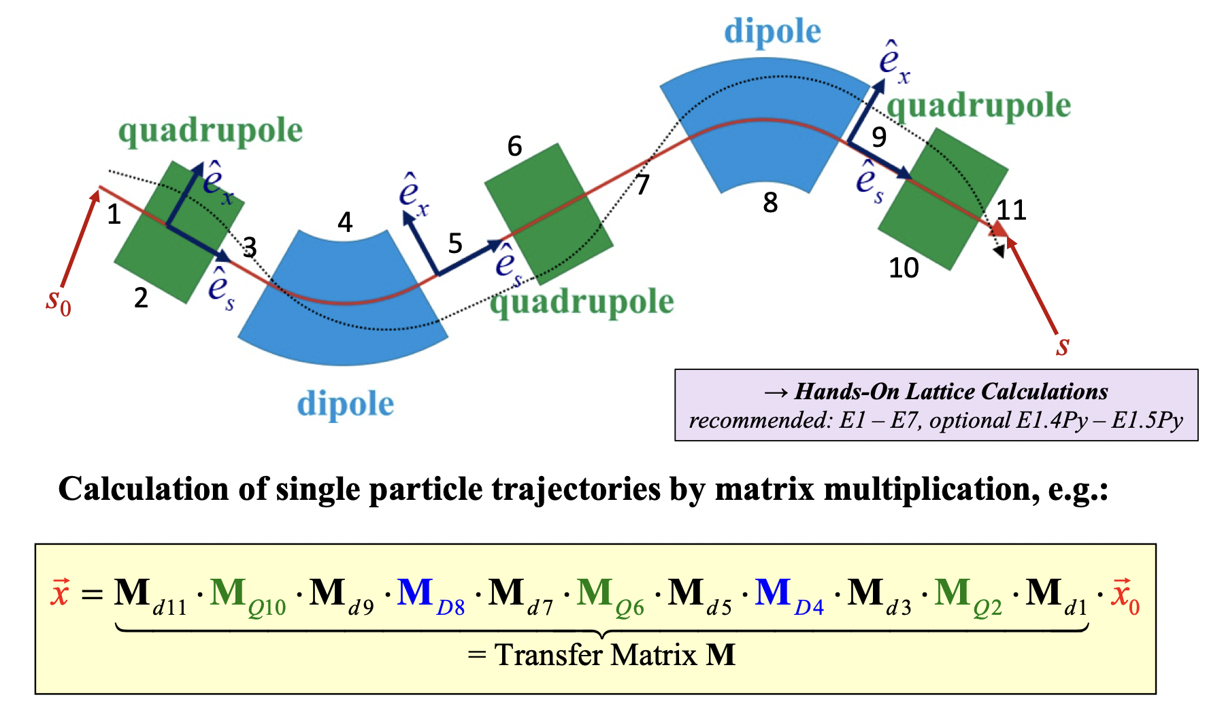
Putting them together

Slide 39
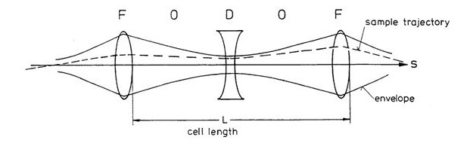
Equivalent matrix of a FODO cell
Consider an alternating sequence of focussing (F) and defocussing (D) quadrupoles separated by a drift (O)
The transfer matrix of the basic FODO cell reads
Notes:
M =
\begin{pmatrix}
1 & 0 \\
-\frac{1}{f} & 1
\end{pmatrix}
\begin{pmatrix}
1 & \frac{L}{2} \\
0 & 1
\end{pmatrix}
\begin{pmatrix}
1 & 0 \\
\frac{1}{f} & 1
\end{pmatrix}
\begin{pmatrix}
1 & \frac{L}{2} \\
0 & 1
\end{pmatrix}
=\begin{pmatrix}
1 + \frac{L}{2f} & L + \frac{L^2}{4f} \\
-\frac{L}{2f^2} & 1 - \frac{L}{2f} - \frac{L^2}{4f^2}
\end{pmatrix}

Slide 40
Considering both planes
In order to calculate numbers, one usually defines a FODO cell from the middle of the first F-quadrupole up to the middle of the last F-quadrupole.
Hence the resulting transfer matrix looks:
M= $M_{Q}$(2$f_{0})∙M_{D}\left(L\right)∙ M_{Q}$(${−f}_{0}$) $∙M_{D}\left(L\right)$ $∙ M_{Q}$(${2f}_{0}$)
In the ideal case, motion is un-coupled between the two planes!
=> We can study independently x/y planes
Choosing well L and f₀ …
=> overall focusing in both planes!
Notes:
\left(
\begin{array}{cccccc}
1 - \frac{L^2}{2f_0^2} & \frac{L}{f_0}(L + 2f_0) & 0 & 0 \\
\frac{L}{4f_0^3}(L - 2f_0) & 1 - \frac{L^2}{2f_0^2} & 0 & 0 \\
0 & 0 & 1 - \frac{L^2}{2f_0^2} & -\frac{L}{f_0}(L - 2f_0) \\
0 & 0 & -\frac{L}{4f_0^3}(L + 2f_0) & 1 - \frac{L^2}{2f_0^2} \\
\end{array}
\right)

Slide 41
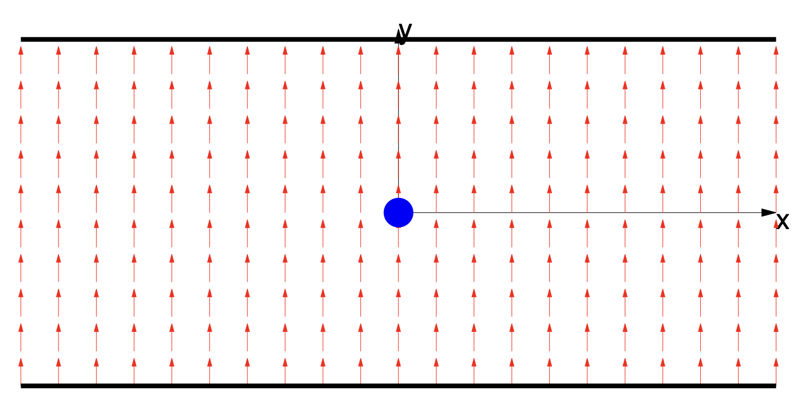
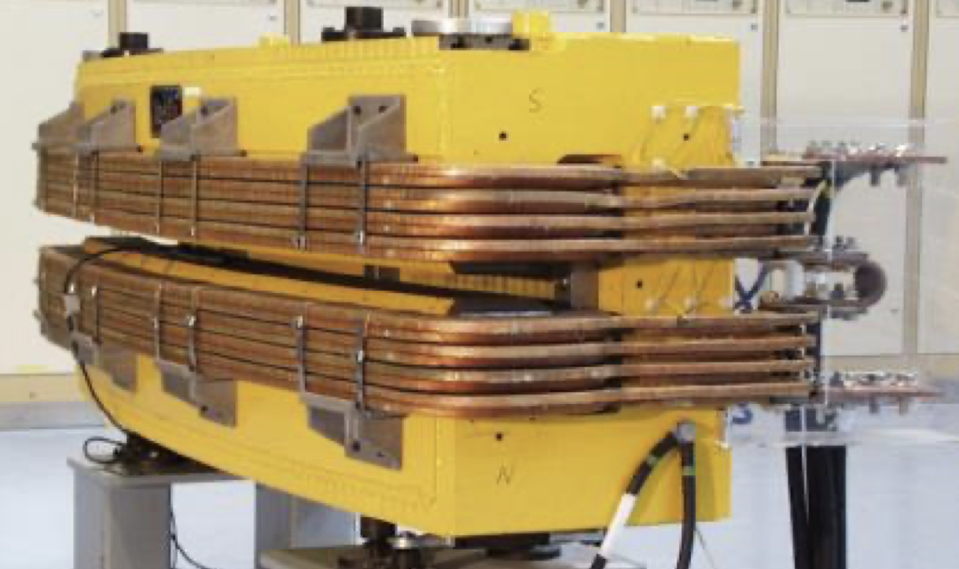
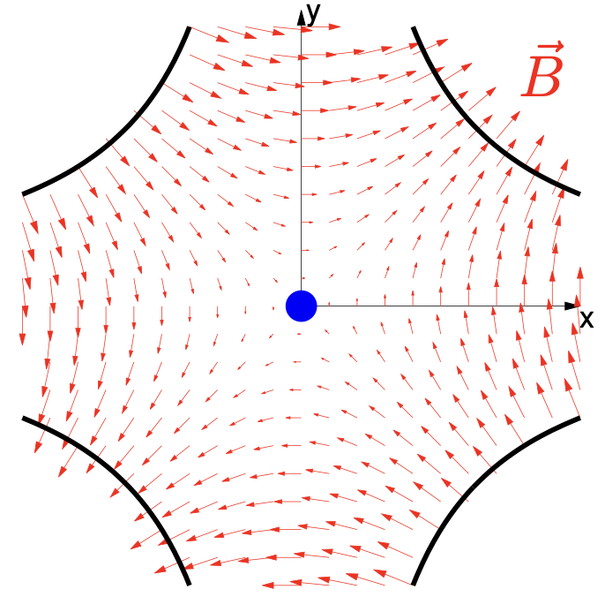



Basics accelerator lattice
An accelerator is usually build using a repetition of basic ‘cells’
A simple FODO cell usually contains:
  Dipole magnets to bend the beams
  Quadrupole magnets to focus the beams
  Beam position monitors (BPM) to measure the beam position
  Small dipole corrector magnets for beam steering
  (Sextupole magnets to control off-energy focusing)
Quadrupole
(focussing)
Quadrupole
(de-focussing)
Sextupole
Dipole corrector
Dipole
Dipole
beam
Beam position monitor
Schematic of a ½ cell (not to scale)

Slide 42












Numerical Tracking in a toy FODO lattice
Tracking a single particle, for many turns in a synchrotron made of a series of FODO cells
A)
B)
A) Before foc. quad.
B) After foc. quad.
C)
D)
Starting point
C) Before defoc. quad.
D) After defoc. quad.
Element by element “tracking” till completion of one turn…
… and start a new turn
NOTE! Horizontal and Vertical motions are uncoupled (i.e. x particle trajectory doesn’t depend on its y coordinate)

Slide 43




Beam Envelope: Courant-Snyder formalism
Courant-Snyder formalism (Twiss functions):
Introduced in the late 50’s to parametrize the phase space evolution along the accelerator starting from linear equation:
with the transfer matrix defined as :
using 4 Twiss functions: 𝛼(𝑠); 𝛽(𝑠); 𝛾(𝑠) 𝑎𝑛𝑑 𝜇(𝑠)
and some relations among them:

Slide 44

Beam envelope at a given s location
The beam size and/or the maximum particle offset (at a given location s!) scales like :
  => machine optics !
  => beam/particle property !
  They can be both very different between the two planes (like in EIC)
It is an invariant of the motion!
Depending on the context, it can be:
  The action of a single particle under consideration
  The emittance of an ensample of particle
Note again: horizontal and vertical plane have their own functions/emittances, in principle independent !

Slide 45



What about “off-momentum” particles?
=> A particle with a momentum deviation $δ=\frac{δp}{p}$ > 0 gets bent less in a dipole.
In a uniform dipolar field it would just settle to another circular orbit with a bigger diameter
In an alternate gradient synchrotron it is more complicated:
the focusing/defocusing is also dependent on the momentum, so the resulting orbit follows the optics of the accelerator.
We describe the dispersion as a function of s introducing a new function $D\left(s\right)$
$x_{δp}$= $x_{0}$+ $D\left(s\right)\frac{δp}{p}$

Slide 46

So: beam size at the IP?!
It depends on optic functions (β(s), D(s)) and beam properties (ε, σ_{δ})
Optic functions can be controlled by accurately choosing quadrupole strengths
Emittances and energy spread of e⁻ beam are defined by synchrotron radiation damping!
  Naturally producing “flat” e⁻ beam (ε_{e,x} >> ε_{e,y})
Hadron (heavy!) beams are unaffected
  Typically, round beams (ε_{h,x} = ε_{h,y})
To maximise luminosity (and beam lifetime), colliding beams must have the same beam size at the IP
  Need some “cooling” mechanism to make hadron beams flat as well…
Assuming “betatronic motion” is independent from “dispersive motion”
Recall energy loss/turn formula:

Slide 47
Electron Cooling Cartoon
Well-established technique with almost 50 years of experimental experience (at low energy!)
Simple analogy (by I. Meshkov): a bullet (“ion”) shot at a heap of sand (“electrons”!) flying with average velocity v₀ :
V_{ion} ⇒ v₀ ≡ ⟨v_{e}⟩
V_{ion} ≠ v₀
ion
e⁻
v₀

Slide 48


Electron cooling to produce ‘Flat’ Proton Bunches
RF diagnostics line with Deflecting cavity
180°Dipole
(U-turn)
LEReC
Cooling Solenoids
180° Dipole
Spectrometer
Mu-metal shielding
Quad
cooling
RF diagnostic
hadron
hadron
hadron
e⁻
HSR
e⁻
HSR
e⁻
extraction
transport
IR2 layout
(all within the
existing RHIC
Tunnel)
Injector test
injection
SC Quad
PM
Cathode transport
PM
PM
Solenoids
Laser
197 MHz
130 kW Beam Dump
Extraction line
900 kW Beam Dump
4x 591 MHz
NCRF correction Cavities
DC Gun
400kV
Injector/linac
Test line
24MHz
RF cavity
16x 197 MHz
NCRF LINAC
Not to scale

Slide 49


EIC IP Optics design
Generally, one needs to first “explode” beam size to then reach smallest beam size at IP
Asymmetric to accommodate difference in emittances of e⁻ and h beams
Need to consider also trajectory of secondary particles generated during collision and being lost somewhere downstream (but carrying useful information..)
From: “Electron Ion Collider Conceptual Design Report 2021” - DOI

Slide 50


Ways to Increase Luminosity
Increase the beam brightness from the injectors (N/ε)
Increase number of bunches
Reduce the β* (σ)
  Stronger focusing around the Interaction Point (IP)
Use crab cavities to reduce the crossing angle effect (s)
  Tilt the bunches to have more head-on collision effect
  => Built in the EIC design!
To take into account geometric aberration
at the IP
Beam 1
Beam 2
Beam 1
Beam 2
With crabbing
Without crabbing

Slide 51
Its sounds cool…
…but it can get hot
Introduction to imperfections

Slide 52


From model to reality - fields
  The physical units of the machine model defined by the accelerator physicist must be converted into magnetic fields and eventually into currents for the power converters that feed the magnet circuits.
  Imperfections (= errors) in the real accelerator optics can be introduced by uncertainties or errors
    E.g., actual beam momentum, magnet calibration and hysteresis, power converter regulation, …
Magnet strength
Actual magnet current
Actual field seen by the beam
Magnetic field (gradient)
Requested current
Beam momentum
Magnet
Calibration/hysteresis curve (transfer function)
Power converter
Additional effects, e.g. eddy currents
Earth currents flowing over the LEP vacuum chamber that were generated by the DC railway line near Geneva
Example of the ELENA main dipoles hysteresis curve

Slide 53

Illustration of closed orbit distortion
Ideal machine toy model (no errors)
  Particle injected on the design (or reference) orbit … remains on the design orbit turn after turn
Starting point with (x=0, x’=0)

Slide 54






Illustration of closed orbit distortion
Ideal machine toy model (no errors)
  Particle injected on the design (or reference) orbit … remains on the design orbit turn after turn
  Particle injected with offset …

Slide 55

Illustration of closed orbit distortion
Ideal machine toy model (no errors)
  Particle injected on the design (or reference) orbit … remains on the design orbit turn after turn
  Particle injected with offset … performs betatron oscillations around the closed orbit which is the same as the design orbit as long as there are no imperfections

Slide 56






Illustration of closed orbit distortion
Ideal machine toy model with dipole error (unintended deflection) somewhere
  Particle injected on the design orbit … receives dipole kick every turn
Dipole error location

Slide 57

Illustration of closed orbit distortion
Ideal machine toy model with dipole error (unintended deflection) somewhere
  Particle injected on the design orbit … receives dipole kick every turn … and consequently performs betatron oscillation around a distorted closed orbit

Slide 58









Single dipole kick vs. tune
  Closed orbit distortion is most critical for tunes close to integer → closed orbit becomes unstable
  (but beam size not affected)

Slide 59


Integer and half-integer resonance
  Dipole kicks add-up in
  consecutive turns for Q = n
  Integer tune excites orbit
  oscillations (resonance)
    orbit becomes unstable!
  Dipole kicks get cancelled in consecutive turns for Q = n+1/2
  Half-integer tune cancels orbit
  oscillations
u'
u'
u
u

Slide 60


Illustration of optics distortion
Ideal machine toy model with regular FODO lattice and quadrupole error at the end of circumference
  Our particle performs betatron oscillations but gets additional focusing from quadrupole error
    There is a tune-shift (additional de-/focusing)
    Beam envelope is distorted around the machine … “beta-beating”
Quadrupole error location
Note the change of the ellipse shape!
Note the change of the actual machine tune!

Slide 61






Optics distortion vs. tune
  For which configuration quadrupole errors have biggest impact on optics?
    Close to integer and half-integer tunes → envelope (or beam size) becomes unstable

Slide 62


Quadrupole error in phase space
  Therefore, integer tunes and half-integer tunes need to be avoided for machine operation to avoid beam envelope becoming unstable due to quadrupole errors
  Recall: for integer tunes dipole errors drive the closed orbit unstable, but for half-integer tunes they have minimum effect
Q = n (integer)
→ kicks from quadrupoles add up (same as for kicks from dipoles)
Q = n/2 (half-integer)
→ kicks from quadrupoles also add up
(while kicks from dipoles cancel)

Slide 63

What about higher order errors?
Our beautiful phase space ellipses degrade to complex structures…
  “islands” of stable region and chaotic motion at the edges appear
  Generally, this leads to emittance growth and losses
In general, including both vertical as well as horizontal motion, resonances occur when the tunes (Q_{x} and Q_{y}) satisfy:
where m_{x}, m_{y} and l are integers
  The order of the resonance is |mx| + |my|

Slide 64

Tune diagram with resonances: LHC example

Slide 65


Dynamic aperture (DA)
The most direct way to evaluate the nonlinear dynamics performance of a ring is the computation of Dynamic Aperture (short: DA), which is the boundary of the stable region in co-ordinate space
Need a symplectic tracking code to follow particle trajectories (a lot of initial conditions) for a number of turns until particles start getting lost: this boundary defines the Dynamic Aperture
Dynamic aperture plots show the maximum initial values of stable trajectories in x-y coordinate space

Slide 66

Many (corrector) magnets needed to maximise DA!

Slide 67
Last not least: Collective Effects
Collective = generic term for all effects when the coulomb force of the particles in a bunch can no longer be neglected; in other words when there are too many particles…
We distinguish between:
  self interaction of the particles within a bunch or interaction with counter-rotating bunch
    Intra Beam scattering
    Touschek scattering
    Space Charge effects
    Beam-Beam effect
  typically leading to emittance growth and particle loss
  Interaction of the particles with the vacuum wall or rest gas
    concept of impedance of vacuum system
    e-cloud: interaction with electrons trapped in magnetic fields
  leads to instabilities of single bunches and multiple bunches, hence emittance growth and losses
iii) Interaction of with particles from other counter-rotating beam
→ beam-beam effects (→ more later this school)
Most is very advanced matter → here only concepts and buzz-words

Slide 68

Heating: Intrabeam Scattering
Particles within a bunch can collide with each other as they perform betatron and synchrotron oscillations. The collisions lead to a redistribution of the momenta within the bunch, and hence to a change in the emittances.
If a collision results in the transfer of transverse to longitudinal momentum at a location where the dispersion is non-zero, the result (after many scattering events) can be an increase in both transverse and longitudinal emittance.

Slide 69

Heating: Touscheck effect
The Touschek effect is related to intrabeam scattering, but refers to scattering events in which there is a large transfer of momentum from the transverse to the longitudinal planes. IBS refers to multiple small-angle scattering; the Touschek effect refers to single large-angle scattering events.
If the change in longitudinal momentum is large enough, the energy deviation of one or both particles can be outside the energy acceptance of the ring, and the particles will be lost from the beam.

Slide 70

Space-charge Forces

Slide 71



Space Charge: scaling with energy
Recall from relativity
Electrical field : repulsive force between two charges of equal polarity
Magnetic field: attractive force between two parallel currents after some work:
→ space charge diminishes with $1/{γ^{2}}$ scaling
→ each particle source immediately followed by a linac or RFQ for acceleration

Slide 72

Effect of space charge: Tune Shift!
Linear force as a function of transverse particle position
=> like a quadrupole defocusing in both planes
Tune decreases!
Different for each particle,
i.e. intercepting resonances!
Possible mitigations:
Effect scales with peak line density (𝜆)
  maximizing the bunch length
  flattening the bunch profile
Effect dramatically reduced at higher energies:
  Increase upstream (linac) energy
  Accelerate the beam as quickly as possible

Slide 73



Beam-Beam effect
Most beam particle don’t collide!
But still fill the electro/magnetic field induced by the other beam!
In first approximation, this induces a tune shift (beam-beam parameter):
What you get most of the time

Slide 74

Beam-Beam: a highly non-linear effect
Particle diffusion due to the non-linear force leads to emittance growth and/or beam losses

Slide 75
Bunch in a conducting pipe with sudden change
Impedance effects:
Some electro-magnetic field is left behind the beam!
v
+
+
+
+
+
+
+
+
v
v
+
+
+
+
+
+
+
+
v

Slide 76

Interaction of beam with vacuum chamber

Slide 77
Wake potential for a distribution of particles
L
Source, q₁
Witness, q₂
Δx₁ (or Δy₁)
Generated field (wake) can can couple within the bunch itself or following bunches
=> instabilities!
2b
z₁
Δx₂ (or Δy₂)
z
We define the wake function as the integrated force on the witness particle
(associated to a change in energy):
For an extended particle distribution this becomes (superposition of all source terms)
  Forces dependent on the particle distribution function

Slide 78

Generation and trapping of e⁻ cloud
Generated from stripping of rest-gas ions …
  + acceleration of e- from circulating-beam-induced field
  + secondary emission from vacuum chamber walls…
  + trapping of e⁻ in magnetic field of magnets
Electron Clouds

Slide 79

High Luminosity and Hadron Cooling
The luminosity of lepton-hadron colliders in the energy range of the EIC benefits strongly from cooling the hadron’s transverse and longitudinal beam emittance
IBS longitudinal and transverse(h) growth time is 2-3 hours. Beam-beam growth time(v) is > 5 hours. The cooling time shall be equal to or less than the diffusion growth time from all sources.
Cooling at collisions is essential for maintaining high integrated luminosity, while precooling is essential for peak luminosity​

Slide 80




Cooling at collisions (100 GeV & 275 GeV)
H⁺
E<E₀
E>E₀
Modulator
Kicker
R₅₆
R₅₆
R₅₆
e⁻
The primary concept is based on coherent electron cooling with microbunching amplification
  It’s a type of stochastic cooling based on transit time between the modulator and the kicker. Typical bandwidth of ~40 THz, compared to ~10 GHz (conventional SC).
  This is a longitudinal-only cooling scheme. Cooling in x and y requires coupling/sharing of cooling.
  ERL-based, pre-cooling at injection energy can be integrated into strong hadron cooling, sharing many hardware components.

Slide 81
EIC Accelerator Performance Needs
wide center-of-mass energy √s: 20 – 140 GeV :
map the out nucleon and nuclei structure from high to low x
polarized electron and hadron (p, He-3) beams:
access to spin structure of nucleons and nuclei
Spin vehicle to access the spatial and momentum structure of the nucleon in 3d
Full specification of initial and final states to probe q-g structure of NN and NNN interaction in light nuclei
nuclear beams: d to Pb
accessing the highest gluon densities → saturation
quark and gluon interact with a nuclear medium
high luminosity 10³³-10³⁴ cm⁻²s⁻¹ :
mapping the spatial and momentum structure of nucleons and nuclei in 3d
access to rare probes, i.e. Ws
large acceptance (0.2 – 1.3 GeV) through forward focusing IR magnets
spatial imaging of nucleons and nuclei
gluon emission
gluon recombination
?
=

Slide 82

Spin Rotators
Both electrons and protons will need longitudinal polarization at the IP
Hadron spin rotators will be taken from present RHIC (helical dipoles)
Electron spin rotators are based on solenoid magnets with subsequent dipole

Slide 83



High Intensity Polarized HVDC Gun
High intensity polarized HVDC gun
  R&D achievements

Slide 84
EIC Electron Polarization
Physics program requires bunches with spin “up” and spin “down” (in the arcs) to be stored simultaneously
Sokolov-Ternov self-polarization would produce only polarization anti-parallel to the main dipole field
  However, the asymptotic polarization is quite low, ~30%
The only way to achieve required spin patterns is by injecting bunches with desired spin orientation at full collision energy
Sokolov-Ternov will over time re-orient all spins to be anti-parallel to main dipole field
Spin diffusion reduces equilibrium polarization
Need frequent bunch replacement to overcome Sokolov-Ternov and spin diffusion

Slide 85

Electron polarization loss in the ESR
Frequent injection of bunches with high initial polarization of 85%
Initial polarization decays towards P∞
At 18 GeV, every bunch is replaced (on average) after 2.2 min
B P
B P
Refilled every 3.2 minutes
Refilled every 1.2 minutes
Re-injection
P_{av}=80%
P∞= 30%
(conservative)
P_{av}=80%
Re-injections

Slide 86
EIC Accelerator Performance Needs
wide center-of-mass energy √s: 20 – 140 GeV :
map the out nucleon and nuclei structure from high to low x
polarized electron and hadron (p, He-3) beams:
access to spin structure of nucleons and nuclei
Spin vehicle to access the spatial and momentum structure of the nucleon in 3d
Full specification of initial and final states to probe q-g structure of NN and NNN interaction in light nuclei
nuclear beams: d to Pb
accessing the highest gluon densities → saturation
quark and gluon interact with a nuclear medium
high luminosity 10³³-10³⁴ cm⁻²s⁻¹ :
mapping the spatial and momentum structure of nucleons and nuclei in 3d
access to rare probes, i.e. Ws
large acceptance (0.2 – 1.3 GeV) through forward focusing IR magnets
spatial imaging of nucleons and nuclei
gluon emission
gluon recombination
?
=

Slide 87


EIC IR Layout
High Luminosity:
  25 mrad crossing angle
  Small β* for high luminosity
  with limited IR chromaticity contributions
  Large final focus quadrupole aperture
  Machine Detector Interface
  Large detector acceptance
  Forward spectrometer
  No magnets within - 4.5 / +5 m from IP
  Space for luminosity detector, neutron detector, “Roman Pots”

Slide 88
Luminosity Sharing with two IRs
Both electrons and hadrons are at the beam-beam limit with one collision point – they would not “survive” a second IR
To enable two collision points, both electron and hadron bunch intensity would have to be reduced by a factor two – resulting luminosity at each IR would be factor 4 smaller
Instead, we can modify the fill pattern such that half the bunches collide in IR6, while the other half collides in IR8
As a result, the total luminosity is preserved, and each detector gets half of the total

Slide 89

To Summarize: the EIC
EIC calls for high luminosity for hadron-electron collision at various energies
  Synchronisation challenges (1)
e⁻ energy limited by synchrotron radiation
  Also, naturally producing flat electron beams
  Need e-cooling to generate flat hadron beams (2)
Peak luminosity scales inversely to beam size
  Highly asymmetric optics between ions and electrons
  Strongly affected by beam-beam effects
  Coherent-e-cooling to maintain hadron beam emittances
Beam polarisation required
  Need to keep re-injecting polarized e⁻ at collision energy (3)
High acceptance of the IR layout and need for multiple IRs adds further constrains
  Each bunch either collide in one or the other IP (4)
2025
1
2
3
4
Protons: ~40 – 275 GeV
Electrons: 5 – 18 GeV

Slide 90

Thanks for listening till here !
Questions?! ...
… or not

Slide 91
APPENDIX

Slide 92

EIC: present concept
HERA (1992 – 2007)
2025
1
3
4
2
920 GeV protons (unpolarized)
27.5 GeV electrons (self-polarized by Sokolov-Ternov)
Peak luminosity: ~5x10³¹ cm⁻²s⁻¹
Protons: ~40 – 275 GeV
Electrons: 5 – 18 GeV

Slide 93
HERA vs EIC: key parameters
HERA EIC FACTOR
Circumference (km) 6.3 3.8 1.7
Number of bunches 174 1160 6.7
Proton bunch charge (nC) 11.7 11 1
Electron bunch charge (nC) 5.3 28 5.3
Bunch length (cm), p/e 16/0.9 6/0.7
Beta at IP (cm), proton H/V (cm) 245/18 80/7.2
Beta at IP (cm), electron H/V (cm) 62/26 45/5.6
Proton emittance, (nm, rms) 4/4 11/1
Electron emittance, (nm, rms) 20/3 20/1.3
Energy (COM), GeV 320 105
Luminosity, x10³¹ cm⁻²s⁻¹ 5.3 1000 190
60
~3

Slide 94
Key EIC accelerator physics concepts
Flat hadron bunches (~10:1 emittance ratio)
Large crossing angle (25 mrad)
Beam-beam limits for both beams (~0.1 e/ ~0.01 p)
Spin preservation from source to collisions (protons and electrons)
Upgrade path: hadron cooling at collisions
These are the key concepts that allow to attain luminosity of ~10³⁴ cm⁻²s⁻¹ and maintain high polarization at collisions

Slide 95
Key EIC Accelerator Technology Areas
Hadron Beam Cooling
Spin-transparent optics
  High polarization for both beams from source to collisions
  Swap-out injection for electron bunches (at 1 Hz) to maintain high polarization
Crab cavities
  Large-size, complex geometries;
  Very tight phase and amplitude noise requirements
IR magnets (large aperture, 2K SC magnets)

Slide 96



Adding an electron source and a storage ring
The ESR at the same height as RHIC, tilted by 200 urad around axis through IPs 6 and 8 to simplify cross-overs in IRs 4 and 12
The RCS is at ~60 cm above tunnel floor, underneath ESR in three arcs.
The electron source is capable of producing polarized electron bunches of up to 10 nC
591 MHz Single Cell ESR Cryomodule

Slide 97



Present EIC Concept (2025) - summary
Ultimate EIC Performance Parameters:
High Luminosity: L= 10³³ – 10³⁴cm⁻²sec⁻¹
Highly Polarized Beams: 70%
Large Center of Mass Energy Range: Ecm = 28 – 140 GeV
Large Ion Species Range: protons – Uranium
Large Detector Forward Acceptance and Low-Background Conditions
Possibility to Implement a Second Interaction Region (IR)
Accelerator Status in a glance:
Polarized ion/proton source
Ion injection and initial acceleration systems – Linac (200 MeV), Booster (1.5 GeV), AGS (25 GeV)
Hadron Storage Ring (40-275 GeV) – HSR
Electron Pre-Injector (750 MeV linac) – EPI
Electron Rapid Cycling Synchrotron (0.75 GeV – top energy) – RCS
Electron Storage Ring (5 GeV – 18 GeV) – ESR
Interaction Region(s) – IR
Hadron Injection Cooling System

Slide 98


From RHIC to EIC
EIC HSR to be composed of existing arcs of the Yellow RHIC ring (remove unused magnets)
Insert sleeves coated with Cu and amorphous C into SC magnet beam pipes to improve conductivity & reduce SEY (i.e. mitigate e-cloud)
Add new RF cavities
Add hadron cooling to create ‘flat’ bunches
Add crab cavities, new IR SC magnets
Add a collimation system
EIC is based on the existing RHIC facility
RHIC: Two SC storage rings, 3.8km circumference
Energy up to 255 GeV protons, or 100 GeV/n gold,
111 bunches/beam. Ion species from protons to uranium. 60% proton polarization. Exceeded Au+Au design luminosity by a factor of 44. In operation since 2001; operations will end in 2025.

Slide 99

Electron Injector & its upgrade path
750 MeV linac @ 1.3 GHz SC (or 3 GHz NC)
7 nC single bunch at 5 Hz
0.75 to 18 GeV at 1 Hz
4 x 7nC after upgrade
ESR
Initial configuration
750 MeV linac, 7nC
10 GeV RCS & ECR, 7nC
Upgrade path
  Add RCS rf cavities: = > 18 GeV
    Add a ~30-m long BAR (Bunch Accumulation Ring) to accumulate 4 x 7-nC bunches = 28 nC/bunch
RCS
1.4 km circ.
In RHIC tunnel
Swap out
BAR
28 nC/bunch
accumulator
ring
f_{RF} = 591 MHz
RF
RF
APS PAR ring
30 m long
The APS Particle Accumulator Ring (PAR) is similar to BAR

Slide 100
EIC Accelerator Performance Needs
wide center-of-mass energy √s: 20 – 140 GeV :
map the out nucleon and nuclei structure from high to low x
polarized electron and hadron (p, He-3) beams:
access to spin structure of nucleons and nuclei
Spin vehicle to access the spatial and momentum structure of the nucleon in 3d
Full specification of initial and final states to probe q-g structure of NN and NNN interaction in light nuclei
nuclear beams: d to Pb
accessing the highest gluon densities → saturation
quark and gluon interact with a nuclear medium
high luminosity 10³³-10³⁴ cm⁻²s⁻¹ :
mapping the spatial and momentum structure of nucleons and nuclei in 3d
access to rare probes, i.e. Ws
large acceptance (0.2 – 1.3 GeV) through forward focusing IR magnets
spatial imaging of nucleons and nuclei
gluon emission
gluon recombination
?
=

